Slide 2
Cost-effectiveness of scaling up short course preventive therapy for tuberculosis among children across 12 countries
(Preliminary finding)
October 24, 2020 (13:05-13:15)
Youngji Jo, Isabella Gomes, Joseph Flack, Nicole Salazar-Austin,
Gavin Churchyard , Richard E Chaisson, David W Dowdy

Slide 3
Conflict of interest disclosure
All authors report grant support from Unitaid, during the conduct of the study.
Dr. Chaisson also reports personal fees from Sanofi, outside the submitted work.
Role of funding source: This work was funded by Unitaid through the IMPAACT4TB project (2017-20-IMPAACT4TB). The funder selected the set of 12 countries that were the focus of the analysis. The funder had no other role in study design, data collection, data analysis, data interpretation, or writing of the report. The findings and conclusions in this report are those of the authors and do not necessarily represent the official position of the Unitaid.

Slide 4
Introduction
Around a million children worldwide develop active TB and 239,000 (nearly one in four) die every year.
90 percent of children who die from TB worldwide went untreated.
Household contact investigations for TB detection and latent TB treatment is effective. (Dodd P et al, 2017; Fox G et al 2012 and 2018)
However, logistical and structural barriers have hampered the implementation of routine contact investigations, and only 27% of young child contacts received preventive treatment in 2018.
Notes:
WHO included HIV and Children as key target of prevention efforts and included the TPT coverage in official estimates (but very low coverage: 4-36%)
Study gaps:
Very few cost effectiveness studies compared to other risk groups (e.g. HIV); Not enough evidence how many additional resources to be required to cover target population and what are the optimal (cost effective) strategy of child TB prevention.

Slide 5
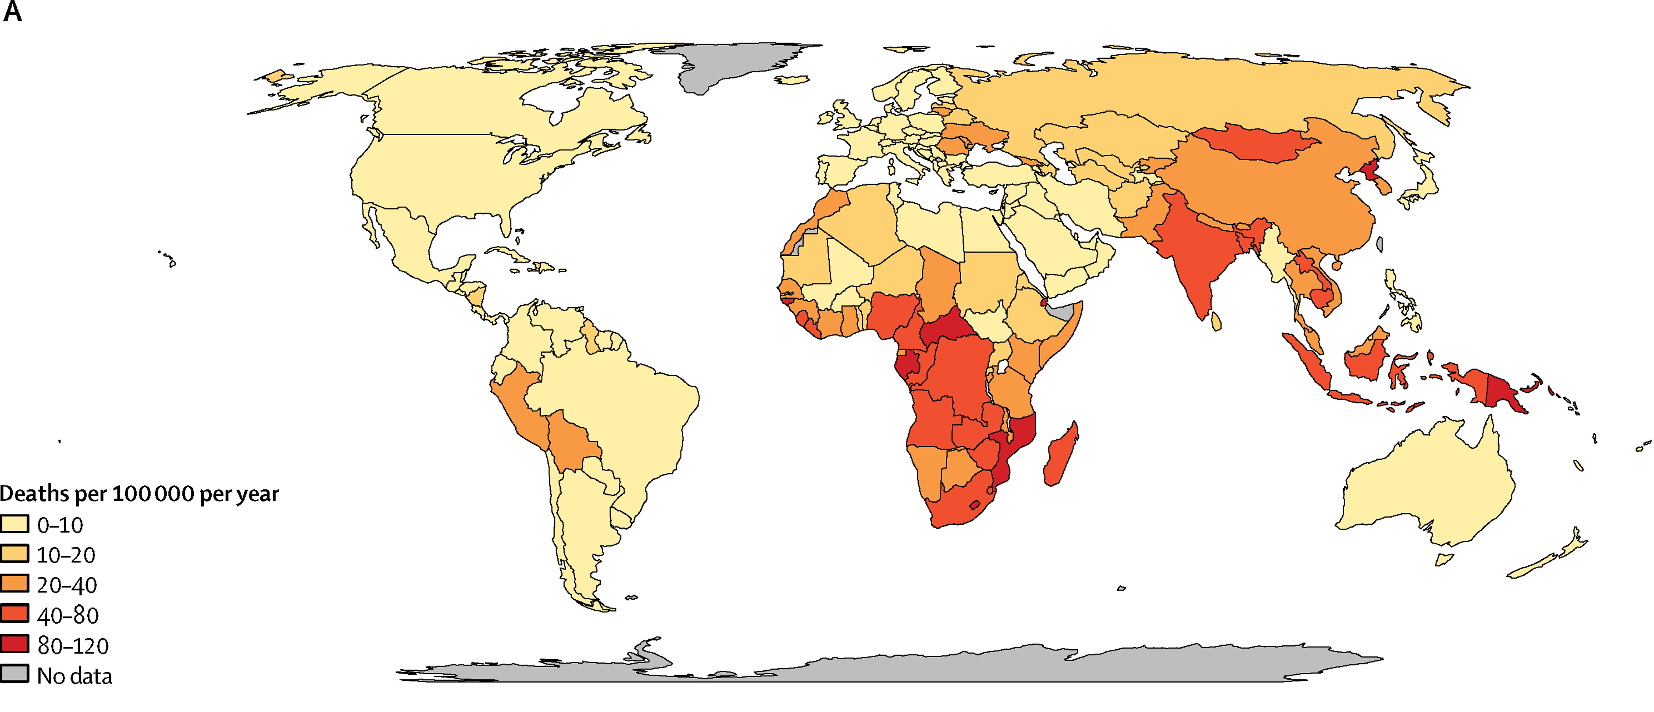
Mortality rate from tuberculosis for children aged under 5 years and 15 years in 2015
(Dodd P et al, 2017)

Slide 6
Objective
To estimate cost and cost effectiveness of household contact investigation for children under 5 and 15 years old across 12 high TB burden countries.
Notes:
Very few cost effectiveness studies compared to other risk groups (e.g. HIV); Not enough evidence how many additional resources to be required to cover target population and what are the optimal (cost effective) strategy of child TB prevention.

Slide 7
Methods
Health system perspective
Time horizon: 1 year of the intervention in 2018 in 12 high burden countries
Impact : # of deaths averted (with 3% annual discounting) between contact investigation vs status quo
Cost effectiveness : cost per death/DALY averted
Intervention group
+ Child contact investigation
+ Child contacts with Sx (37%)
+ TB test to child contacts with Sx
+ TB tx to test positive child contacts (90%)
+ 3HP to all child contacts (90%)
Status quo:
+ Child TB notification/treatment (0-14%)
+ IPT to child contacts (4-36%)
Notes:
9 months of Isoniazid Preventive Therapy (IPT)
3 months of isoniazid and rifapentine therapy
We considered three scenarios: (a) status quo based on the existing country- and age-specific TB case notification rates and isoniazid preventive therapy (IPT, 6 months) coverage, (b) contact investigation with TB treatment alone, and (c) contact investigation with active TB treatment and 3HP provision.

Slide 8
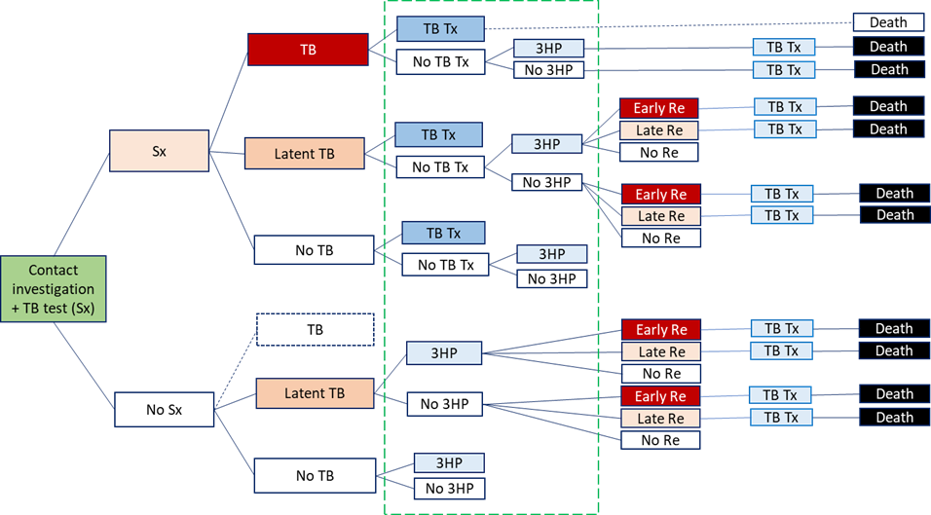
Decision Tree Model
Notes:
In this decision tree model, population characteristics
contact investigation,
36% symptom
10% TB prevalence
36% LTBI prevalence
Probabilities of TB treatment and 3HP provision by contact investigation are represented by the boxes within a green dashed line. We also incorporated existing TB treatment coverage (light blue boxes on the right side, named ‘TB Tx’) based on child TB case notification, reported by country. We assumed no mortality for child contacts with TB disease who received TB treatment as a result of household contact investigation, as TB diagnosis and treatment would generally be initiated early in the course of disease (denoted by the white box labeled “death”). We assumed that TB prevalence would be very low (about 1%) among asymptomatic children (presented as a dashed white box, named ‘TB’)

Slide 9
Target population
Annual child contacts aged <5 and <15 years needing evaluation point estimate (95%UI)
$$E=\frac{C}{H}×A$$
E = Estimated number of child contacts in a specific age group requiring evaluation in one year
C = the number of children in the age group
H = the number of households
A = the number of adult pulmonary TB cases reported in the previous year
Data sources :
Number of children and households from Demographic and Health Survey 2014
Child (<5 and 15 years) TB case notification from WHO 2018.
% of TB disease : 10% for <5 years and 8% for <15 years as pooled estimate in low/middle income countries (Fox G J et al, 2013)
% of LTBI: 36% for <5 years and 48% for <15 years as pooled estimate in low/middle income countries (Fox G J et al, 2013)
We used TB case fatality rate (mortality/incidence: 7-39%) for future TB cases across countries from WHO 2018.
We considered existing TB case detection rate (0-14%) and existing IPT coverage (4-36%) for the status quo from WHO 2018.

Slide 10
Annual number of children for contact investigation
 | # of children contacts |  | # of children with TB |  | # of children with LTBI
 | Age 0-4 | Age 0-14 | Age 0-4 | Age 0-14 | Age 0-4 | Age 0-14
Brazil | 24,000 | 81,000 | 2,000 | 7,000 | 8,500 | 39,000
Cambodia | 9,000 | 28,000 | 900 | 3,0000 | 3,300 | 13,000
Ethiopia | 50,000 | 151,000 | 5,000 | 13,000 | 40 | 54,000
Ghana | 6,000 | 19,000 | 60 | 2,000 | 2,300 | 9,000
India | 643,000 | 2,079,000 | 64,000 | 184,000 | 228,200 | 989,000
Indonesia | 108,000 | 332,000 | 11,000 | 29,000 | 38,300 | 157,000
Kenya | 44,000 | 124,000 | 4,000 | 11,000 | 15,500 | 58,000
Malawi | 8,000 | 23,000 | 830 | 2,000 | 2,900 | 11,000
Mozambique | 40,000 | 108,000 | 4,000 | 10,000 | 14,000 | 50,000
South Africa | 112,000 | 393,000 | 11,000 | 35,000 | 39,800 | 189,000
Tanzania | 36,000 | 99,000 | 4,000 | 9,000 | 12,700 | 46,000
Zimbabwe | 14,000 | 42,000 | 1,500 | 3,737 | 5,100 | 19,699
Total | 1,094,000 | 3,481,000 | 109,000 | 308,000 | 389,000 | 1,636,000
(Yuen C et al, 2016)

Slide 11
Epidemic and cost parameters
Epidemic parameters | Base case | Range
Drug efficacy & completion
Rifapentine plus isoniazid for 3 months (3HP) efficacy (0.9) x completion (0.9) | 81% | 67-97%
Isoniazid preventive therapy (IPT) efficacy (0.9) x completion (0.8) | 72% | 58-86%
TB treatment efficacy x completion | 90% | 80-95%
LTBI reactivation rate
Early reactivation rate (within 1 year) | 5% | 2-7%
Late reactivation rate (average year of late reactivation: 10 years) | 10% | 8-12%
Prevalence/Coverage/Efficacy
% of children with symptoms | 37% | 30-45%
Sensitivity of TB diagnosis (Contact investigation) | 65% | 30-80%
% of child contacts without TB who are inappropriately treated (Contact investigation) | 5% | 3-7%
% of child contacts receiving 3HP (Contact investigation) | 90% | 80-95%
% of child contacts without TB who are inappropriately treated (Status quo) | 19.4% | 15-23%
% of child contact experiencing TPT(3HP/IPT) induced hepatoxicity | 0.83% | 0.63-1%
% of child contact experiencing hospitalization due to toxicity | 0.015% | 0.012-0.018%
Cost parameters
3HP drug regimen (3 months) | $15 | $10-$19
IPT drug regimen (6 months) | $2.20 | $1.0-$6.08
Cost per household contact investigation screening | Country specific | Country specific
Cost per testing one child for TB
Cost per TB treatment
Cost per TPT (3HP/IPT) induced hepatoxicity treatment

Slide 12
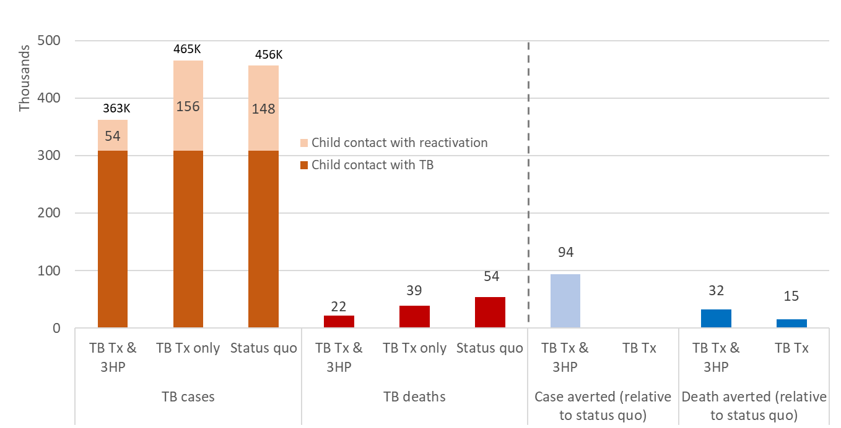
Results : Incremental TB cases and deaths averted

Slide 13
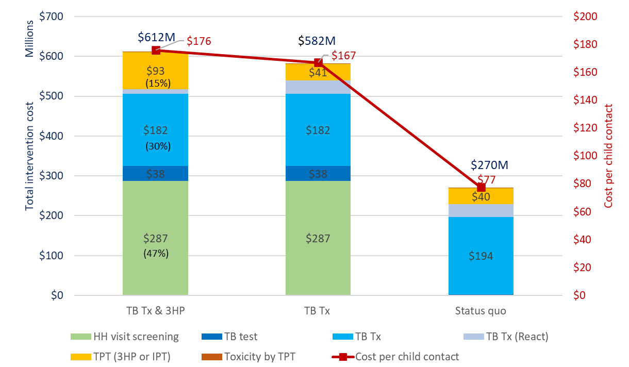
Results : Intervention costs by scenario
Notes:
We can make cost saving by reducing HH screening and TB Tx cost.

Slide 14
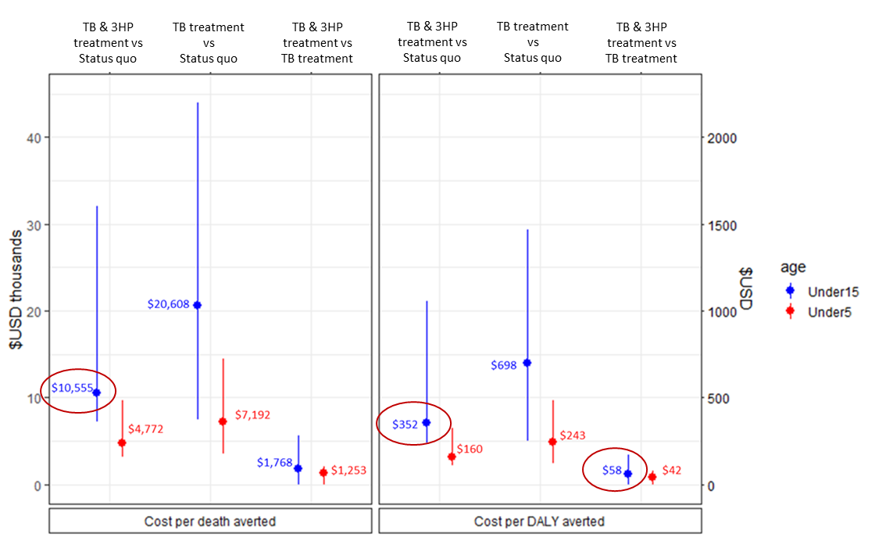
Results : Incremental Cost Effectiveness Ratios

Slide 15
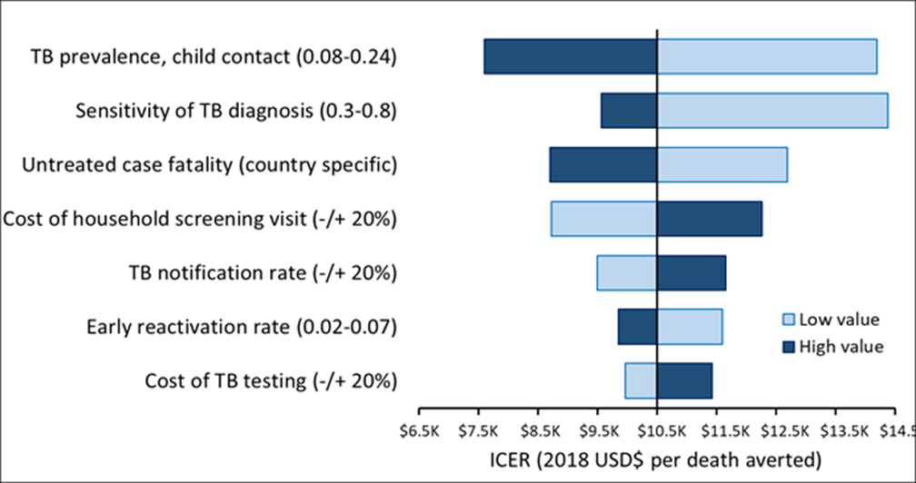
One way sensitivity analysis:
Children younger than 15 years old

Slide 16
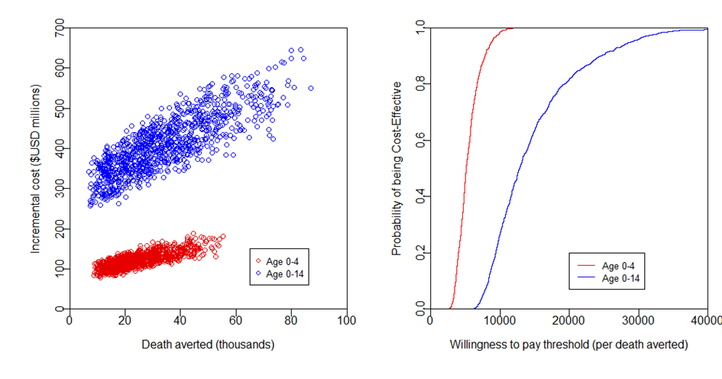
Cost Effectiveness Plane and
Cost Effectiveness Acceptability Curves
*
*

Slide 17
Results
Contact investigation with active TB treatment and 3HP is highly cost-effective compared to the status quo ($160 and $352 per DALY averted for children under 5 years and 15 years respectively)
Country specific cost-effectiveness would fall between $100 and $1600 per DALY averted (children under 15 years), with higher estimate in wealthier countries.
Key drivers of cost-effectiveness were TB prevalence, sensitivity of TB diagnosis, case fatality for untreated TB, and cost of household screening.
Notes:
Reduce early reactivation and case detection rates are the key drivers for cost per *case* averted → emphasizing the importance of 3HP provision and effective contact investigation for case detection
In fact, TB Tx vs Status quo is likely less cost effective ($10,000 per death averted) than (adult) active case findings ($2000-$4000 per deaths averted), but by adding 3HP Tx together, it can slightly improve cost effectiveness.
Recent estimates of low mortality rates in children on treatment (<1% mortality) imply that the number of pediatric tuberculosis deaths could be roughly halved if the “case-detection ratio” for children were improved from its current value of approximately one in three to the two in three currently achieved in adults, or reduced by more than ten times if all children with tuberculosis were given treatment. The large numbers predicted by the model also represent the present and accumulated result of a failure to identify and treat adults with tuberculosis effectively. (Dodd P et al)

Slide 18
Limitations
Lack of country-specific data:
Pediatric TB/LTBI prevalence
Natural history of pediatric TB and reactivation
Case-fatality ratio of untreated pediatric TB
Costs of performing household screening
Case notification among child contacts who subsequently develop TB
We did not include:
Costs of supplies needed to obtain sputum in children (e.g. gastric and nasopharyngeal aspirates)
HIV and antiretroviral therapy status
BCG vaccination status
Multidrug-resistant tuberculosis.
Notes:
Registered numbers of pediatric contacts eligible for TB preventive treatment were much lower than the estimated total numbers of child contacts with TB infection based on TB prevalence and demographic surveillance data. Accordingly, our estimates of cost-effectiveness are likely conservative.
Our estimate of this latter quantity (based on the estimated case notification ratio for all children with active TB¹⁴) may be overestimated for countries with poor existing implementation of household contact investigation implementation.

Slide 19
Conclusions
Household contact investigation for tuberculosis, with extensive provision of 3HP to children and adolescents, is likely to be cost-effective ($58 per DALY averted relative to TB treatment only and $383 per DALY averted relative to status quo).
Cost-effectiveness is optimized in regions with high TB prevalence, low TB case notification levels and low existing coverage of preventive therapy.
Future evaluations of implementation, including the collection of setting-specific data, will further inform decision-making.
Notes:
Reduce early reactivation and case detection rates are the key drivers for cost per *case* averted → emphasizing the importance of 3HP provision and effective contact investigation for case detection
In fact, TB Tx vs Status quo is likely less cost effective ($10,000 per death averted) than (adult) active case findings ($2000-$4000 per deaths averted), but by adding 3HP Tx together, it can slightly improve cost effectiveness.
Recent estimates of low mortality rates in children on treatment (<1% mortality) imply that the number of pediatric tuberculosis deaths could be roughly halved if the “case-detection ratio” for children were improved from its current value of approximately one in three to the two in three currently achieved in adults, or reduced by more than ten times if all children with tuberculosis were given treatment. The large numbers predicted by the model also represent the present and accumulated result of a failure to identify and treat adults with tuberculosis effectively. (Dodd P et al)

Slide 20
Acknowledgement
Johns Hopkins Bloomberg School of Public Health
Isabella Gomes
Joseph Flack
David W Dowdy
Center for Tuberculosis Research, Johns Hopkins University School of Medicine
Nicole Salazar-Austin
Richard E Chaisson
The Aurum Institute & University of Witwatersrand
Gavin Churchyard
We thank for the funding support from Unitaid (2017-20-IMPAACT4TB) for this study.
Thank you for listening!

