Slide 1
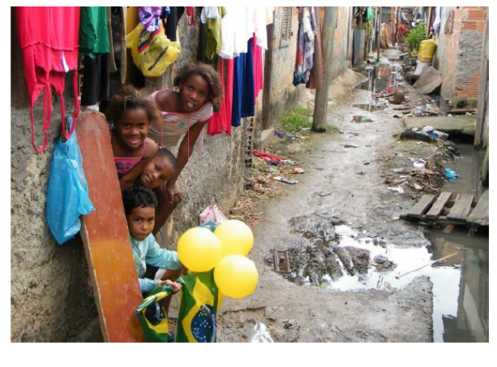
Understanding the contribution of social protection to accelerate TB elimination: the S-PROTECT Project
Delia Boccia on behalf of the S-PROTECT team
London School of Hygiene and Tropical Medicine
Notes:
Good afternoon, I will use these 10 min to introduce you to the SP project, sprotect stands, it was funded by the Gates Foudatio through TB MAC on January 2016. for and in this ppt I will describe the research approach we took in these past year, and some vry preliminary findings that are meant to be used as an illustrative example of what we did and how we did it and the challenges we met.

Slide 2
TB and social protection
Social protection is a wide range of poverty reduction strategies largely and successfully implemented in development
Conditional cash transfers (CCTs) are the most popular form of social protection
Increasing evidence of the public health impact of CCTs
Social protection, including CCTs, is now considered a key element of the post-2015 end TB strategies
Impact evidence on the impact of CCTs on TB are accumulating, but they remain fragmented and inconclusive
Mathematical modelling can be useful to fill these knowledge gaps

Slide 3
Existing barriers
Mathematical models in TB mainly used to evaluate biomedical interventions
Classical compartmental models cannot easily adapt to the complexity of socioeconomic phenomena or policies
Insufficient understanding of mechanism through which CCTs may act on TB epidemiology and control
Lack of good quality epidemiological and development data to populate these pathways
No multidisciplinary effort to strengthen knowledge across disciplines
Notes:
Mathematical modelling has been extensively used to enhance our understanding of TB biology and transmission;{Dowdy, 2013 #1942} however, its use has been mainly focussed on biomedical interventions.{Childs, 2015 #1943} Few modelling exercises have explored the degree to which socioeconomic factors increase TB risks, and to which CCT interventions can reduce TB burden by improving these determinants.
This is also partially because there is no consensus yet on the mechanisms

Slide 4
S-PROTECT aim and objectives
To leverage an interdisciplinary consortium to strengthen our understanding of how social protection can enhance the end of TB
To develop a conceptual framework suitable for mathematical modelling purposes
To create a publicly available data portal
To develop an innovative mathematical modelling approach
Notes:
This project aims to address the above challenges by leveraging an interdisciplinary consortium to develop a framework for modelling of social protection interventions to enhance TB control. The S-PROTECT Modelling Consortium, made of social epidemiologists, modellers, and thought leaders, will:
Develop a conceptual framework, that is a qualitative map¹⁵ or flowchart reflecting the pathway between social determinants, TB risk factors and TB outcomes (i.e. TB incidence and mortality) and where and how social protection interventions are expected to act in this complex web of interrelations, and link this explicitly to a mathematical model of TB control;
Create a publicly available data portal for the collection and collation of standardized data to inform mathematical models aiming to assess the impact of social protection on TB; and
Construct an innovative mathematical model able to capture the complex social protection processes that may influence TB epidemiology and control, using as a test case Bolsa Familia, the Brazilian national conditional cash transfer programme.

Slide 5
S-PROTECT research framework
Bolsa Familia Programme in Brazil
Target poor households earning US$35-70 per month
Nearly 50 million people
Cash benefit: US$18 – US$175
Three conditions:
antenatal-postnatal care
Nutrition and vaccination check ups
School attendance
Conceptual framework development and translation
Pathways prioritisation
Model development and testing

Slide 6
Social protection strategies as Bolsa Familia
Indirect effect
Direct effect
Level 1: Impact of Bolsa Familia on distal determinants of TB
Better education
Better access to social/health services
Better Food security / food consumption
Higher household / individual
socioeconomic position
Better access to TB care
resulting from conditionalities
specific for TB care
Level 2: Impact of distal factors on more proximal determinants of TB
Crowding
Housing quality
Poor ventilation
Biological risk
factors*
Individual / household food security/
food consumption patterns
Health seeking
behaviors
Level 3: Impact of proximal factors on TB outcomes
Exposure risk
Infection risk
Disease
Progression risk
Time and quality of diagnosis
Treatment
outcome
TB – associated
costs
Prevention
Treatment
Support
TB prevalence in
the community
MDR-TB prevalence
in the community
Community economic growth
Social cohesion
Country security
Notes:
The framework assumes that cash transfers can act on TB prevention, care and support either indirectly by influencing the social determinants of the epidemic (such as household / individual living conditions or food security), or directly if conditioned on health-seeking behaviours relevant for TB (i.e. TB testing and preventive therapy among household TB contact, TB treatment completion, BCG vaccination in children). These distal social determinants can act on a number of proximal mediators (here identified as HIV, smoking, alcohol consumption/drug abuse, malnutrition, etc) which ultimately will result in the impact on TB prevention, TB treatment or TB costs mitigation depending on which specific stage of the disease or population is targeted by the intervention.

Slide 7
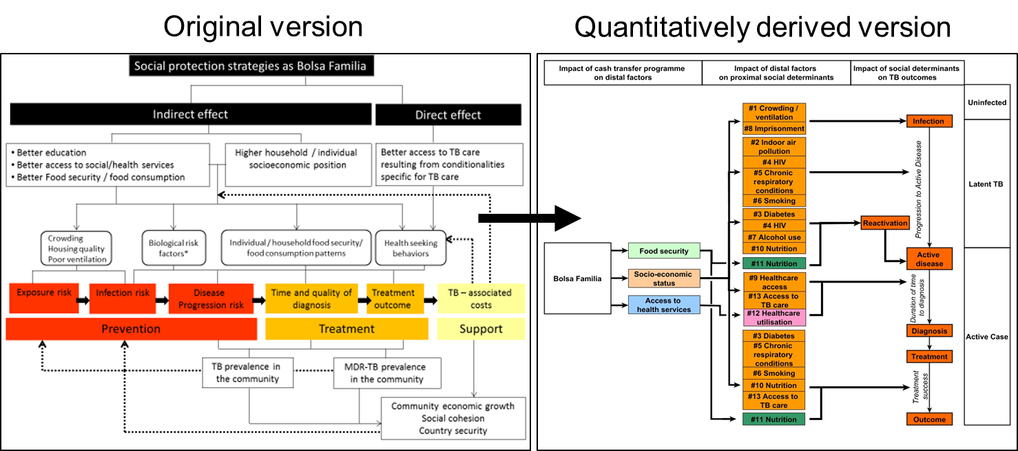
Conceptual framework development and translation

Slide 8
High priority pathways: pathway #10
Intervention |  |  |  | CCT like Bolsa Familia Programme
Level 1 |  | Distal social determinant of TB |  | Higher Household socioeconomic position
Level 2 |  | Proximal social determinant of TB |  | Malnutrition reduction
Level 3 |  | TB outcome |  | Reduced risk of TB reactivation
 |  |  |  | Higher chances of treatment success
Level 1

Slide 9
Model development and testing
I. Effect of BFP on each level of impact (Level 1, 2, 3)
Level 1 = BFP → Household SES (income)
Level 2 = Houseshold SES (income) → nutrition (BMI)
Level 3 = Nutrition (BM) → TB treatment
TB diagnosis
TB transmission
II. Estimate of combined effect across these three levels on 3 TB outcomes
III. Inclusion of these estimate into the TB transmission model
Notes:
We conceptualized our modelling approach to capture the impact of CCTs – and BFP in particular - on TB in two parts. I
Simple TB transmission model incorporating proximal social determinants of TB as estimated from the review of the literature.
This was achieved by:
We first estimated the impact of BFP on Level 1, 2 and 3 of each pathway: we gathred data from both development and epidemiological literature to populate each step along the pathways. And for each of them we tried to come up with a point estimate (baseline) and a range (low and high estimate).
We combined this effect across levels to estimate the impact on three TB outcomes
By incorporating the level 3 estimates into the TB transmission model, we estimated the impact of BFP on long term prevalence
n the first part, we aimed to estimate the impact of CCTs like BFP on each of the proximal mediators of TB outcomes. This was achieved by estimating the effects at each of the three levels of a given pathway separately based on the literature review, and then combining them together. In the second part, we aimed to estimate the impact of change in any of the proximal mediators of TB outcomes on the overall TB prevalence.
Simple TB transmission model incorporating proximal social determinants of TB as estimated from the review of the literature.
This was achieved by:
We first estimated the impact of BFP on Level 1, 2 and 3 of each pathway: we gathred data from both development and epidemiological literature to populate each step along the pathways. And for each of them we tried to come up with a point estimate (baseline) and a range (low and high estimate).
We combined this effect across levels to estimate the impact on three TB outcomes
By incorporating the level 3 estimates into the TB transmission model, we estimated the impact of BFP on long term prevalence

Slide 10
Preliminary findings from pathway #10: Part I
 | Levels of impact | Baseline |  | Low Estimate |  | High Estimate
Level 1 | The impact of CCT like Bolsa Familia on household socioeconomic position (i.e. income) | +15% |  | +10% |  | +20%
Level 2 | The impact of household socioeconomic position (i.e. income) on nutrition (i.e. BMI) | 0.129 |  | 0.115 |  | 0.143
Level 3 | The impact of nutrition (i.e. BMI) on TB outcomes
 | TB treatment | 15.63 |  | 7.81 |  | 23.44
 | TB diagnosis | 1.26 |  | 1.23 |  | 2.9
 | TB transmission | 13.8 |  | 13.4 |  | 14.2

Slide 11
Preliminary findings from pathway #10: Part II
Combined effect of CCT like Bolsa Familia on TB outcomes | Baseline |  | Low Estimate |  | High Estimate
% Decrease in treatment failure | 1.5 |  | 0.28 |  | 4.77
% Decrease time to diagnosis | 0.12 |  | 0.04 |  | 0.59
% Decrease in TB incidence per unit of increase of BMI | 1.33 |  | 0.48 |  | 2.89
% reduction in long term TB prevalence | 3.89 |  | 0.74 |  | 23.47
Notes:
The key finding was that the projected long term impact of Bolsa Familia-like S-PROTECT was a very modest reduction of TB prevalence of about 4%. The modest estimate was driven partially by very low estimate of the impact of S-PROTECT on HH income, which we estimated to be 15%, and generally low impact of HH income on nutrition, which we estimated of about 0.129 increase in BMI per US$1000 increase in HH income. We also found the range of uncertainty in the impact to be wide, between 0.74% to 23.47% reduction in long-term TB prevalence, reflecting the uncertainty around the estimates.
We also sought to estimate the impact of BFP-like protection program without restricting the impact to be mediated via effect on income. Using an estimated impact of BFP-like in Mexico on nutrition (which estimated a 0.83 units increase in BMI [REF]), we then proceeded to estimate the impact on each of the proximal mediators of TB outcomes, and used the same model to estimate the impact on TB prevalence. As presented in Box 2 as a direct impact, we estimated an impact of 32.06% reduction in TB prevalence, almost 10 times larger than our estimates from pathways including income. Hence, there is potential to underestimate the impact, if we restrict ourselves to estimating the impact via narrowly defined pathways.

Slide 12
Identified challenges and way forward
Challenge |  | S-PROTECT advance |  | Way forward
Study population |  | CCT target population and assumed no mixing |  | More epidemiological studies to understand extent of overlap between TB patients and CCT recipients
Pathways understanding |  | 13 pathways |  | Go beyond material models of aetiology for TB inequalities
 |  |  |  | Gather better data and/or understand whether different modelling approaches are needed
Data availability |  | Creation of a simple data repository |  | Creation of a proper data portal
Data harmonisation and assumptions |  | First set of rules for data ‘conversion’ |  | Reach consensus with TB and development experts.
Notes:
It is critical to specify the population under study.
It is impossible to model the impact of social protection on TB in the general population, without knowing the relative size of population receiving CCT, the prevalence of TB in this group vs the general population, and the extent of mixing of the general population with the population receiving CCT. In S-PROTECT we focussed on the population targeted by CCT which is usually people living below the poverty line. We assumed that this was a plausible option because it can be assumed that this population is also the one that most contribute to the burden of TB in a given country and therefore by controlling TB on them we can alt TB also in the general population. Having said that more epidemiological studies are needed to understand the extent of overlap between TB and CCT recipients and to profile them better so to see in which way the impact observed can be assumed to happen also on TB patients.
S-PROTECT tried to unpack the complexiy of the effect of social protection into a number of shorter pathway. However unlike they can capture the whole effect, also lilekuy to be setting specific. Go beyond also the material….
More importantly we have seen that even if we try to simplify it could be that the effect of the intervention is very pretty much diluted if you take into account all the levels, and also if most of the effect happens at the bottom of the tail. It could be that the situation could improve if we gather better data: we know in fact that not only very limited data on income, but also limited reliability of this measure. It could be also that we need to use different modellinh approaches.
Difficult harmonisation across levels in terms of unit of measurements used. This was partially due to the fact that we aimed to link data extrapolated from different types of sources and also different levels of analysis and partially because there is currently no consensus regarding how to convert outcomes and units of measure even when they are available.
However, it will be key to identify appropriate ways to standardize the outcomes and units of measure used across impact evaluation and epidemiological studies, so that they can be appropriately utilised in any future research work on the relationship between development and TB

Slide 13
Conclusions
Modelling the impact of social protection on TB was a complex, but not impossible task
Impact findings only illustrative of the process and challenges met
Significant progress made our quantitative understanding of the impact of social protection on TB epidemiology and control
The way forward is to consolidate the work done this year, to address the challenges met and come up with even a more ambitious plan for S-PROTECT Phase II
Notes:
Task that was only possible thanks to the broad range of expertise that were colled to work together, which I believe to be the real strength of S-PROTECT
The approach we have adopted can be utilized to improve our quantitative understanding of the linkages between social protection and TB burden, highlight key gaps in both data and conceptual thinking, prioritize efforts to collect data, refine more complex or setting-specific models or even suggest the adoption of alternative approaches derived by other disciplines (including sociology, ecology, economy) more accustomed to complex phenomena.{Galea, 2009 #1145;Speybroeck, 2013 #1947;Mahamoud, 2013 #1948}.

Slide 14
The S-PROTECT team: thank you
David Dowdy (JHU)
Philip Eckhoff (IDM)
Sourya Shrestha (JHU)
William Rudgard (LSHTM)
Debora Pedrazzoli (LSHTM)
Rein Houben (LSHTM)
Jonathan Golub (JHU)
Knut Lonnroth (WHO)
Priya Shete (WHO)
Stuart Chan (ISM)
Davide Rasella (Fiocruz)
Brazilian partners:
Mauro Sanchez (Federal University of Brasilia, Brazil)
Ethel Maciel (University of Espirito Santo, Brazil)
Denise Araki (Head of Brazil NTP)

