Slide 1
TB situation in South and North Korea
Young Ae Kang
Yonsei University College of Medicine

Slide 2
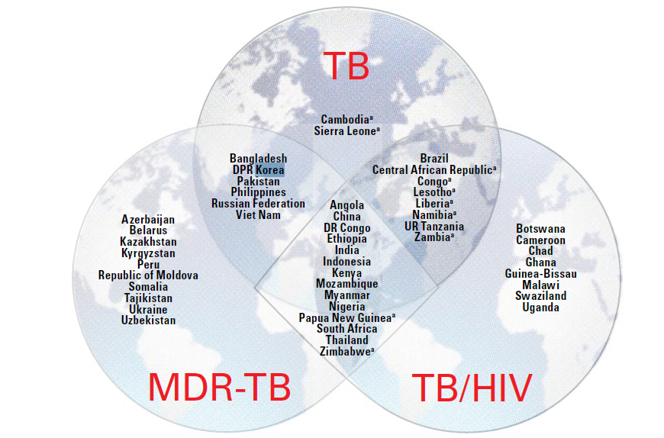
High TB burden in North Korea
WHO TB report 2020
Notes:
,

Slide 3
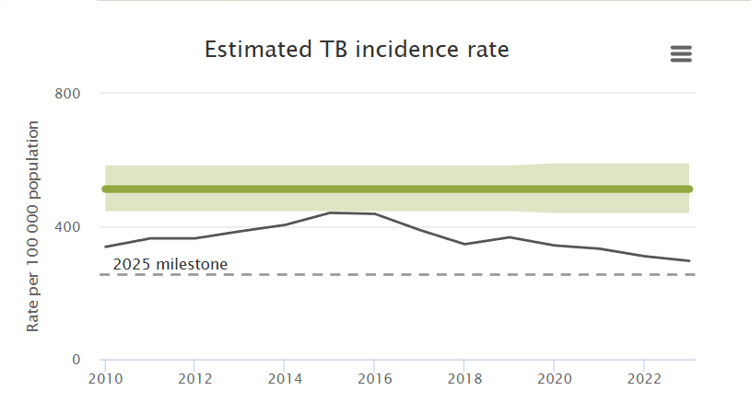
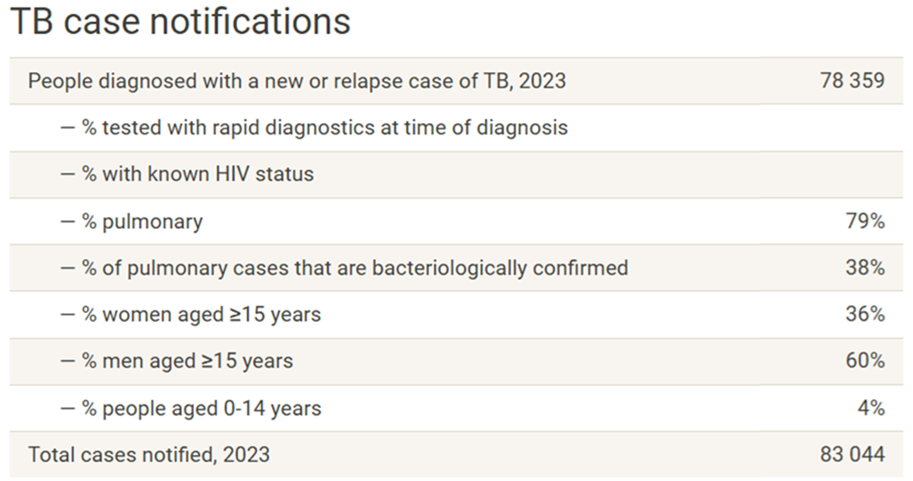
TB in North Korea in 2023

Slide 4
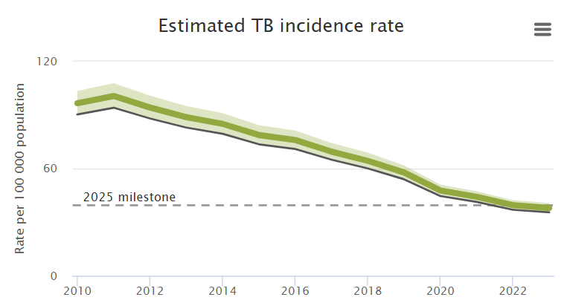
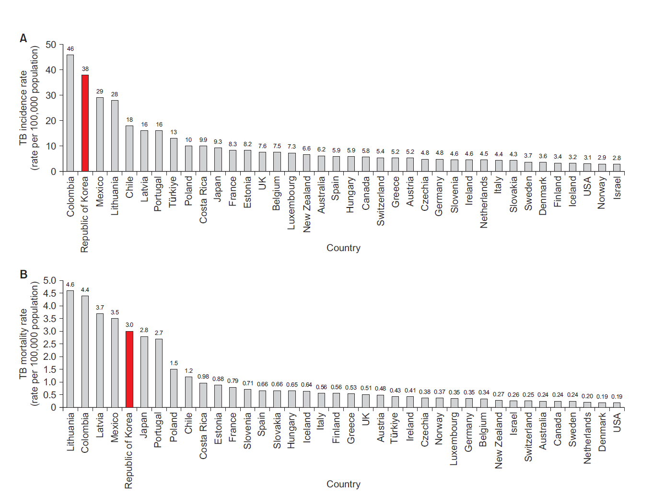
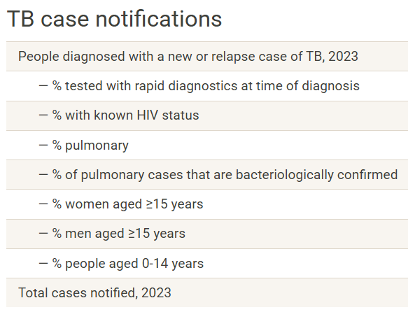
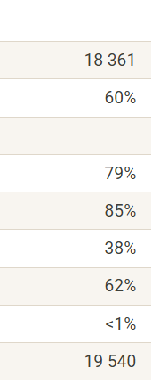
High TB burden in South Korea
Ranking of TB incidence among OECD
38
Ranking of TB mortality among OECD

Slide 5
Key TB indicators in South and North Korea
TB burden
Estimated number, notification number, number of RR/MDR-TB, TB in age group
Diagnosis
% lab-confirmed pulmonary TB, % RIF-tested
Treatment
Treatment success rate in new, treatment success rate for RR/MDR-TB

Slide 6
Number of TB notification, new and relapse

Slide 7
Number of RR/MDR-TB notification

Slide 8
% of lab confirmed TB among pulmonary TB

Slide 9
% RIF resistance testing among previously treated TB

Slide 10
% RIF tested and notified number of RR/MDR TB

Slide 11
Treatment success rate, new and relapse

Slide 12
Treatment success rate, RR/MDR TB

Slide 13
Objective
The purpose of this work was to develop a mathematical model that accounts for recent trends in DS-TB and RR/MDR-TB incidence and to predict TB burden based on the proposed optimal TB control intervention strategy in (South and) North Korea

Slide 14
TB Model
Deterministic Compartment model
Susceptible
Pre-infectious
Infectious
Recovered/
immune
$${rη}_{MDR}q_{DS}(1−m)$$
$${rη}_{DS}q_{DS}(1−m)$$
$${ R}_{DS}$$
$$η_{MDR}(1−q_{DS})(1−φ)$$
$$T_{MDR}$$
$$δ_{TB}$$
$$ν$$
$$a_{1}$$
$$β{(I}_{DS}+UT_{DS})$$
$$δ_{TB}$$
$$η_{DS}(1−q_{DS})(1−φ)$$
$$\frac{αε}{α+ε}d$$
$$μ$$
$$S$$
$${ E}_{DS}$$
$$gν$$
$$I_{DS}$$
$$a_{2}$$
$$T_{DS}$$
$$δ_{TB}$$
$$(1−g)ν$$
$$βh{(I}_{DS}+UT_{DS})$$
$$τ$$
$$a_{3}$$
$$γ$$
$${(1−r)η}_{MDR}q_{DS}$$
$${ L}_{DS}$$
$${(1−r)η}_{DS}q_{DS}$$
$${UT}_{DS}$$
S : Susceptible
E : faster progressor (latent infection, approximately 5% after recent infection )
L : slow progressor (latent infection)
I : infectious active TB
T : treated, UT : untreated , R : relapsed

Slide 15
Intervention and prediction scenario
Intervention
Scenario 1—Preventive treatment enhancement
Scenario 2—Diagnostic capacity improvement
Scenario 3—Active case-finding enhancement
Scenario 4—Scaling up the treatment success rate for active TB
Intervention period : 2020-2025
Prediction :
The future incidence of TB and the number of TB deaths by 2040

Slide 16
Data sources
South Korea
TB notification report since 2001
Public-Private Mix project monitoring indicators
Published articles
Local TB epidemiologists
North Korea
WHO TB data
~ 2018/2019 data

Slide 17
Summary
Using the mathematical model, various TB control intervention (in diagnosis and treatment) can be applied to predict the TB situation in North Korea.
Based on data from 2012-2019 and the local situation, it was estimated that TB in North Korea will decrease, but at a very slow rate, and MDR-TB will continue to increase in the future.
The importance of basic TB management policies such as active case finding, preventive treatment, effective treatment coverage was confirmed.

Slide 18
Limitation
There was substantial range of uncertainty because of lack of actual data and parameters for North Korea in TB model calibration.
Parameters in South Korea and other high burden countries were applied in some part.
We didn’t consider the age structured model.
All data and assumed parameters were from pre-Covid era.
Need more understanding in local TB epidemiology and TB modeling.
Need more experience in TB modeling which can be incorporated in TB program.

Slide 19
Thank you for your attention!

