Slide 2
CONFLICT OF INTEREST DISCLOSURE
☐ I have no Conflict of Interest to report.
☐ I have the following Conflict of Interest(s) to report:
Please tick the type of affiliation / financial interest and specify the name of the organisation:
☐ Receipt of grants/research supports: UK Medical Research Council MR/N013638/1
☐ Receipt of honoraria or consultation fees: ___________________________
☐ Participation in a company sponsored speaker’s bureau: _______________
☐ Tobacco-industry and tobacco corporate affiliate: _____________________
☐ Stock shareholder: _____________________________________________
☐ Spouse/partner: _______________________________________________
☐ Other: ______________________________________________________

Slide 3
The epidemiologic impact and cost-effectiveness of new tuberculosis vaccines on multi-drug resistant tuberculosis in China and India
51st Union Conference
Virtual Event, 20-24 October 2020
Chathika Weerasuriya¹, Rebecca Harris, Gabriela Gomez, Richard White ¹c.weerasuriya@lshtm.ac.uk
‹#›
Notes:
Work funded by grant from Aeras (now IAVI)

Slide 4
Background and Aims
Multidrug Resistant Tuberculosis (MDR-TB) is an emergent global threat.
Several new or repurposed vaccines for tuberculosis are in the late stages of the development pipeline.
The potential impact of these vaccines on MDR-TB is unknown.
This study aims to assess the epidemiologic and health economic impact of potential novel TB vaccines on the RR/MDR-TB epidemic in China and India by WHO target year 2050.
‹#›

Slide 5
Methods I: Model and Vaccine
Construct model
Deterministic, compartmental, age-, drug resistance- and treatment history-stratified dynamic transmission model calibrated to past and current (2000-2018) epidemiologic data in China and India.
Calibration: ABC-RS/ABC-MCMC to WHO/published/national data
Predict future baseline scenarios without vaccine.
Implement vaccine in 2027 and compare against baseline scenarios
Prophylactic, prevention of disease
5-year, 10-year
30%, 50%, 70%, 90% efficacy “leaky” vaccine
Effective against post-infection (PSI) or both pre- and post-infection (PR&PSI)
Routine annual (9yo; 80% covg) and periodic mass campaign (10+; 70% covg) at 10 year intervals.
Comparison:
Epidemiology – change in RR/MDR-TB incidence rate/DALYs averted
Cost-effectiveness analysis – incremental cost/DALY averted.
‹#›

Slide 6
Methods II: Baseline Uncertainty Analysis
Future scenarios: represent a spectrum of possible scale up in programmatic management of (MDR-)TB.
“Status Quo” scenario (both countries)
No change in MDR-TB treatment length after 2018.
No change in case detection or DST coverage after 2018.
China: “Policy” scenario
Progressive increase in DST coverage to 90% by 2050.
Change to mixed 9-month and 24-month MDR-TB regimen by 2035.
India: “Policy” scenario
By 2025:
Overall case detection rate increases to 85% by 2025.
100% public sector notifications receive DST.
35% of all notifications arise from the private sector.
‹#›

Slide 7
Methods III: Summary
Model | Vaccines | Endpoints
Dynamic transmission model with drug resistance and treatment history strata. Setting: China and India Time Horizon: 2050 Baseline scenarios: SQ - No change post 2018. Policy - scaled up programmatic MDR-TB management. | Prevention of Disease vaccines Vaccine Efficacy: 30-90% Duration of Protection: 5y, 10y Host status for efficacy: Pre-, Post-, Pre- and Post- Price: $10, $30 Routine 9yo (80% cov), 10yearly mass 10+ yo (70% cov) Introduced: 2027 | Endpoints at 2035, 2050 Epidemiologic: % Reduction Incidence/Mortality Rate MDR-TB Cases/Deaths averted MDR-TB Health Economic $/DALY averted Annual budget impact Health System Averted treatment regimens

Slide 8
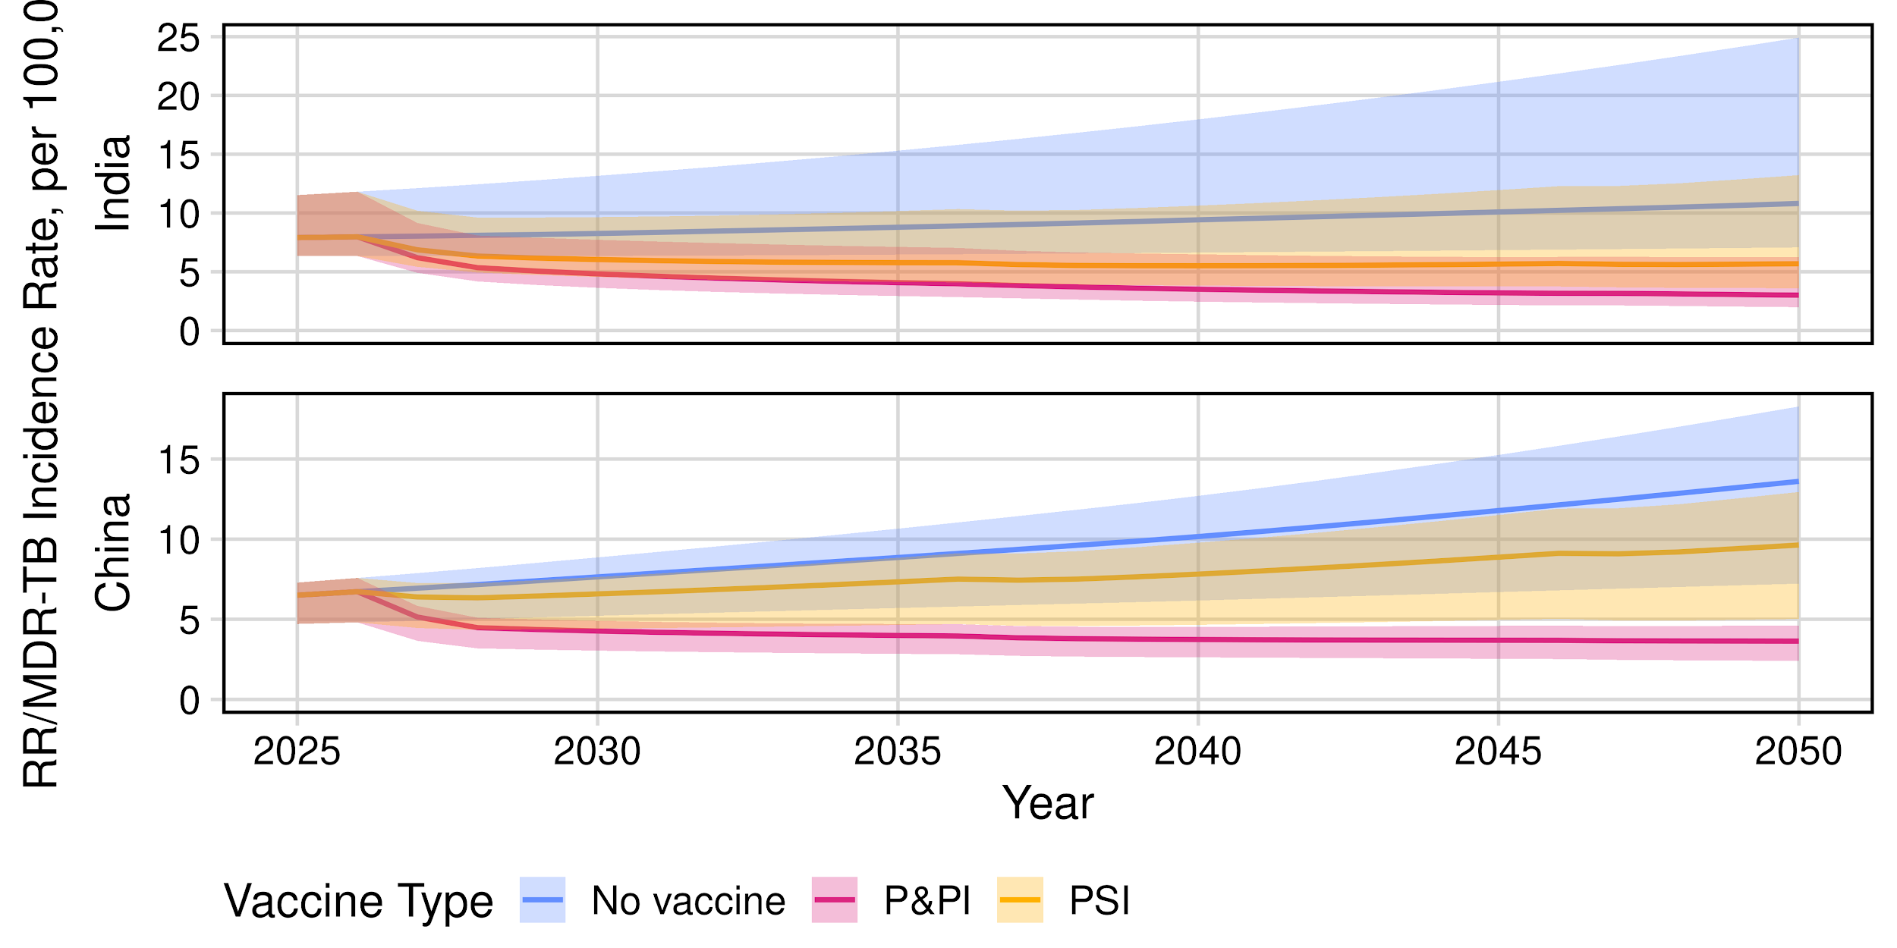
Results Ia - MDR-TB Incidence Rate Reduction
PRELIMINARY RESULTS DO NOT CITE
10 year; 50% efficacy vaccine
By 2050, P&PI vaccine reduced RR/MDR-TB incidence rate by 72% (uncertainty interval: 65–77) and 73% (UI: 66–76), and PSI vaccine by 47% (UI: 37–58) and 29% (UI: 27–31) in India and China, respectively
‹#›

Slide 9
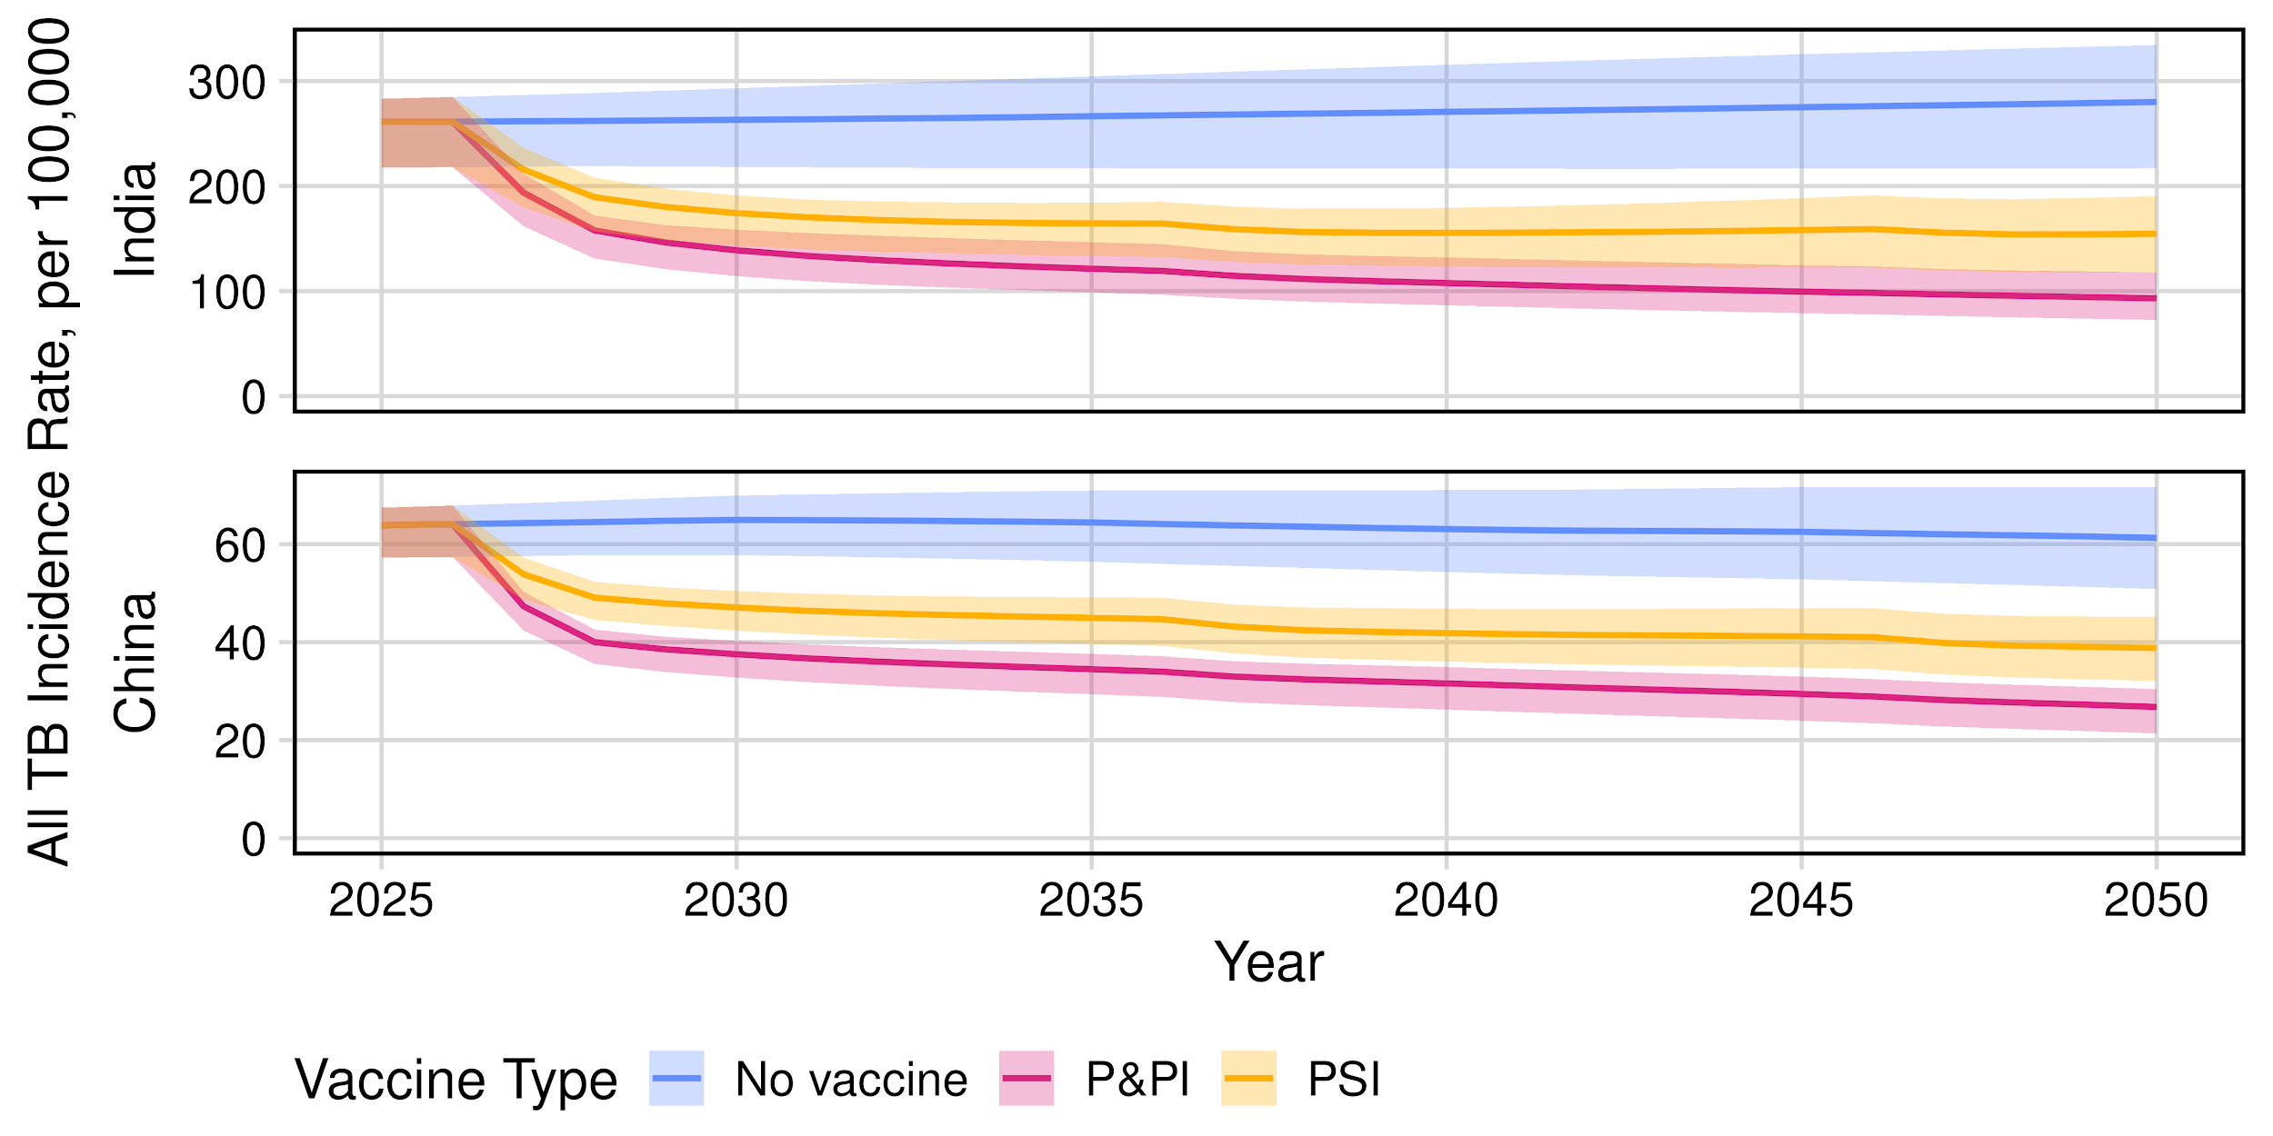
Results Ib - All TB Incidence Rate Reduction
PRELIMINARY RESULTS DO NOT CITE
10 year; 50% efficacy vaccine
P&PI and PSI vaccines reduced all TB incidence rate in 2050 in India by 67% (UI: 59–71) and 44% (UI: 39–49) respectively and in China by 56% (UI: 53–59) and 37% (UI: 35–38) respectively
‹#›

Slide 10
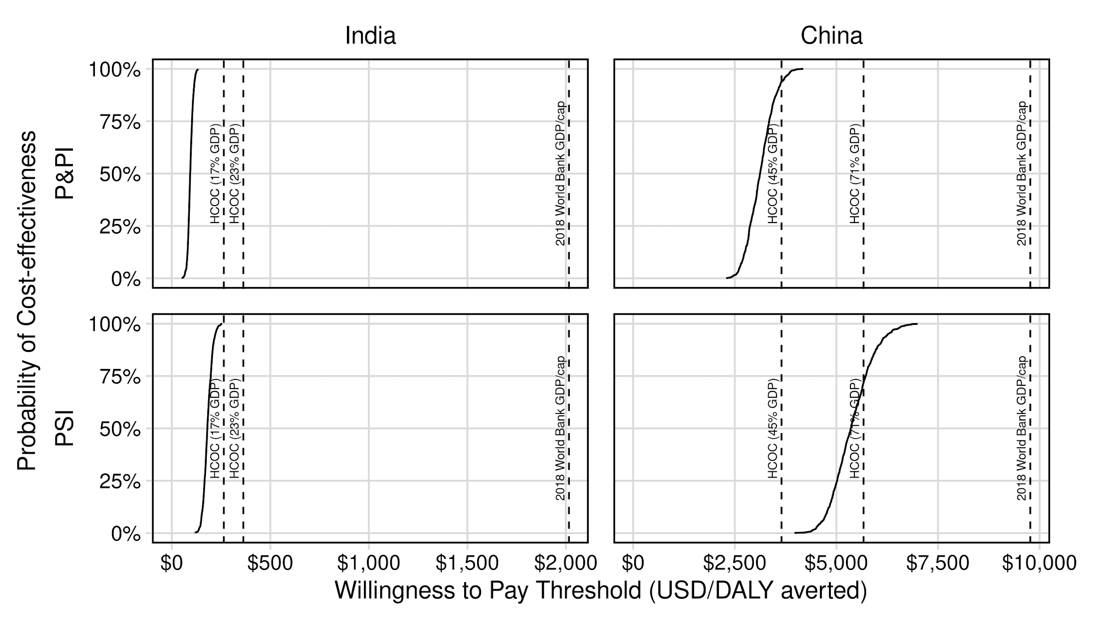
Results II – Cost-Effectiveness Analysis
PRELIMINARY RESULTS DO NOT CITE
10 year; 50% efficacy vaccine
India: probability of cost-effectiveness > 100% for all WTP thresholds for both P&PI and PSI.
China: probability of cost-effectiveness > 94% lower HCOC WTP threshold for P&PI vaccine, >72% cost effective at upper HCOC threshold.
‹#›

Slide 11
Results III – Treatment Averted
 | Averted Treatment Regimens (millions) 2027-2050, cumulative Median (uncertainty range)
 | P&PI | PSI
China | 1.0 (0.6–1.3) | 0.3 (0.2–0.4)
India | 0.8 (0.5–1.4) | 0.5 (0.3–1.1)
PRELIMINARY RESULTS DO NOT CITE
10 year; 50% efficacy vaccine
‹#›

Slide 12
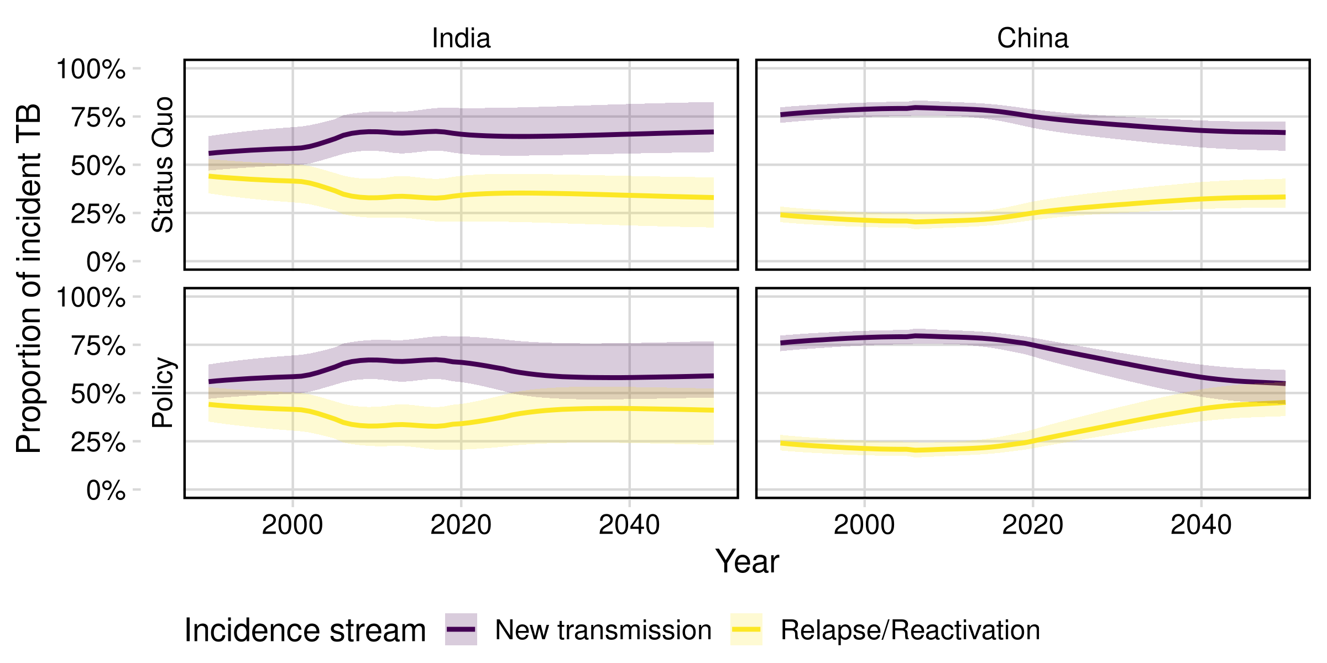
Results IVa - Baseline Uncertainty Analysis
PRELIMINARY RESULTS DO NOT CITE
MDR-TB epidemic transitions from a new-transmission driven towards a mixed new-relapse driven epidemic
‹#›

Slide 13
Results IVb - Baseline Uncertainty Analysis
Compared to the “Status Quo” scenario, in the “Policy”I (scale up) scenario:
Vaccines effect a similar relative change: similar percent reductions in incidence rate and mortality rate in India and China.
Vaccines have a lower absolute impact of vaccination, reflecting a lower burden of disease in both India and China.
Lead to an increased ICER.
PRELIMINARY RESULTS DO NOT CITE
‹#›

Slide 14
Limitations
Data
Limited calibration data, particularly MDR-TB epidemiology and treatment.
Interventions
Limited range of interventions: invariant MDR-TB regimen efficacy, no new drugs, no new diagnostic modes.
Fixed future unit costs and programmatic costs.
‹#›

Slide 15
Conclusions and Key Messages
Vaccination is predicted to substantially reduce MDR-TB burden in both India and China.
The epidemiologic impact of vaccine was maintained across a range of scale-up of programmatic management of (MDR-)TB.
Vaccination may avert a substantial volume of MDR-TB treatment.
Vaccination has a high probability of cost-effectiveness at country-specific willingness to pay thresholds.
PRELIMINARY RESULTS DO NOT CITE
‹#›

Slide 16
Acknowledgements
‹#›

Slide 17
‹#›

