Slide 1




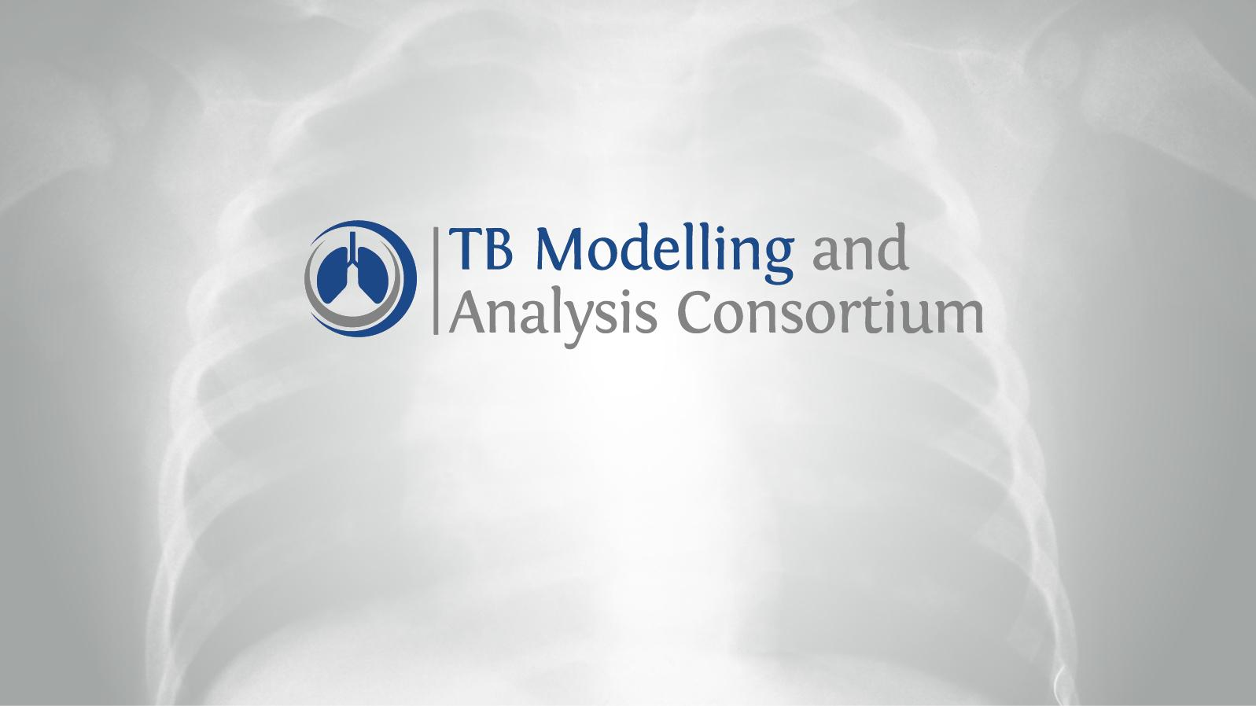













Slide 2






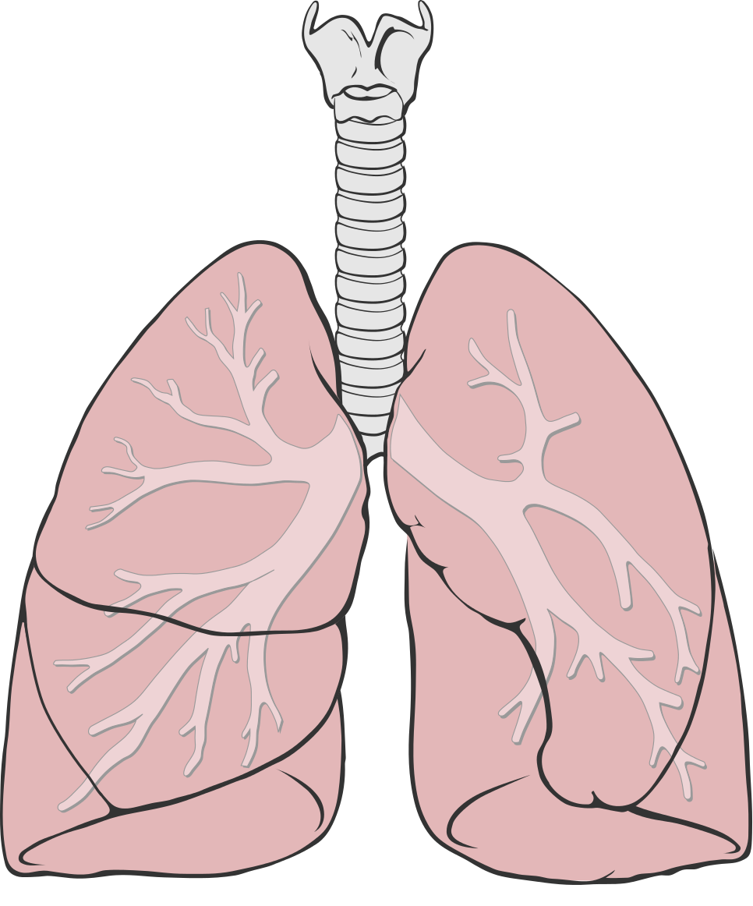








Why does TB MAC exist?
Complex Natural History
Range of settings
Compare strategies, quantify uncertainty
Range of interventions
Notes:
So why does TB MAC exist? Well,
[click] TB has a complex natural history
[click] There are a range of interventions
[click] and settings
[click] and global and country decision makers face great uncertainty
Modelling can be used to compare strategies and quantify this uncertainty

Slide 3




Why does TB MAC exist?
Modelers & economists
Decision makers
Limited data, models and modellers
Data & Country Stakeholders
Lack of co-ordination
Decision-makers & modellers need data-informed guidance
Notes:
But historically there has been a
Lack of co-ordination
Limited data, models and modellers
And decision makers & modellers have often lacked data-informed guidance regarding modelling
TB MAC aims to
[click] Improve co-ordination, knowledge sharing & management
Produce new materials & resources
Inform technical assistance, decision-making & modelling communities

Slide 4

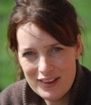
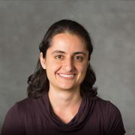
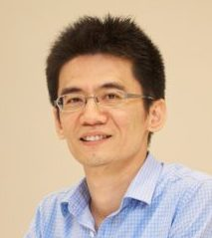
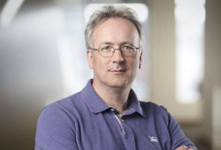
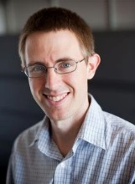
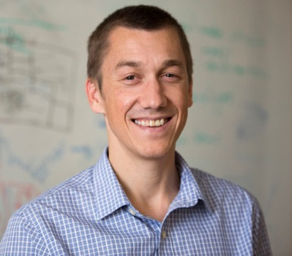
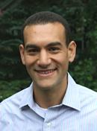
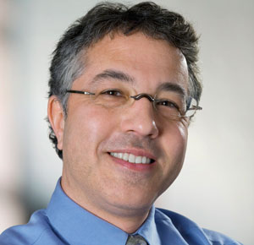
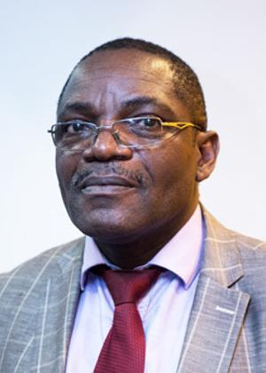
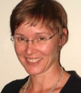

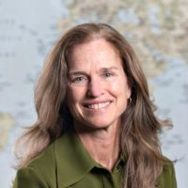
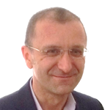
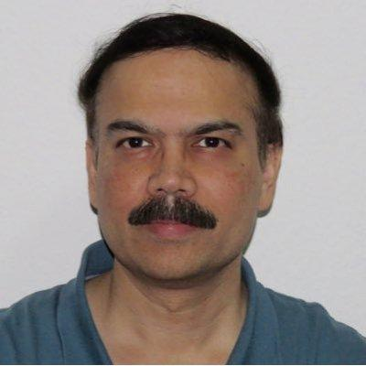
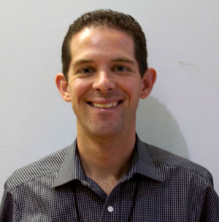
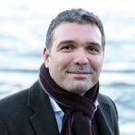
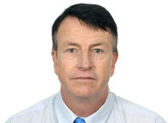
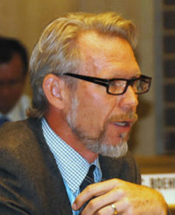
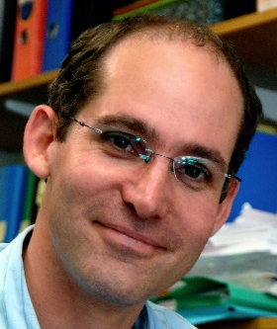
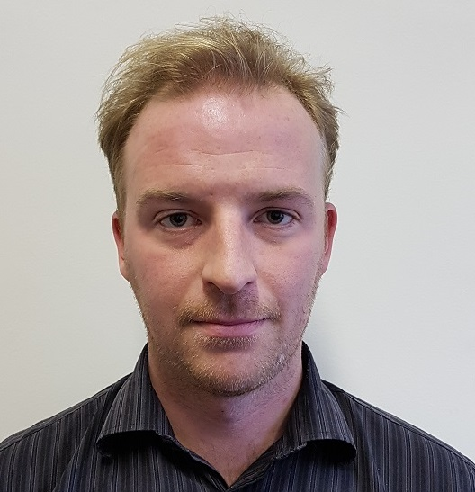
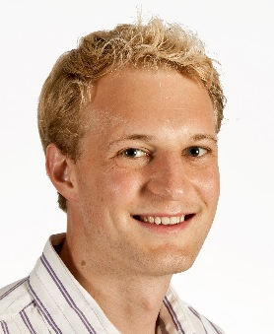
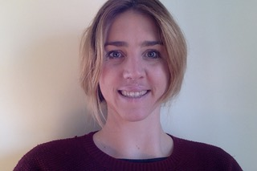
Who are TB MAC?
Katherine Floyd
WHO
Anna Vassall
LSHTM
Anna Bershteyn
IDM
Hsien-Ho Lin
National Taiwan University
Geoff Garnett BMGF
David Dowdy JHU
Nick Menzies Harvard
Ted Cohen Yale
Michael Kimerling KNCV
Steering Committee
Jeremiah C. Muhwa
The Union
Liz Corbett LSHTM
Philippe Glaziou
WHO
Carol Levin
UW
Geoff Garnett
BMGF
Sevim AhmedovUSAID
Sahu Suvanand
StopTB
Adam Macneil
CDC
Johannes Hunger
GFATM
David Wilson
World Bank
Knut
Lönnroth
KI
Advisory Panel
Richard White
Kristian Godfrey
Finn McQuaid
Madeleine Clarkson
Secretariat (LSHTM)
Notes:
TB MAC is led by the steering committee,
[click] its main decision making body
TB MAC is advised by the advisory panel,
[click] which includes a number of funders and international agencies & provides strategic long-term direction & priorities
Lastly, TB MAC activities are co-ordinated & administered by the secretariat
[click]

Slide 5




What does TB MAC do?
At a global & country level
Strengthening Networks
START
1.
Decision makers
Modellers
Economists
Improved TB Policy & Practice
&
Creating solutions
Increased Efficacy Effectiveness
2.
Resources
3.
Empowering decision makers
Equipped
Notes:
Strengthening networks
Strong and effective links between decision makers and modelers & economist
Creating solutions
New high quality resources available/accessible to decision makers
Empowering decision makers
TB decision makers are better equipped to integrate these resources in their decision making and makers
Improved TB control policy decision making and practice at global and country level
Increased effectiveness and efficiency of TB control policy and practice at global and country level

Slide 6
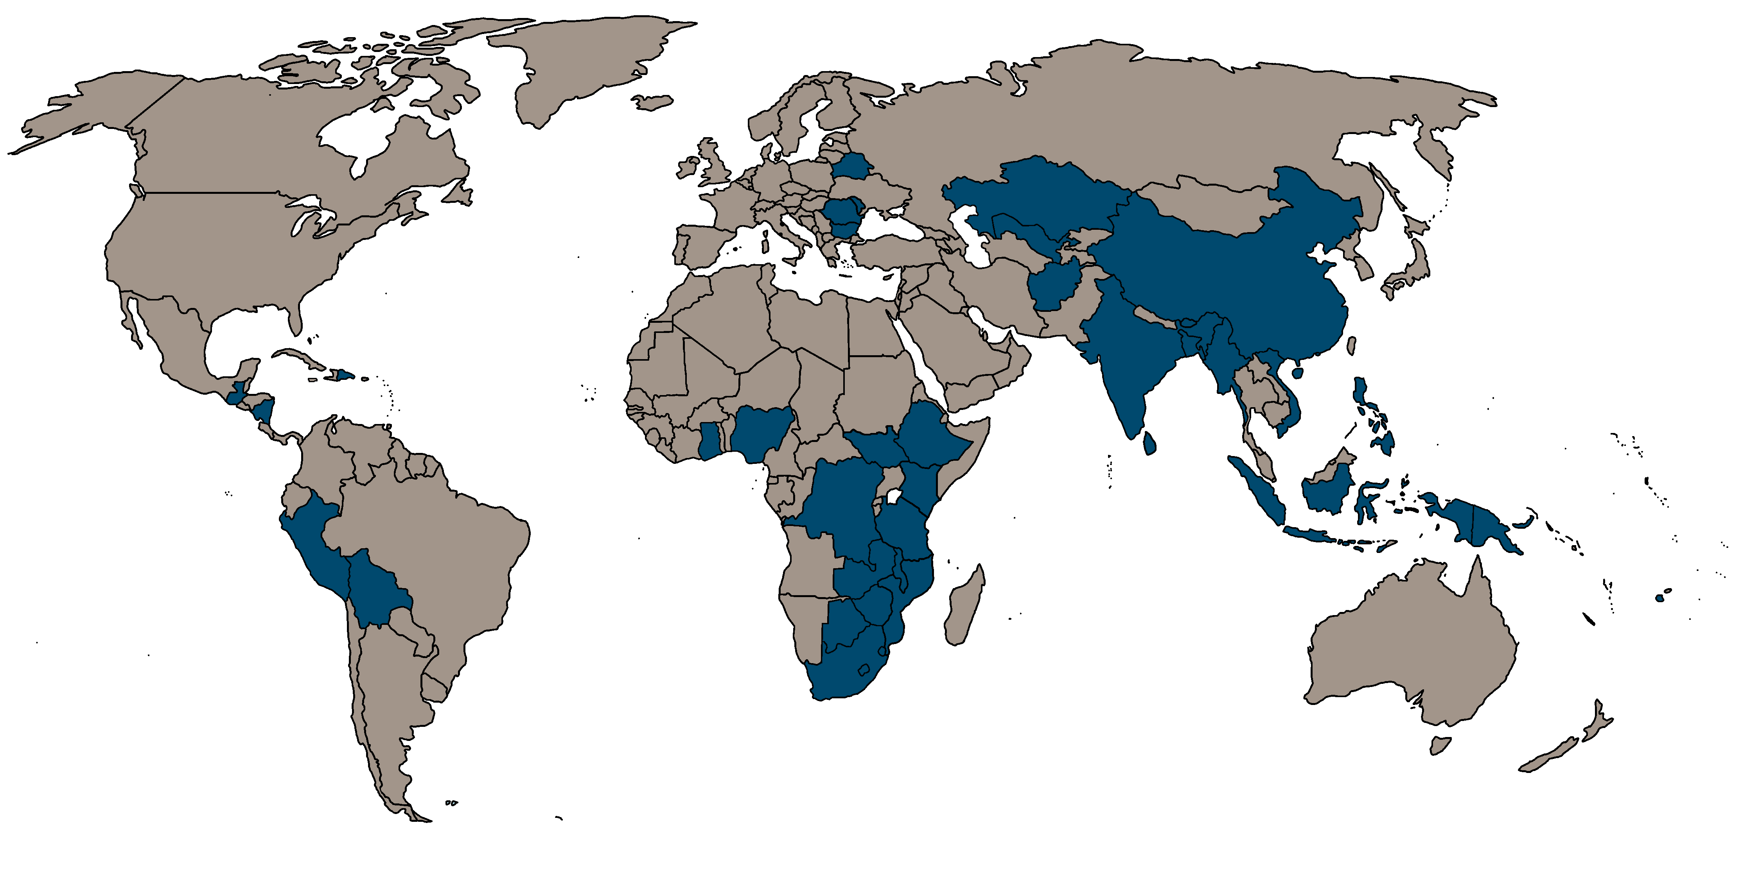
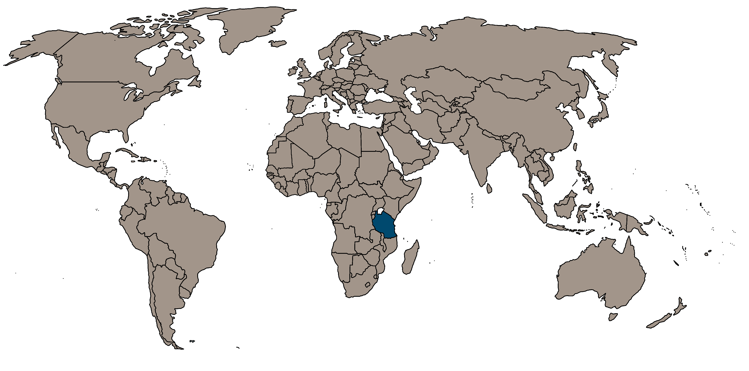
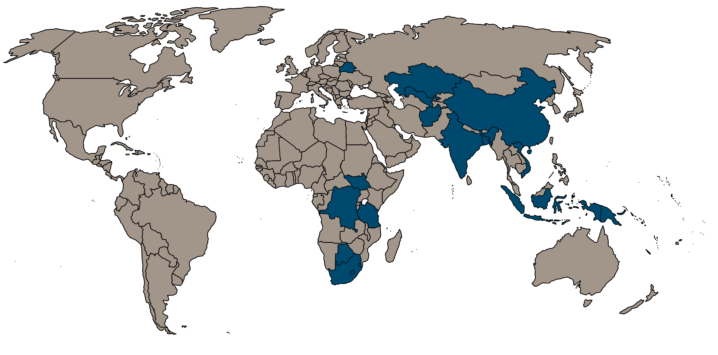


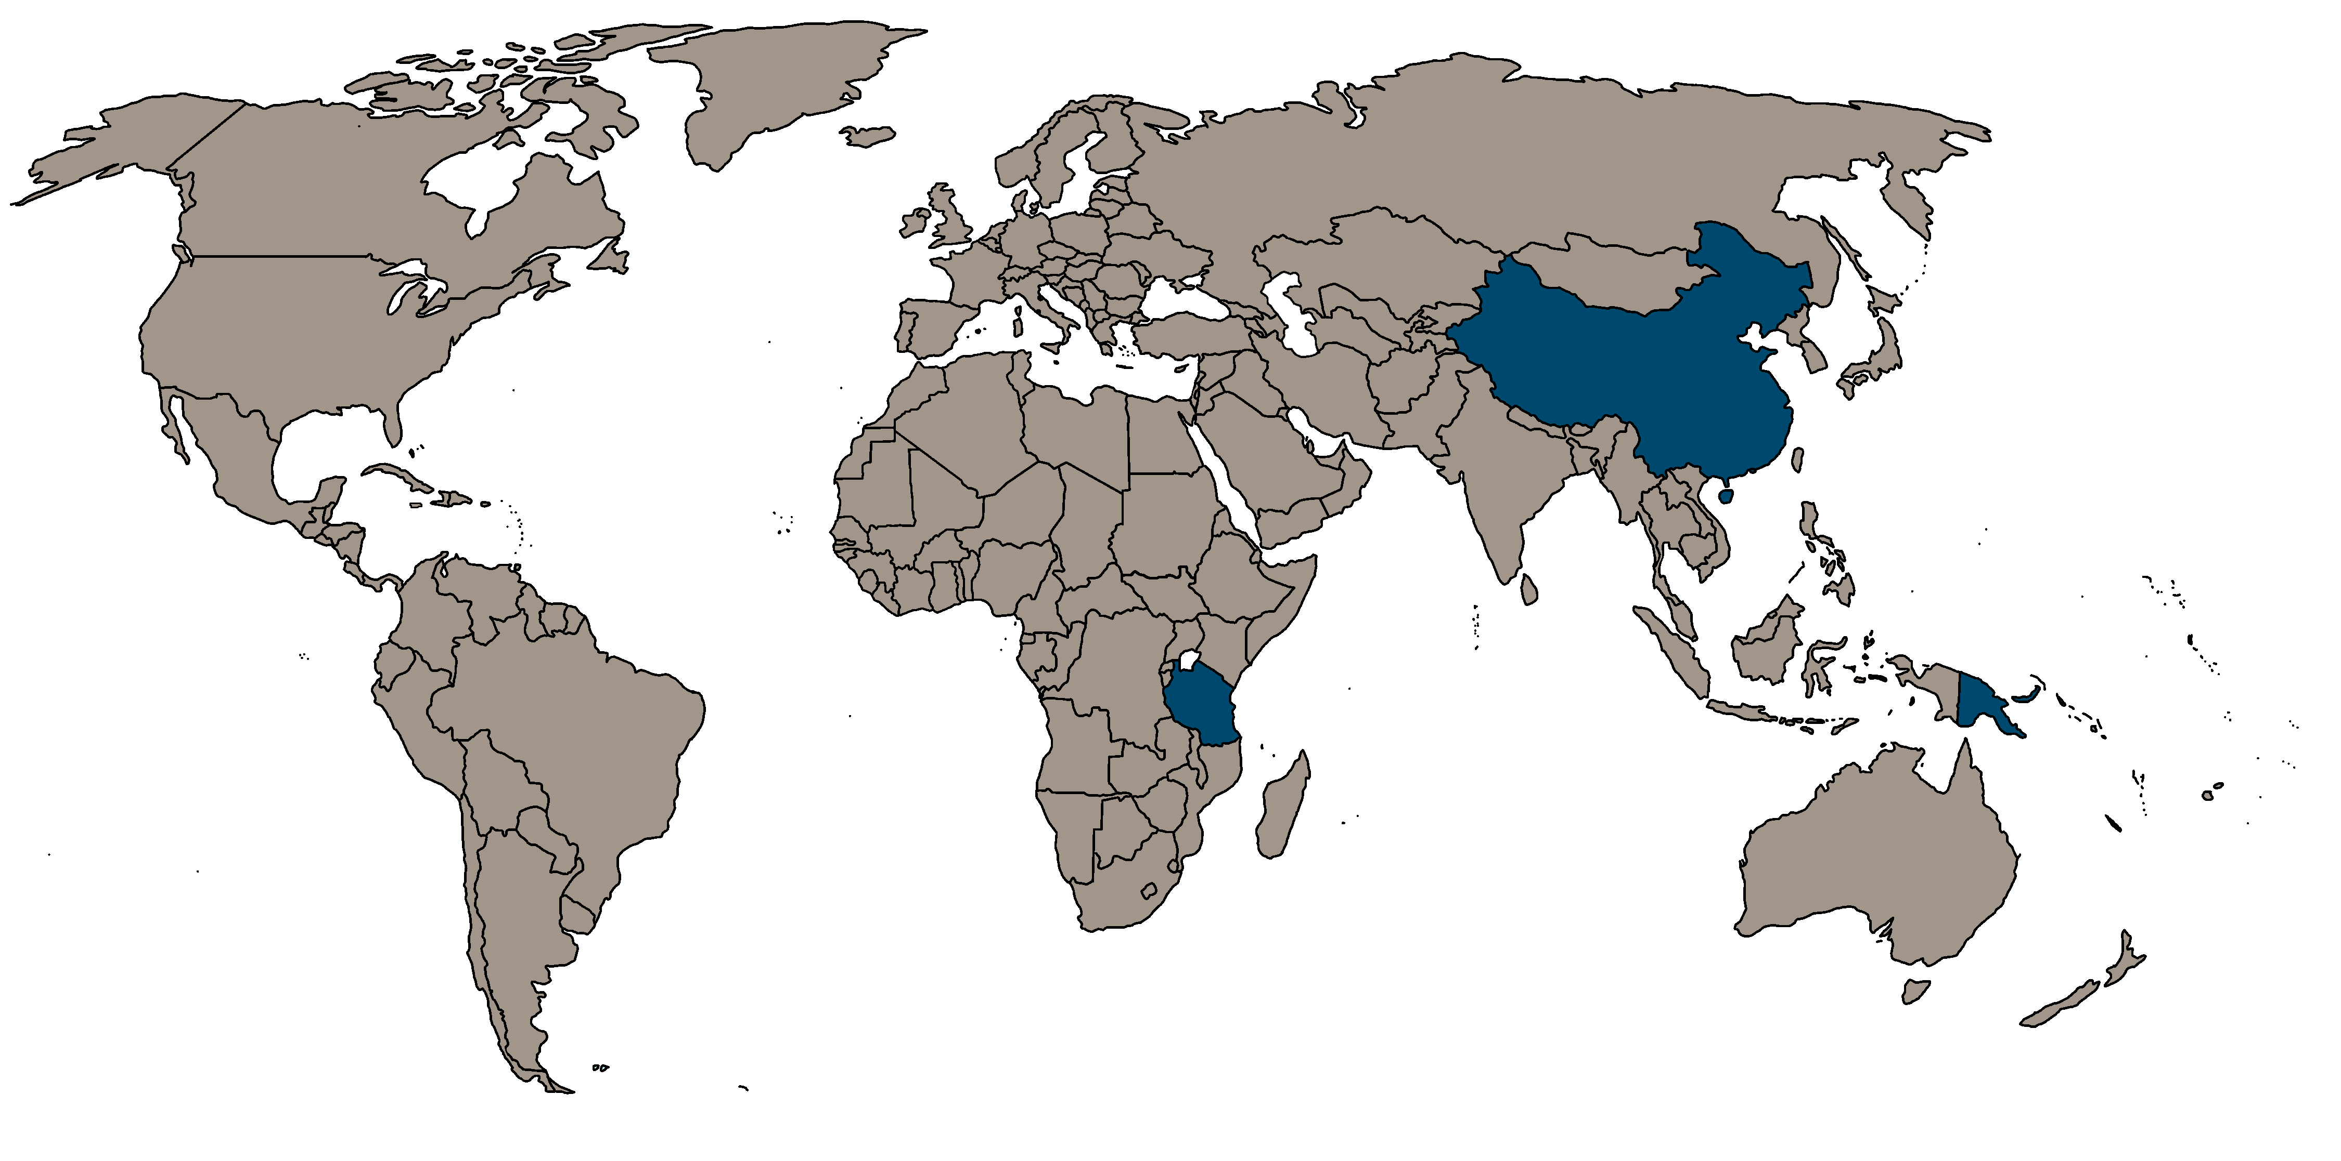




TB MAC activities: a closer look
1. Targets
2017
2012
2014
2015
2016
2013
2. Guidance
2018
 | Have used country-level modelling
 | Have not used country-level modelling
3. Benchmarks
Notes:
So, let’s take a closer look at some of these TB MAC activities
[click] We’ve chosen to focus on country-level modelling here
[click] Over the years demand has increased for modelling to inform
Global Fund applications
The development of National Strategic Plans
& other domestic funding applications
Here we pick out three activities TB MAC has undertaken to support this increase in demand
[click] A multi-model comparison exercise
[click] Guidance to improve country-level modelling applications
[click] And benchmarking and reporting templates to help review applications

Slide 7



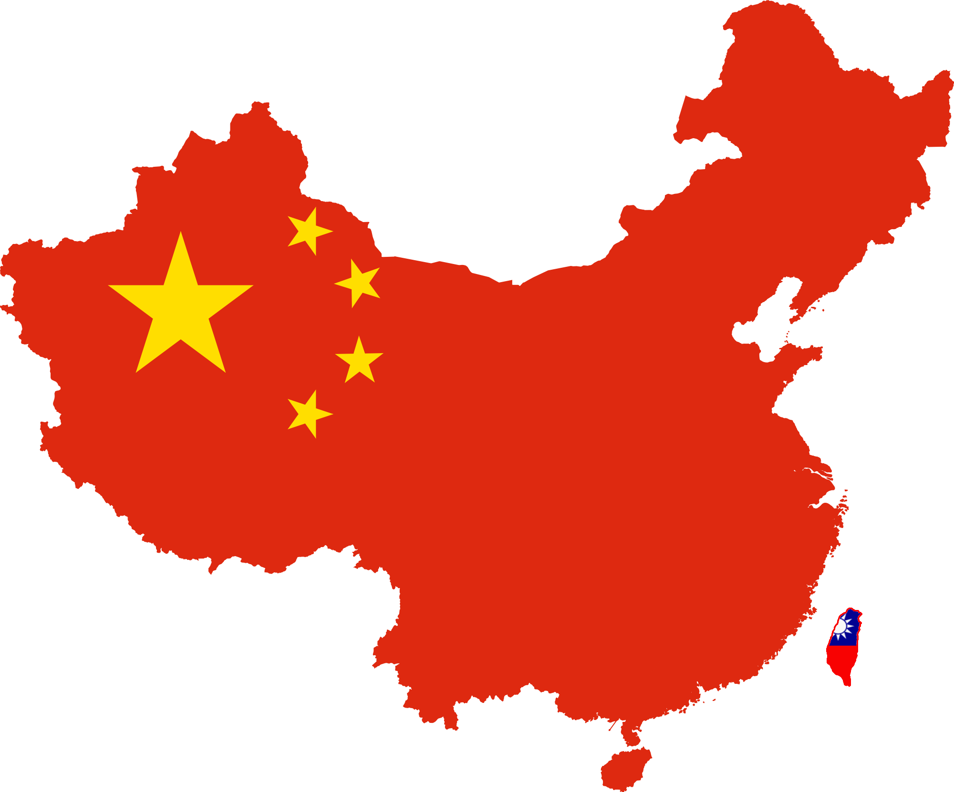










TB MAC Targets
Multi-modelling group exercise
2025 WHO global TB Targets
China, India, South Africa
Notes:
[click] TB MAC coordinated a multi-modelling group exercise including 11 groups working on the same question
[click] To explore IF and HOW the post-2015 WHO global TB Targets could be reached
[click] In China, India and South Africa

Slide 8



TB MAC Targets
Targets
Targets
multiple
interventions
multiple
interventions
multiple
interventions
single
intervention
single
intervention
single
intervention
Notes:
What this work discovered is that
[click] models suggested aggressive scale-up of any single intervention scenario could not achieve the targets in any country
[click] a combination of interventions in South Africa could achieve the global target, but not in India or China
where while models suggested major reductions were possible in all three countries, additional new country-specific interventions would be required to meet the targets
At the same time, most interventions substantially reduced patient costs, and in India and China produced net cost savings from a societal perspective
indeed, most interventions were highly cost-effective compared to current practice

Slide 9
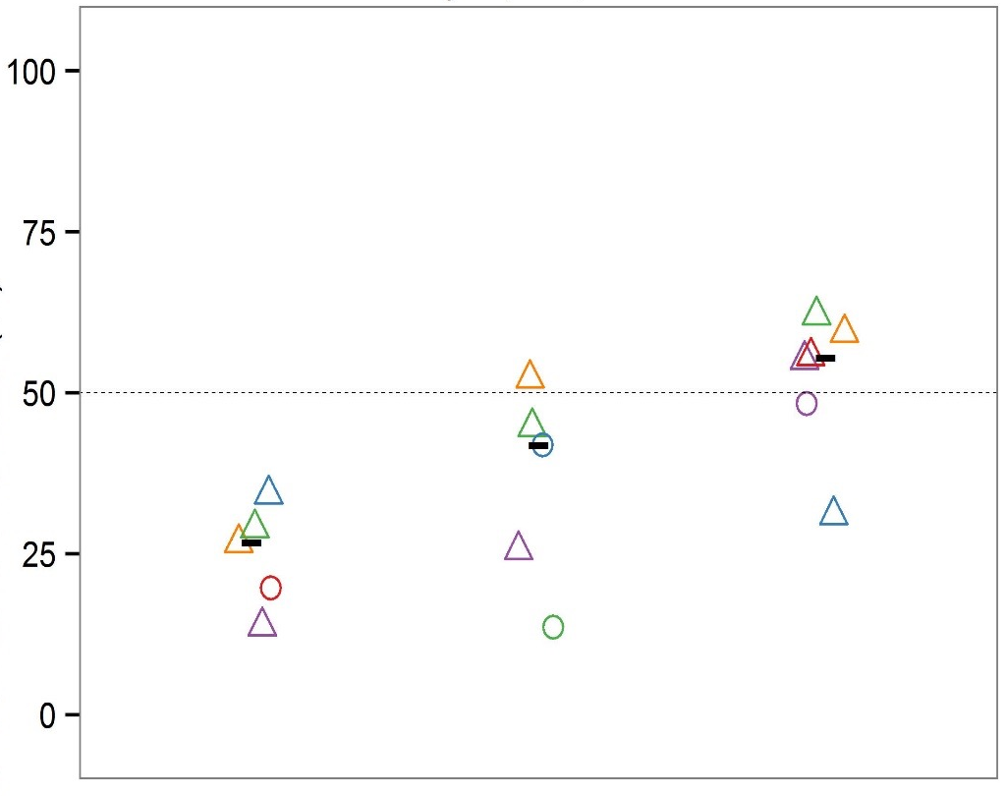
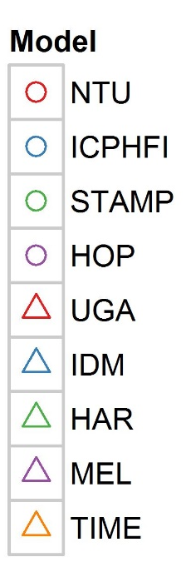
TB MAC Targets
Percent reduction in TB incidence (2015-2025) with aggressive action on TB
CHINA INDIA SOUTH
AFRICA
Different models
Same countries
Same policies
Same measures
Different results
Percent reduction (%)
Notes:
At the same time, this work raised important issues
We have different models
[click] Working on the same countries, with the same policies and same outcome measures
[click] But finding very different results
The figure shows results for incidence reductions achieved, where each point is the result of one individual model
[click] For example, in India the lowest estimate is 15-20%, while the highest estimate is ~50%, 2 to 3 times the low-end estimate

Slide 10
TB MAC Targets
Different models
Same countries
Same policies
Same measures
Different results
Incremental Costs (US$, mil.)
DALYs Averted (mil.)
Notes:
We see something similar with cost-effectiveness
This example is from China, where the kite-shaped regions are the smallest convex shape that encloses results from all models
[click] Orange is the combination scenario of all different policies listed
So if we divide the mean incremental costs by mean DALYs averted, we obtain the summary cost-effectiveness ratio
This is approximately $4000 per DALY averted
However, for individual models the range is $2000-$23000 per DALY averted, a multiple of more than 10
So we clearly have a problem here, in terms of the epi impact models are predicting, and the costs associated with that impact, where model results vary markedly.
How do we know which model or result is correct, and under which circumstances?
A first step towards resolving this is to ensure that modelling is of the highest standard.

Slide 11

TB MAC Guidance
Modelers & economists
Funders & technical experts
Country Stakeholders
Notes:
To meet this need for high-quality modelling, TB MAC undertook to develop a set of guidance,
[click] For modellers on how to conduct country-level modelling
[click] For funders on how to identify models and modelling technical assistance organisations to support
[click] And for country national TB programmes and other stakeholders on how to evaluate modelling evidence
TB MAC worked with representatives from each of these groups
[click] To develop a guidance document for TB country-level modelling to inform decision-making
[click] This document provides concrete, pragmatic guidance for how TB modelling and related technical assistance should be given to best support country decision-making

Slide 12

Identified need
Targets
Guidance
Benchmarks
Put into practice
Notes:
[click] The targets exercise identified the need for the development of formal guidance on how to do country level TB modelling
[click] But now the community needs the tools with which to operationalize this guidance
This brings us to the benchmarks

Slide 13







TB MAC Benchmarks
Benchmarks
Reporting template
Review process
Notes:
The last activity that we’ll look at here is the development of benchmarking and reporting tools for model application review
In 2017, representatives of several key global TB funders and stakeholders met and discussed how modelling could best support country level TB decision making
Out of this the TB Modelling Roadmap was developed, where key stakeholders formed the Roadmap Steering Committee.
This includes
[click] The Bill and Melinda Gates Foundation,
[click] The Global Fund to Fight AIDS, Tuberculosis and Malaria,
[click] The United States Agency for International Development,
[click] The World Bank,
[click] and The World Health Organization
In support of the Modelling Roadmap, and at the request of the Roadmap Steering Committee, TB MAC undertook to operationalise the Guidance document
[click] This included the development of
[click] a set of benchmarks against which modelling assumptions and results could be compared
[click] a standard reporting template to ensure that all relevant information is included in a standardised way
[click] and an external review system
These will subsequently be piloted in 5 countries with a number of the modelling groups (some of whom were involved in the Targets exercise)
Taken together, these various activities serve to standardise and improve the quality of modelling applications, increasing funder and country confidence in their results

Slide 14





TB MAC impact
Influenced development of country level models & methods
Influenced development of global level models & methods
Provided evidence at
high-level meetings
Contributed to recommendations
Helped foster
links
Supported WHO Task Force
Notes:
Lastly, I’d just like to mention some of the other impacts that TB MAC has had
[click] TB MAC has helped foster modeller-economist-global/country decision maker links
[click] TB MAC supported the WHO-GTB to include modelling & projections in the new mandate of the Task Force for TB Impact and Measurement
[click] TB MAC has provided expert advice and evidence at numerous high level meetings
For example in the External Review of the Global Fund Distribution of Funding by Disease, which resulted in the Global Fund decision not to reduce the proportion of the Global Fund funds allocated to TB
[click] TB MAC has funded the development of global-level models and methods
For example those previously used by the WHO Global TB Department to make estimates for HIV-positive TB incidence and mortality and indirect estimates of HIV-negative TB mortality for countries without vital records or mortality survey data
[click] TB MAC has also influenced activities at country level:
The TB MAC Targets modelling (and subsequent in-country modelling) was used to focus a call by the South Africa Medical Research Council, to support South Africa’s first ever combined TB & HIV investment case, to support the decision to create South Africa’s first ever ring-fenced grant for TB, and to support the NTP Strategic Plan 2017- 2021
Modelling groups supported by TB MAC activities have also been used to improve the 2014 Global Fund Concept Note submission in Viet Nam (resulting in an additional $20m in incentive funding)
and reprogram the Ghana Global Fund grant after the recent survey showed much higher TB prevalence.
[click] TB MAC contributed to the European Centre for Disease Control recommendations for LTBI screening in European countries

Slide 15



Thank You
www.tb-mac.org
@tb_mac

