Slide 1

Infectious & clinical TB trajectories: Bayesian modeling with case finding implications
Tess Ryckman
TB MAC Seminar: new models of natural history
21 September 2023

Slide 2
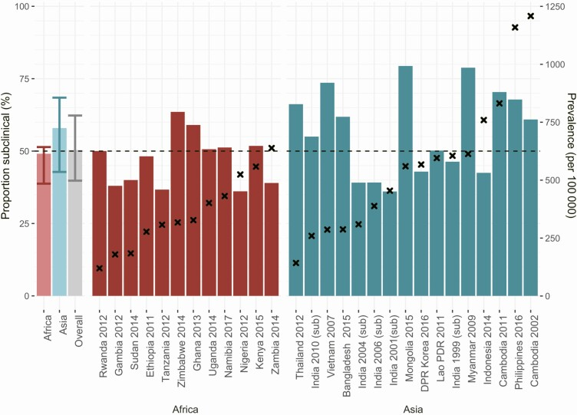
Motivation
People w/ subclinical TB make up a large % of all prevalent TB
  35-75% of undiagnosed cases
X’s indicate overall prevalence.
Frascella et al., Subclinical Tuberculosis Disease-A Review and Analysis of Prevalence Surveys to Inform Definitions, Burden, Associations, and Screening Methodology. CID 2021.

Slide 3
Motivation
People w/ subclinical TB make up a large % of all prevalent TB.
They have the potential to be infectious.
Evidence on the infectiousness of subclinical TB is based on:
Bacteriologically-positive sputum
  25-50% of people w/ subclinical TB are smear-positive
Face mask sampling & cough aerosol studies
Household contact studies
Molecular epidemiology studies

Slide 4
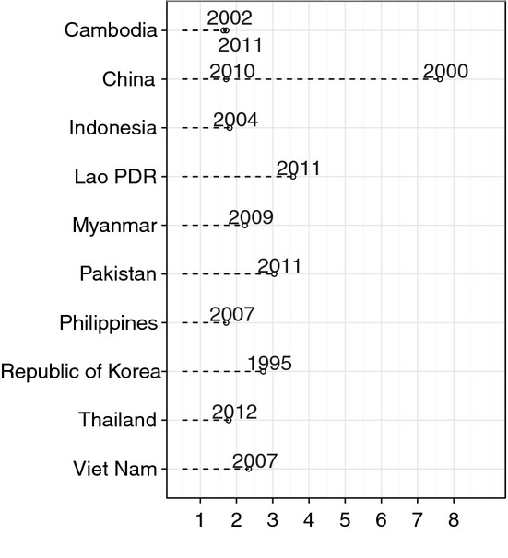
Motivation
People w/ subclinical TB make up a large % of all prevalent TB.
They have the potential to be infectious.
They are generally not detected by the health system.
Source: Onozaki et al., National tuberculosis prevalence surveys in Asia, 1990–2012: an overview of results and lessons learned. TMIH 2015.

Slide 5
How important is it to find and treat people with subclinical TB?

Slide 6
Stability (and infectiousness?) of subclinical TB?
[potentially] infectious subclinical time
Disease Course #1
Disease Course #2
Disease Course #3
Treatment (or death)
Recognizable symptoms
Bacillary load – and infectious potential?
Culture positivity
Time since start of TB disease
Time since start of TB disease
Time since start of TB disease
If most people w/ TB quickly develop symptoms and are treated…
Or quickly resolve without become very infectious…
But if TB can persist, be infectious, and stay largely subclinical for long durations…
…then finding & treating subclinical TB may have little impact.
…then finding & treating subclinical TB may be crucial to reduce transmission.
Adapted from: Kendall, Shrestha, & Dowdy. The Epidemiological Importance of Subclinical Tuberculosis: A Critical Reappraisal. AJRCCM 2021.

Slide 7
Overview of this study
1. Model Calibration: Learn about TB natural history by parameterizing a model that is consistent with empirical data, including:
  Historical cohort survival
  Present-day:
    Prevalence survey smear and symptom distribution
    Notifications
    TB mortality
2. Individual-level microsimulation: Use the calibrated model to describe:
  Stability of TB states (especially the infectious, subclinical state)
  Contribution of TB states to transmission
    Individual level
    Population level

Slide 8
TB natural history model
Markov state-transition model
Key assumptions:
Subclinical TB does not get detected or treated
No excess mortality from subclinical or resolved TB
Spontaneously resolved stay spontaneously resolved
  Sensitivity analysis allowed transition back to smear-negative subclinical.
Correlation between smear and symptom status
  Smear and symptom progression are more likely (and regression less likely) when someone is already symptom or smear positive, respectively.
spontaneously resolved
inflows
smear-negative subclinical
smear-positive subclinical
smear-negative symptomatic
smear-positive symptomatic
detected and treated
background mortality
TB mortality

Slide 9
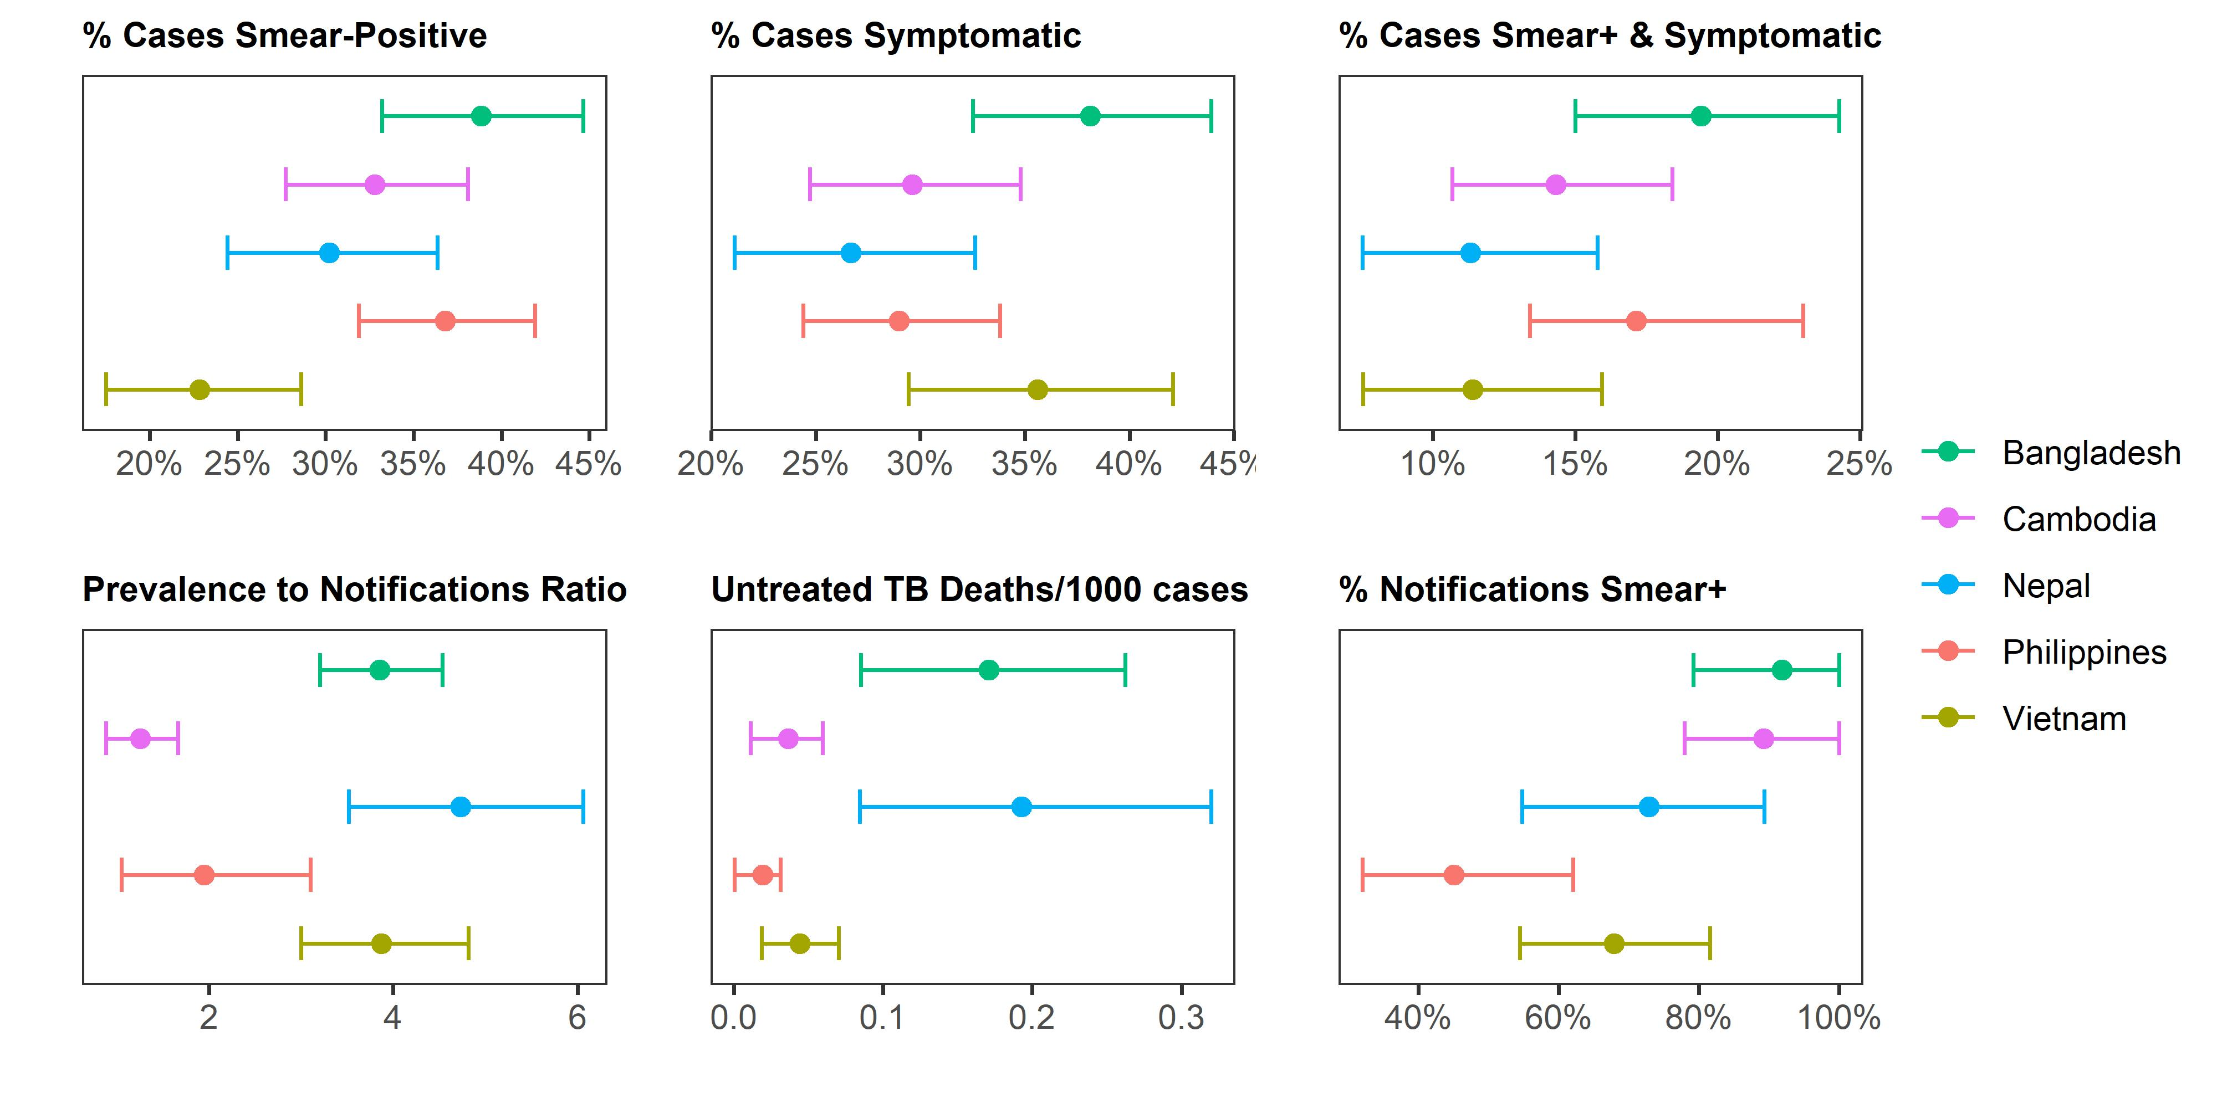
Present-day calibration targets
From prevalence surveys:
Untreated TB Deaths/1000 prevalent cases
Adding notification and mortality data:

Slide 10
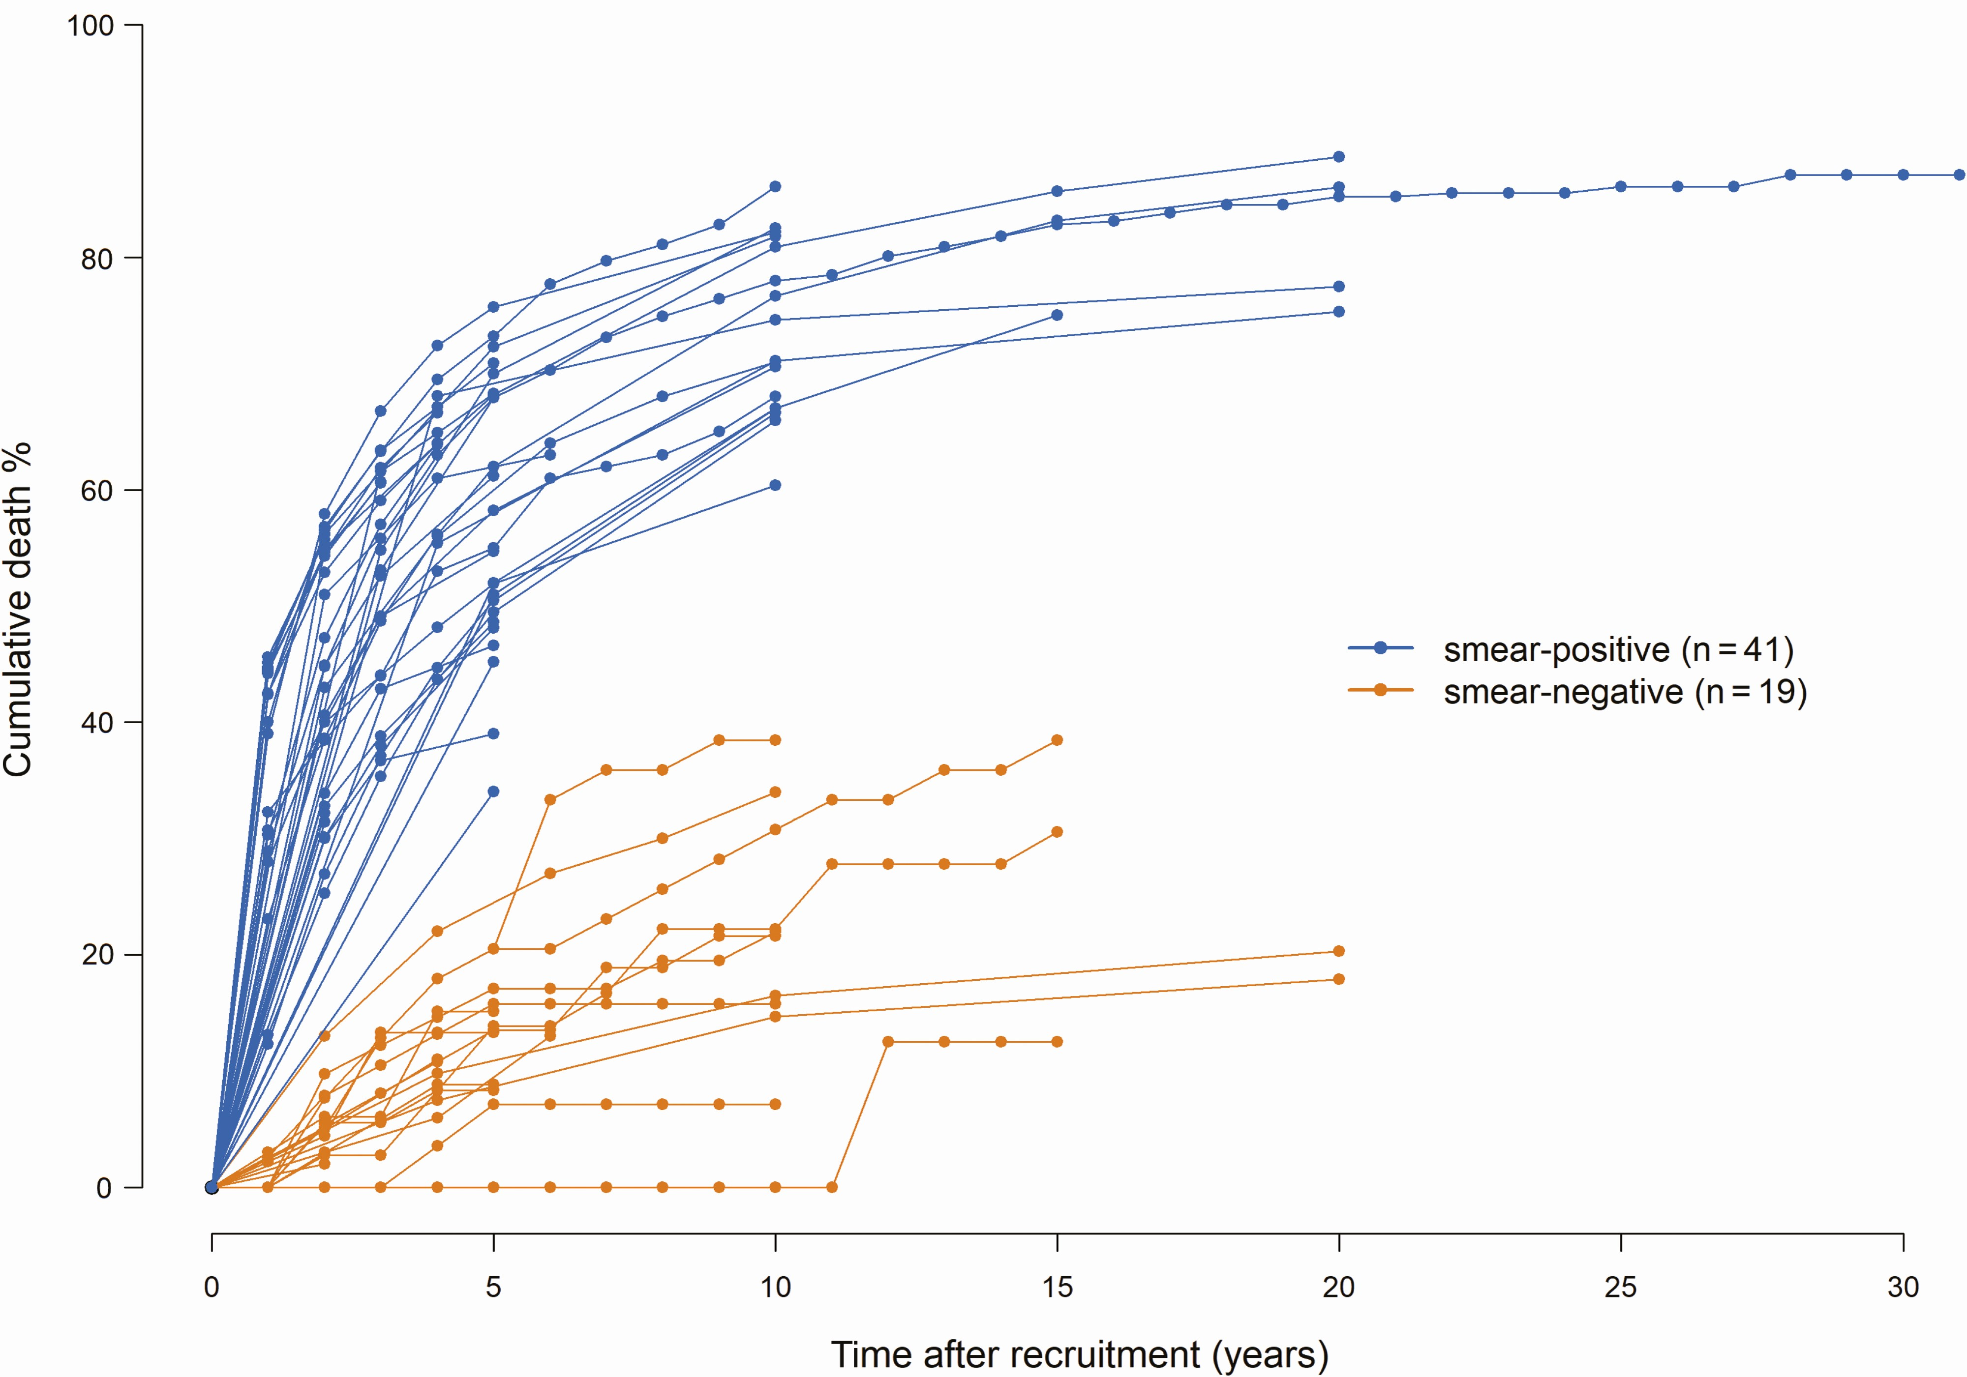
Historical calibration targets
Pooled 5- and 10-year survival data from historical cohort studies using Poisson meta-regression
Only included cohorts that had been bacteriologically-confirmed at some point
Limitation: some in the smear-negative cohorts may have fully resolved (not just regressed to smear-negativity)
Source: Ragonnet et al. Revisiting the Natural History of Pulmonary Tuberculosis: A Bayesian Estimation of Natural Recovery and Mortality Rates. CID 2021

Slide 11
Bayesian calibration procedure
We used Incremental Mixture Importance Sampling (IMIS) to calibrate the model.
For each country:
Parameters sampled from minimally-informative (uniform) prior distributions
3 distinct simulations run w/ each parameter set:
  Present-day simulations w/ treatment and open cohort brought to a steady state
  Historical simulations w/ no treatment and closed cohort of smear-negative symptomatic cases
  Historical simulations w/ no treatment and closed cohort of smear-positive symptomatic cases
Joint likelihood calculated across all 3 simulations, accounted for fits to both historical and present-day targets
50 initial sets of 100,000 parameter set samples, with 10 subsequent rounds of targeted sampling
Posterior = 50,000 likelihood-weighted parameter sets sampled for each country

Slide 12
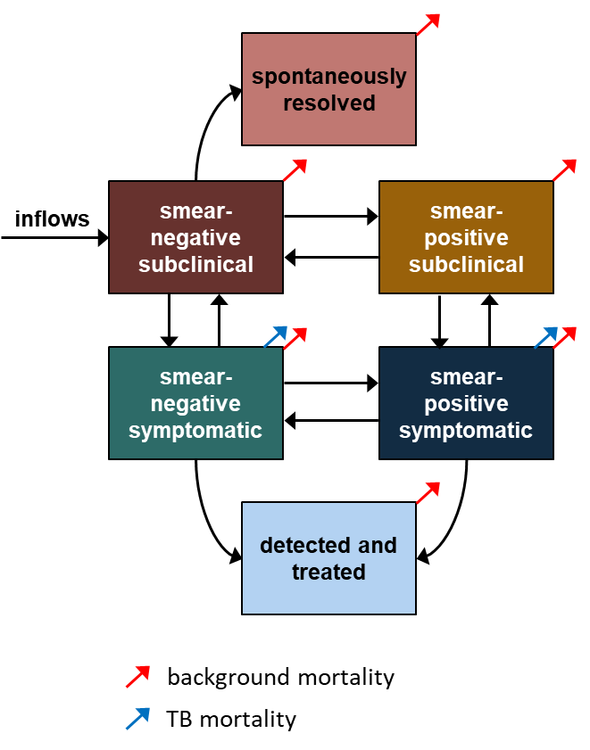
Microsimulation methods
For each posterior parameter set in each of the 5 countries:
  Population of 100,000 individuals with TB
  Individuals start in 1 of the 4 TB states
    Starting state distribution is based on prevalence survey data
  No inflows
  Stochastic state transitions each month
  Followed for 5 years

Slide 13
Contribution to transmission calculations
For each modeled individual:
Individual contribution to TB transmission =
Time spent smear-positive symptomatic
Time spent smear-positive subclinical
Time spent smear-negative symptomatic
Time spent smear-negative subclinical
100% x
+ 70% x
+ 35% x
+ 25% x
Normalized to 1
Studies on TST conversion among household contacts of TB patients w/ and w/out cough
Studies on TST conversion among household contacts of TB patients w/ smear-positive vs. smear-negative TB
35% x 75% = 25%
Given potential bias and limitations, estimate of instantaneous relative infectiousness were varied widely in sensitivity analysis

Slide 14
Contribution to transmission calculations
For each modeled individual:
Individual contribution to TB transmission =
Time spent smear-positive symptomatic
Time spent smear-positive subclinical
Time spent smear-negative symptomatic
Time spent smear-negative subclinical
100% x
+ 70% x
+ 35% x
+ 25% x
For each of the 4 TB states:
Population contribution to TB transmission =
Sum of individual contributions to TB transmission, for all individuals starting in that state
Given potential bias and limitations, estimate of instantaneous relative infectiousness were varied widely in sensitivity analysis

Slide 15
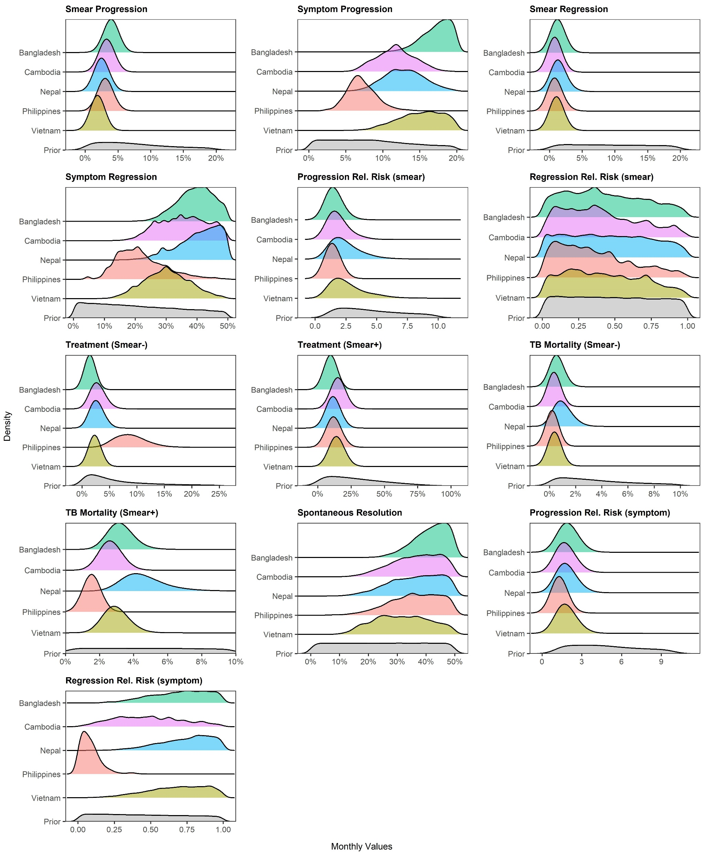
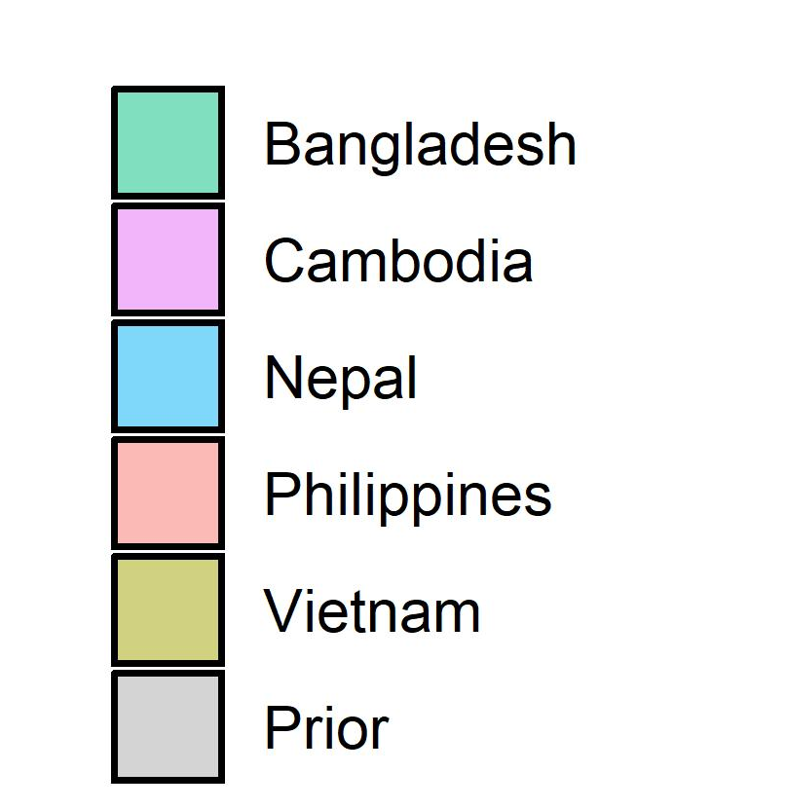
Calibration results: posterior parameters

Slide 16
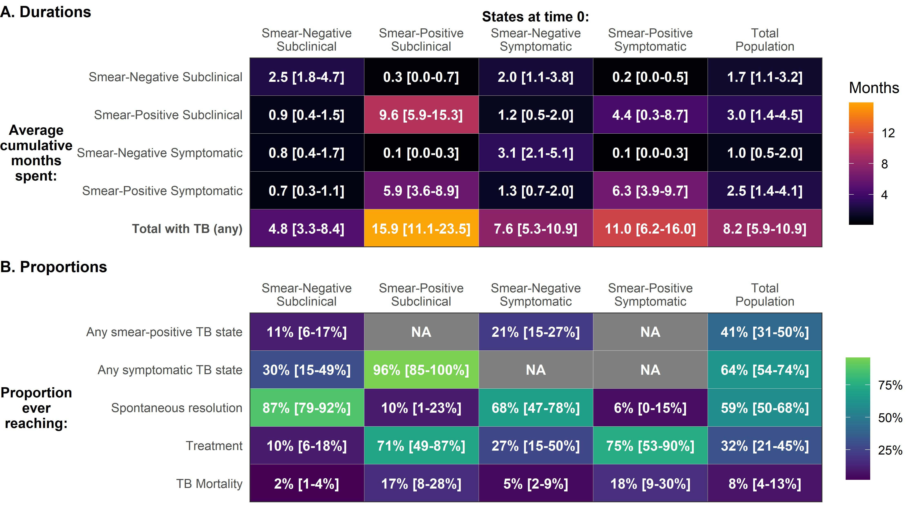
State stability: durations by starting state
States at time 0:

Slide 17
State stability: outcomes by starting state
States at time 0:

Slide 18
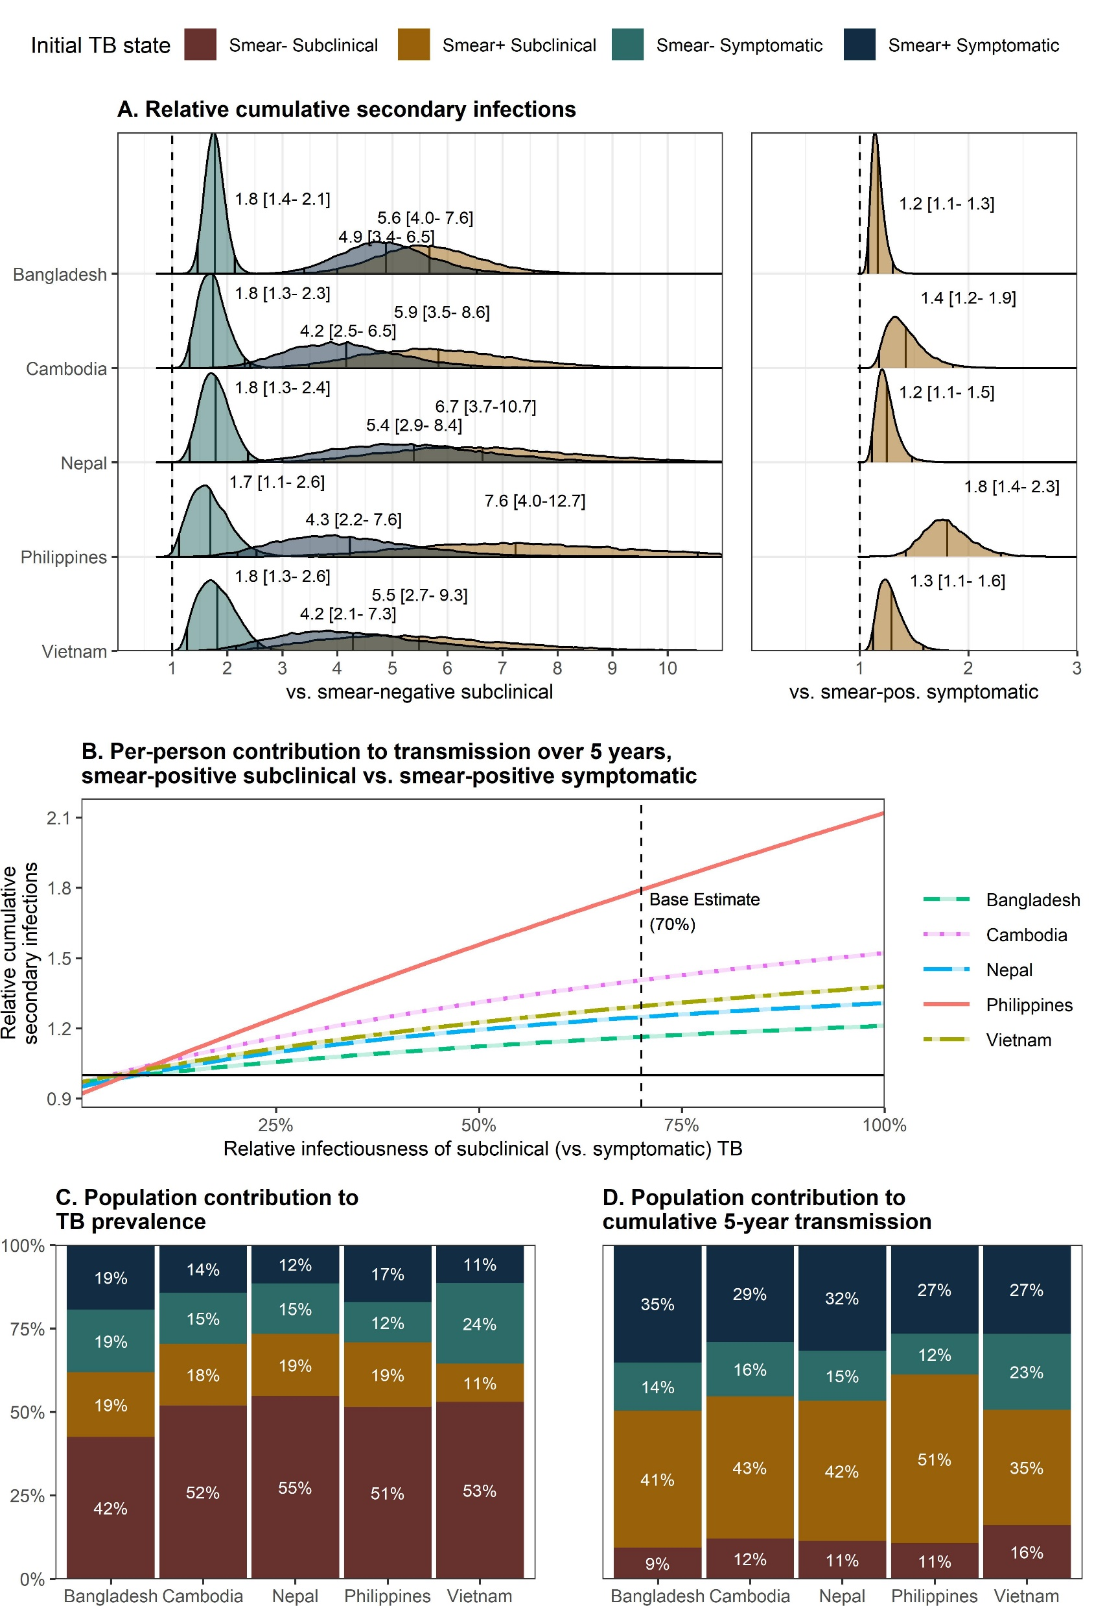
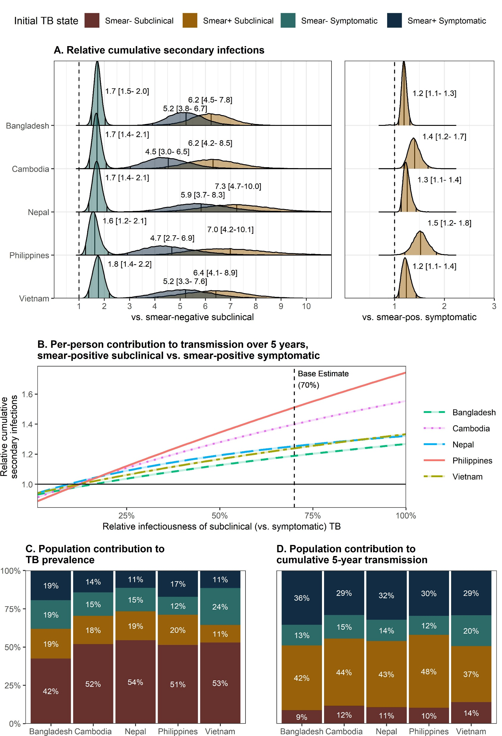
Contribution to transmission: individual-level
Initial TB state

Slide 19
Contribution to transmission: individual-level

Slide 20
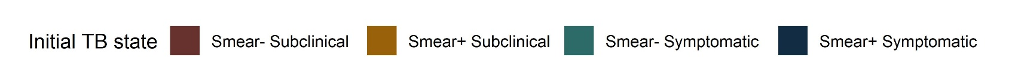
Contribution to transmission: population-level

Slide 21
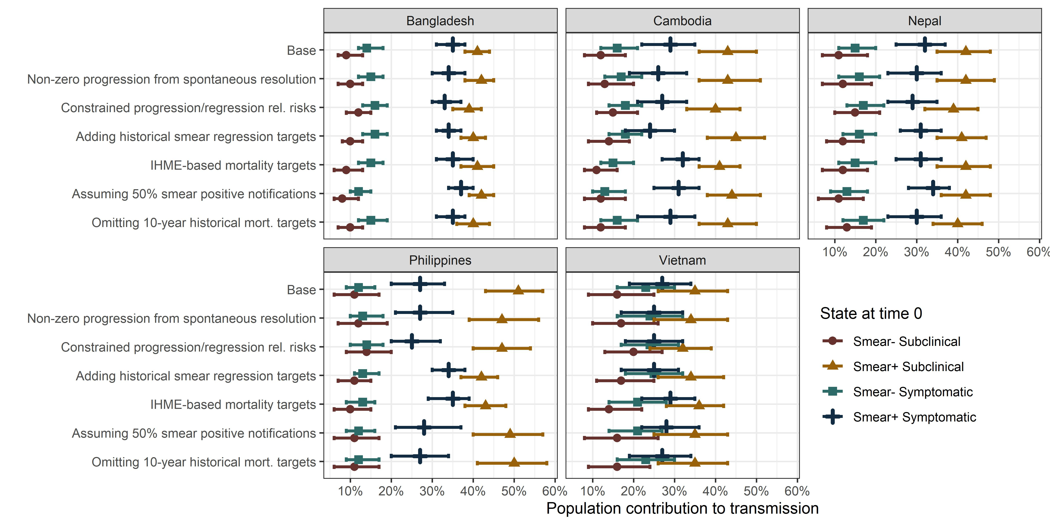
Sensitivity analyses
Conclusions re transmission were consistent across sensitivity analyses:

Slide 22
Key takeaways
Most people who develop bacteriologically-detectable TB don’t ever develop symptoms or become highly infectious.
But for those who develop smear+ TB, the cumulative smear+ time before resolution or treatment averages 16 months.
  Half of this time is spent without typical/noticeable symptoms.
Smear-positive subclinical TB may contribute disproportionately to Mtb transmission
  10-20% of undiagnosed TB
  35-51% of secondary transmission

Slide 23
Limitations
Uncertainty regarding per-unit-time relative infectiousness
Representativeness/classification of historical smear-negative cases
Applicability of the Markov assumption
Dichotomization of smear and symptom status
Generalizability to high-HIV-burden settings (but results should generalize to HIV-negative people in these settings)

Slide 24
Policy implications
Symptom screening alone is unreliable
  People with smear+ subclinical TB account for a high % of future transmission and clinical disease
But detecting all TB is inefficient
  Most prevalent TB is subclinical & smear-negative
  ~90% of subclinical smear-negative TB resolves and contributes little to transmission
Screening-specific use case for less sensitive diagnostics – if:
  Sensitivity depended on bacillary burden (but not symptoms)
  Specificity were high
  Lower sensitivity requirements allowed for portability, lower cost, greater uptake

