Slide 2
Estimating the
global burden of viable Mycobacterium tuberculosis infection
Alvaro Schwalb, MD MSc
September 19th, 2024

Slide 3
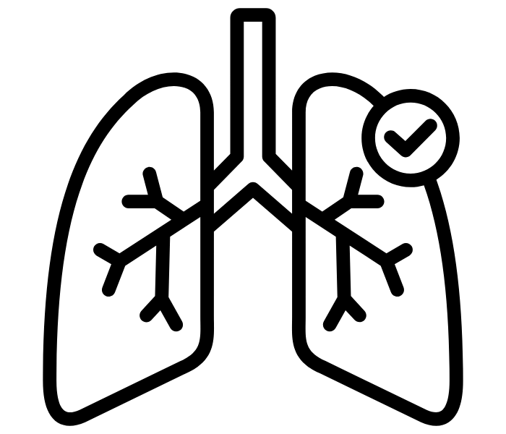
Background: Estimates of Mtb infection
Estimates of Mycobacterium tuberculosis (Mtb) infection burden are fundamental in shaping global health strategies for TB.
These estimates were based on two key assumptions:
Provision of TB preventive therapy
1. Viability of infection
Reflecting who stands to benefit from TPT
2. Recency of infection
At highest risk of progression to disease
Behr et al. Nat Microbiol 2024
Matteelli et al. PLoS GPH 2024
Focusing on recent viable Mtb infections sets a medically actionable target for the optimisation of the TB prevention cascade
Notes:
Estimates of Mtb infection serve as a guide for shaping global health strategies for TB
A key intervention to reduce TB incidence is the provision of TB preventive therapy
However, estimates should consider the viability of infection and recency of infection

Slide 4
Background: Estimates of Mtb infection
Estimates of Mycobacterium tuberculosis (Mtb) infection burden are fundamental in shaping global health strategies for TB.
These estimates were based on two key assumptions:
Provision of TB preventive therapy
Focusing on recent viable Mtb infections sets a medically actionable target for the optimisation of the TB prevention cascade
1. Viability of infection
Reflecting who stands to benefit from TPT
2. Recency of infection
At highest risk of progression to disease
Behr et al. Nat Microbiol 2024
Matteelli et al. PLoS GPH 2024

Slide 5
Background: Previous estimates
Global prevalence of Mtb infection has previously been estimated using mathematical modelling
These estimates were based on two key assumptions:
32%
ARIs derived:
Directly: TST surveys
Indirectly: TB incidence (Stýblo rule)
1997
1.86 billion people
Dye et al. JAMA 1999
Progressive scientific insights:
Using revised Stýblo rule
Additional TST surveys
Population growth + demographic shift
23%
2014
1.70 billion people
Houben and Dodd PLoS Med 2016
Notes:
ARI 1000/100000 = 0.01 = 1%
Incidence 50/100000
Prevalence 100/100000

Slide 6
Background: Key assumptions
These estimates were based on two key assumptions:
32%
1997
1.86 billion people
1. Unchanging TB immunoreactivity
i.e. TST/IGRA positivity is stable and permanent
23%
2014
2. Persistent Mtb infection
1.70 billion people
i.e. Individuals are infected for life and thus are at continuous risk of progression to disease

Slide 7
Background: Challenging assumptions
These estimates were based on two key assumptions:
32%
1997
Suggested since the early 1900s, with significant implications on the estimated risk of infection
1. Unchanging TB immunoreactivity
1.86 billion people
CHALLENGED BY REVERSION
i.e. TST/IGRA positivity is stable and permanent
von Pirquet J Am Med Assoc 1909
Dale et al. Eur Respir Rev 2023
23%
2014
A substantial proportion of individuals self-clear infection (and risk of TB disease) in the absence of treatment
2. Persistent Mtb infection
CHALLENGED BY SELF-CLEARANCE
1.70 billion people
i.e. Individuals are infected for life and thus are at continuous risk of progression to disease
Emery et al. Proc R Soc B 2021

Slide 8
Background: Other issues
These estimates were based on two key assumptions:
Reliance on immunoreactivity estimates in children as a proxy of recent infection
Considerable population shifts and dynamics are constantly occurring
Suggested since the early 1900s, with significant implications on the estimated risk of infection
1. Unchanging TB immunoreactivity
CHALLENGED BY REVERSION
i.e. TST/IGRA positivity is stable and permanent
von Pirquet J Am Med Assoc 1909
Schwalb et al. Am J Epidemiol 2023
A substantial proportion of individuals self-clear infection (and risk of TB disease) in the absence of treatment
2. Persistent Mtb infection
CHALLENGED BY SELF-CLEARANCE
Children have lower exposure than adolescents and adults
Aging population, migration, economic shocks all play a role
i.e. Individuals are infected for life and thus are at continuous risk of progression to disease
Neuenschwander et al. Int J Tuberc Lung Dis 2000
Dowdy and Behr Lancet Infect Dis 2022
Dye and Williams Science 2010
Emery et al. Proc R Soc B 2021

Slide 9
Background: Research gap
Unchanging TB immunoreactivity
Lifelong
Mtb infection
Current estimates do not accurately capture viable Mtb infections
Risk of infection from children
RESEARCH GAP
Evolving population trends

Slide 10
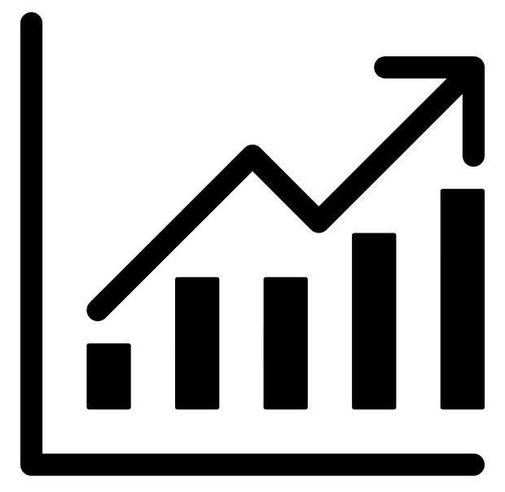
Methods: Annual risk of infection
We constructed national annual risk of infection (ARI) trajectories
using two sources
DIRECT ESTIMATES:
Immunoreactivity surveys
171
INDIRECT ESTIMATES:
TB prevalence estimates
countries
(99.6% of global population)
Notes:
ARI trajectories spanning from 1950 to 2022
Based on methods by Houben and Dodd

Slide 11
Methods: Annual risk of infection
DIRECT ESTIMATES:
Immunoreactivity surveys
INDIRECT ESTIMATES:
TB prevalence estimates
$$ARI=1−{(1−{TST}_{prev})}^{1/{age}}$$
We used the most recent WHO TB incidence estimates and turned them into TB prevalence by applying an average duration of disease
We extracted the estimated ARI from nationally representative immunoreactivity surveys
These estimates (2000-2022) are then converted into ARIs through the revised Styblo rule, and adjusted to account for the influence of age and HIV on smear-positivity
Most on children and using TST
Cauthen et al. Bull World Health Organ 2022
Houben and Dodd PLoS Med 2016
Rickman et al. In preparation
WHO Global TB Report 2023
Houben and Dodd PLoS Med 2016
IMPACT OF REVERSION
Ignoring reversion leads to a stark underestimation of the true ARI in populations and our interpretation of Mtb transmission intensity
True ARI is roughly 3 times higher than calculated
All ARI estimates (and uncertainty) were adjusted based on this
Schwalb et al. Am J Epidemiol 2023

Slide 12
Methods: Annual risk of infection
DIRECT ESTIMATES:
Immunoreactivity surveys
INDIRECT ESTIMATES:
TB prevalence estimates
IMPACT OF REVERSION
$$ARI=1−{(1−{TST}_{prev})}^{1/{age}}$$
We used the most recent WHO TB incidence estimates and turned them into TB prevalence by applying an average duration of disease
Ignoring reversion leads to a stark underestimation of the true ARI in populations and our interpretation of Mtb transmission intensity
We extracted the estimated ARI from nationally representative immunoreactivity surveys
True ARI is roughly 3 times higher than calculated
These estimates (2000-2022) are then converted into ARIs through the revised Styblo rule, and adjusted to account for the influence of age and HIV on smear-positivity
All ARI estimates (and uncertainty) were adjusted based on this
Most on children and using TST
Cauthen et al. Bull World Health Organ 2022
Houben and Dodd PLoS Med 2016
Rickman et al. In preparation
Schwalb et al. Am J Epidemiol 2023
WHO Global TB Report 2023
Houben and Dodd PLoS Med 2016

Slide 13
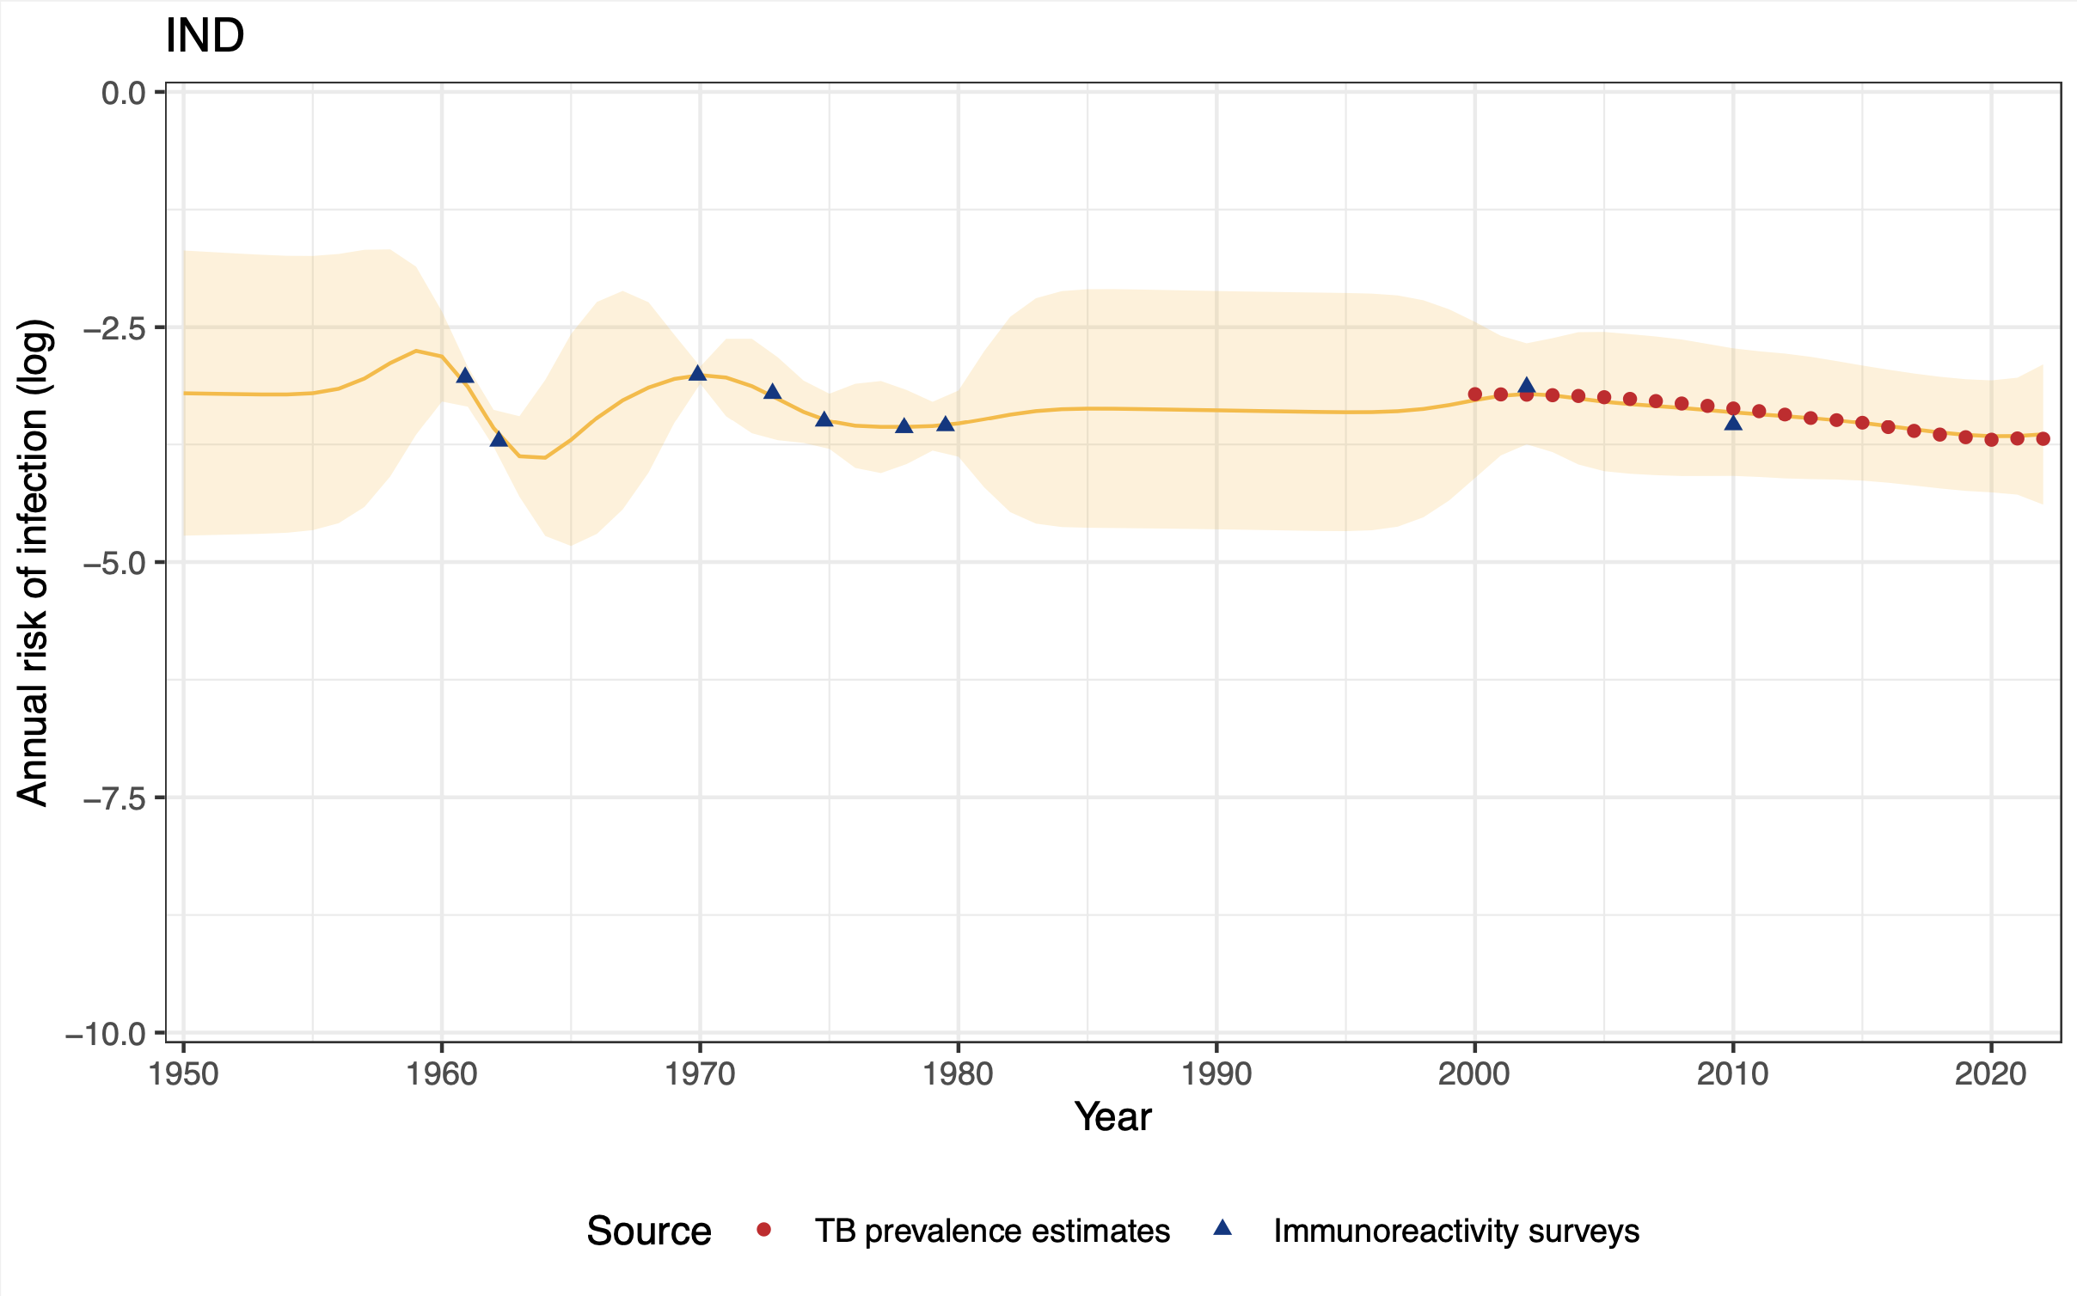
Methods: GP regression
A Gaussian Process (GP) regression is applied to each national ARI trajectory (1950-2022)
Flexible, non-parametric regression framework accounting for measurement uncertainty
Assuming a linear interpolation
Rasmussen and Williams MIT Press 2005
Houben and Dodd PLoS Med 2016
Notes:
For each country, 1,000 simulated ARI trajectories from 1950 to 2022 were generated.

Slide 14
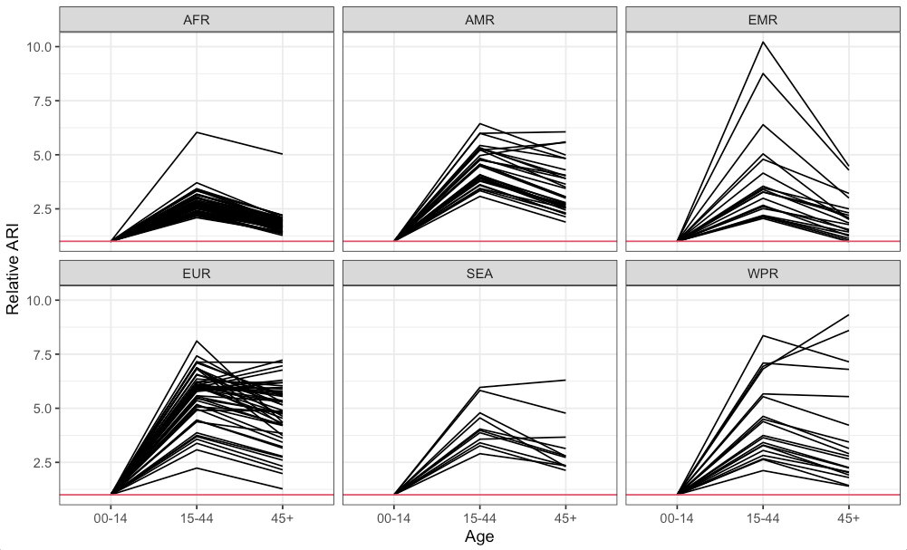
Methods: Mixing and age-specific ARIs
Calculating age-specific ARIs using:
00-14
15-44
45+
reference
Relative TB incidence per age group
Mean number of contacts per age group from mixing matrices
Obtaining relative ARIs to apply to GP regression trajectories*
WHO Global TB Report 2023
Prem et al. Comput Biol 2021 (Revised)
Dodd et al. In preparation
*Using regional relative ARIs for countries with missing matrices
Notes:
To address the higher risk of infection in adults compared to children
We defined three distinct age groups to encapsulate varying ARIs
Using the estimated number of incident TB disaggregated by age and country,²¹ we calculated the relative TB incidence per capita, using the under-15-year-old age group as the reference
Employing the synthetic country-specific contact mixing matrices developed by Prem et al.,²² we obtained the average number of contacts between the defined age groups
Finally, ARI trajectories were subdivided by age group and modified based on relative ARI

Slide 15
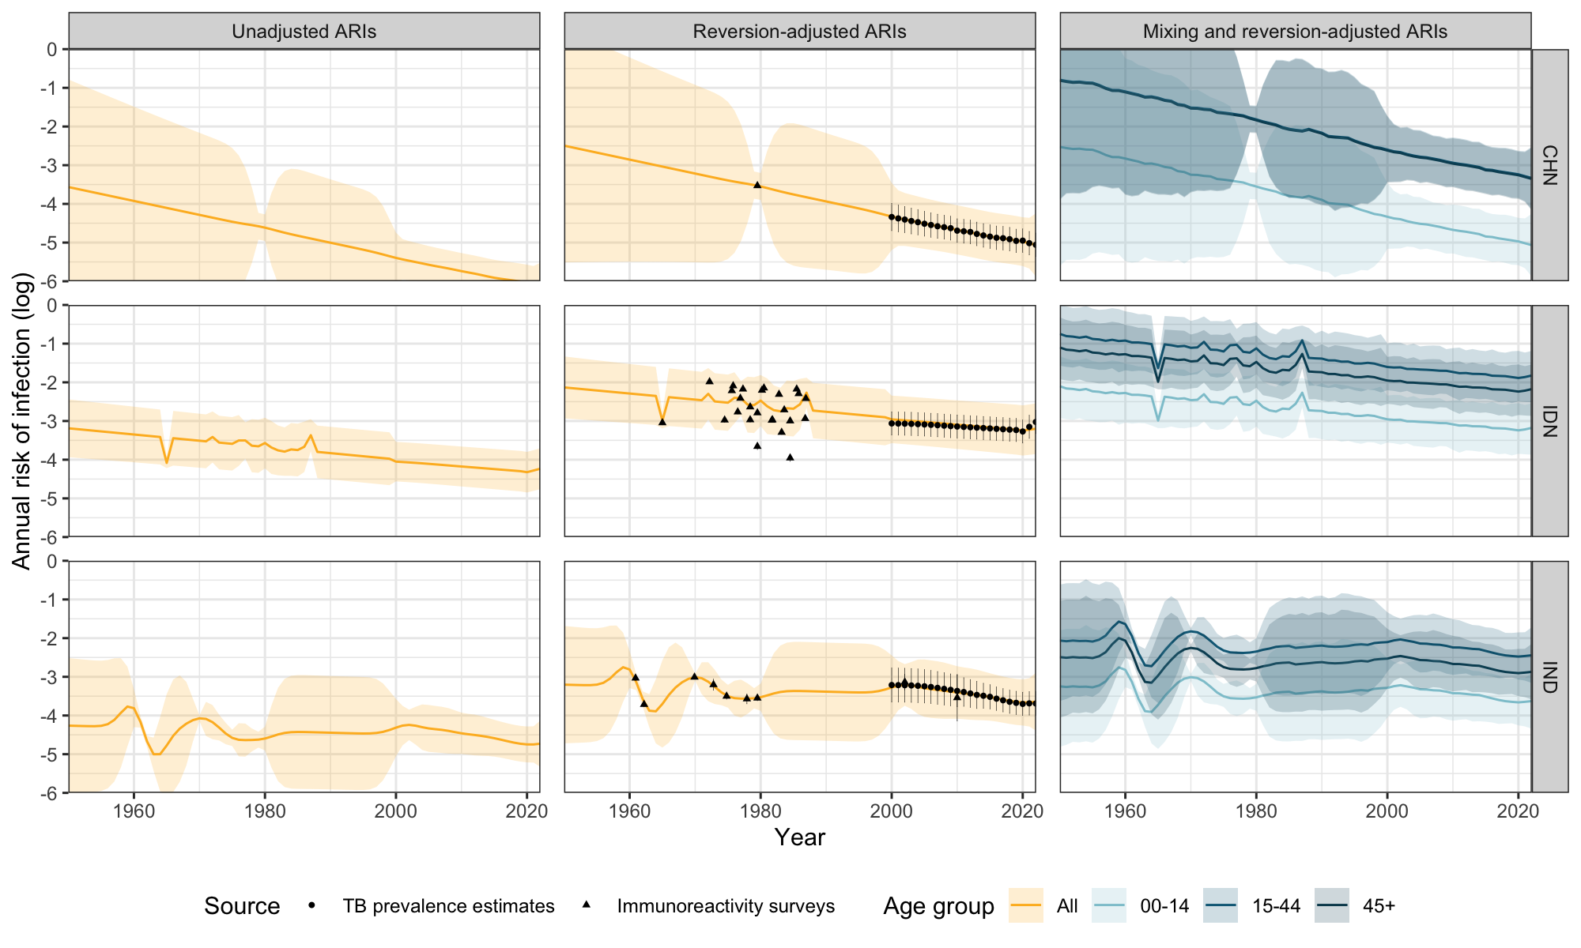
Methods: Mixing and age-specific ARIs

Slide 16
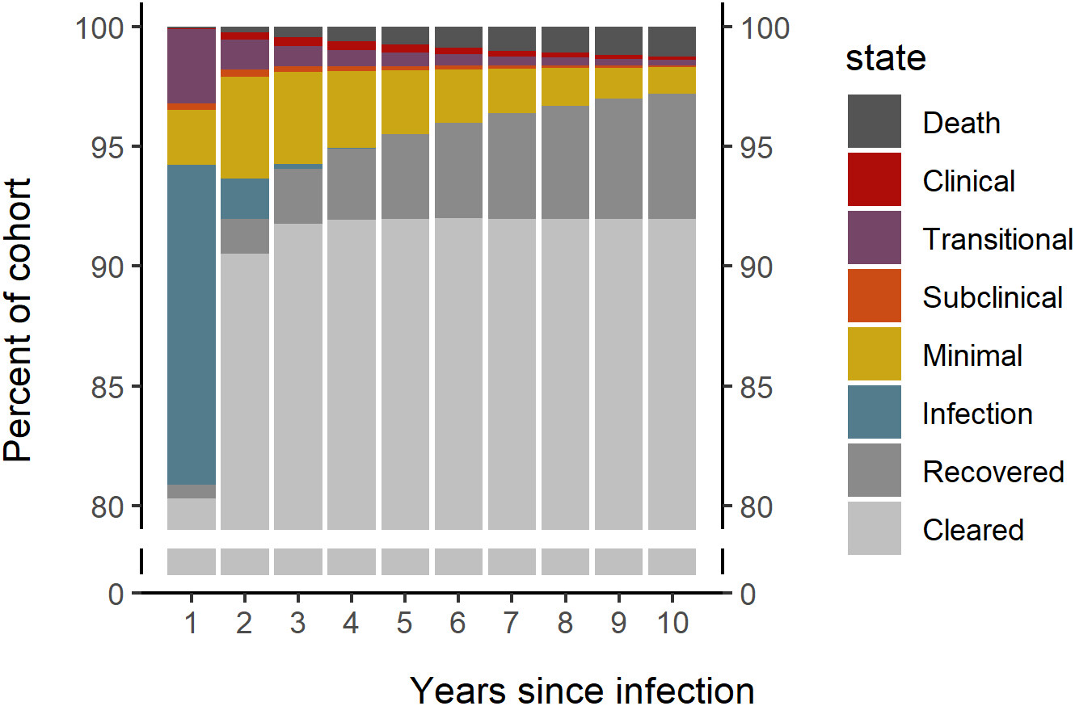
Methods: Self-clearance
Scenario Y20
Using proportion of infected cohort that self-clears or recovers at different time points to inform rates:
Scenario Y50
Data driven and in line with empirical estimates [Behr et al. BMJ 2019]
Year 1: 80.9% [80.1-81.7]
Year 2: 92.0% [91.4-92.5]
Year 10: 97.2% [96.9-97.5]
No data to inform proportion >10 years after infection, thus:
Year 10+: 98.5-99.5% (Assumption)
Horton et al. Proc Natl Acad Sci 2023
Notes:
Using a Bayesian approach, self-clearance rates were calibrated by tracking an infected cohort over time

Slide 17
Methods: Self-clearance
High self-clearance [Target at year 20]
Low self-clearance [Target at year 50]
MAIN ANALYSIS
Notes:
All transition rates were assigned uninformed uniform priors and posterior estimates were calculated using a sequential Markov chain Monte-Carlo algorithm
Due to the lack of robust data on the proportion after 10 years, we opted to assume a range of 98.5-99.5% to inform long-term self-clearance rates and calibrated under two different scenarios: one for year 20 and another for year 50.
The main analysis focused on the Y20 scenario, and results robustness were explored with the Y50 scenario.

Slide 18
Methods: Model structure
Deterministic ODE model tracking Mtb infection and self-clearance of infection
Parameters | Description
λ | Annual risk of infection (00-14, 15-44, and 45+)
γ | Self-clearance rate (according to time since infection)
κ | Infection year transitions (κ_{a} = 1, κ_{b} = 1, κ_{c} = 1/8)
π | Relative risk of reinfection [0.21; 95%CI: 0.14-0.30]
17
age groups
00-04, 05-09, …,
…, 75-79, 80+
Andrews et al. Clin Infect Dis 2012
Notes:
We developed a deterministic ordinary differential equation model tracking Mtb infection and self-clearance of infection across multiple five-year age groups

Slide 19
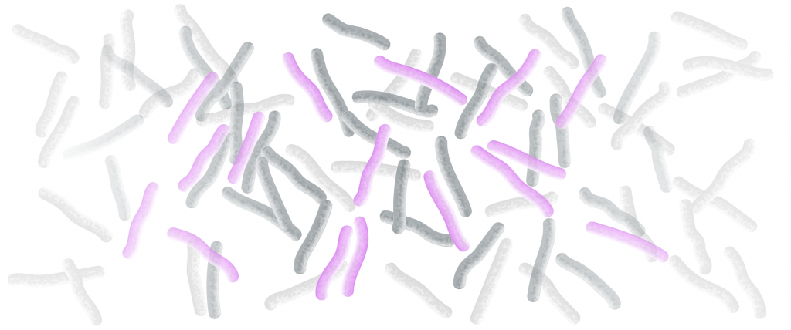
Results: Global burden estimates [2022]
2%
1.9%
Robust to assumptions of long-term self-clearance rates
[95%UI: 1.6-2.5]
[95%UI: 1.5-2.4]
of the global population has been recently (<2 years) infected with Mtb
148
million people
156
million people
[95%UI: 121-186]
Low self-clearance
[95%UI: 127-199]
Notes:
The results presented here are for 2022

Slide 20
Results: Global burden estimates
2%
387
million people
4.9%
Scenario Y20
1.9%
[95%UI: 1.6-2.5]
[95%UI: 4.4-5.6]
Robust to assumptions of long-term self-clearance rates
[95%UI: 1.5-2.4]
TOTAL INFECTIONS
[95%UI: 347-440]
depending on assumptions of long-term self-clearance rates
of the global population has been recently (<2 years) infected with Mtb
148
million people
156
million people
606
million people
7.7%
[95%UI: 121-186]
Scenario Y50
Low self-clearance
[95%UI: 6.9-8.5]
[95%UI: 127-199]
[95%UI: 549-670]

Slide 21
Results: Global burden estimates
387
million people
4.9%
High self-clearance
[95%UI: 4.4-5.6]
TOTAL INFECTIONS
[95%UI: 347-440]
depending on assumptions of long-term self-clearance rates
606
million people
7.7%
Low self-clearance
[95%UI: 6.9-8.5]
[95%UI: 549-670]
2%
1.9%
[95%UI: 1.6-2.5]
[95%UI: 1.5-2.4]
Robust to assumptions of long-term self-clearance rates
of the global population has been recently (<2 years) infected with Mtb
148
million people
156
million people
[95%UI: 121-186]
Low self-clearance
[95%UI: 127-199]

Slide 22
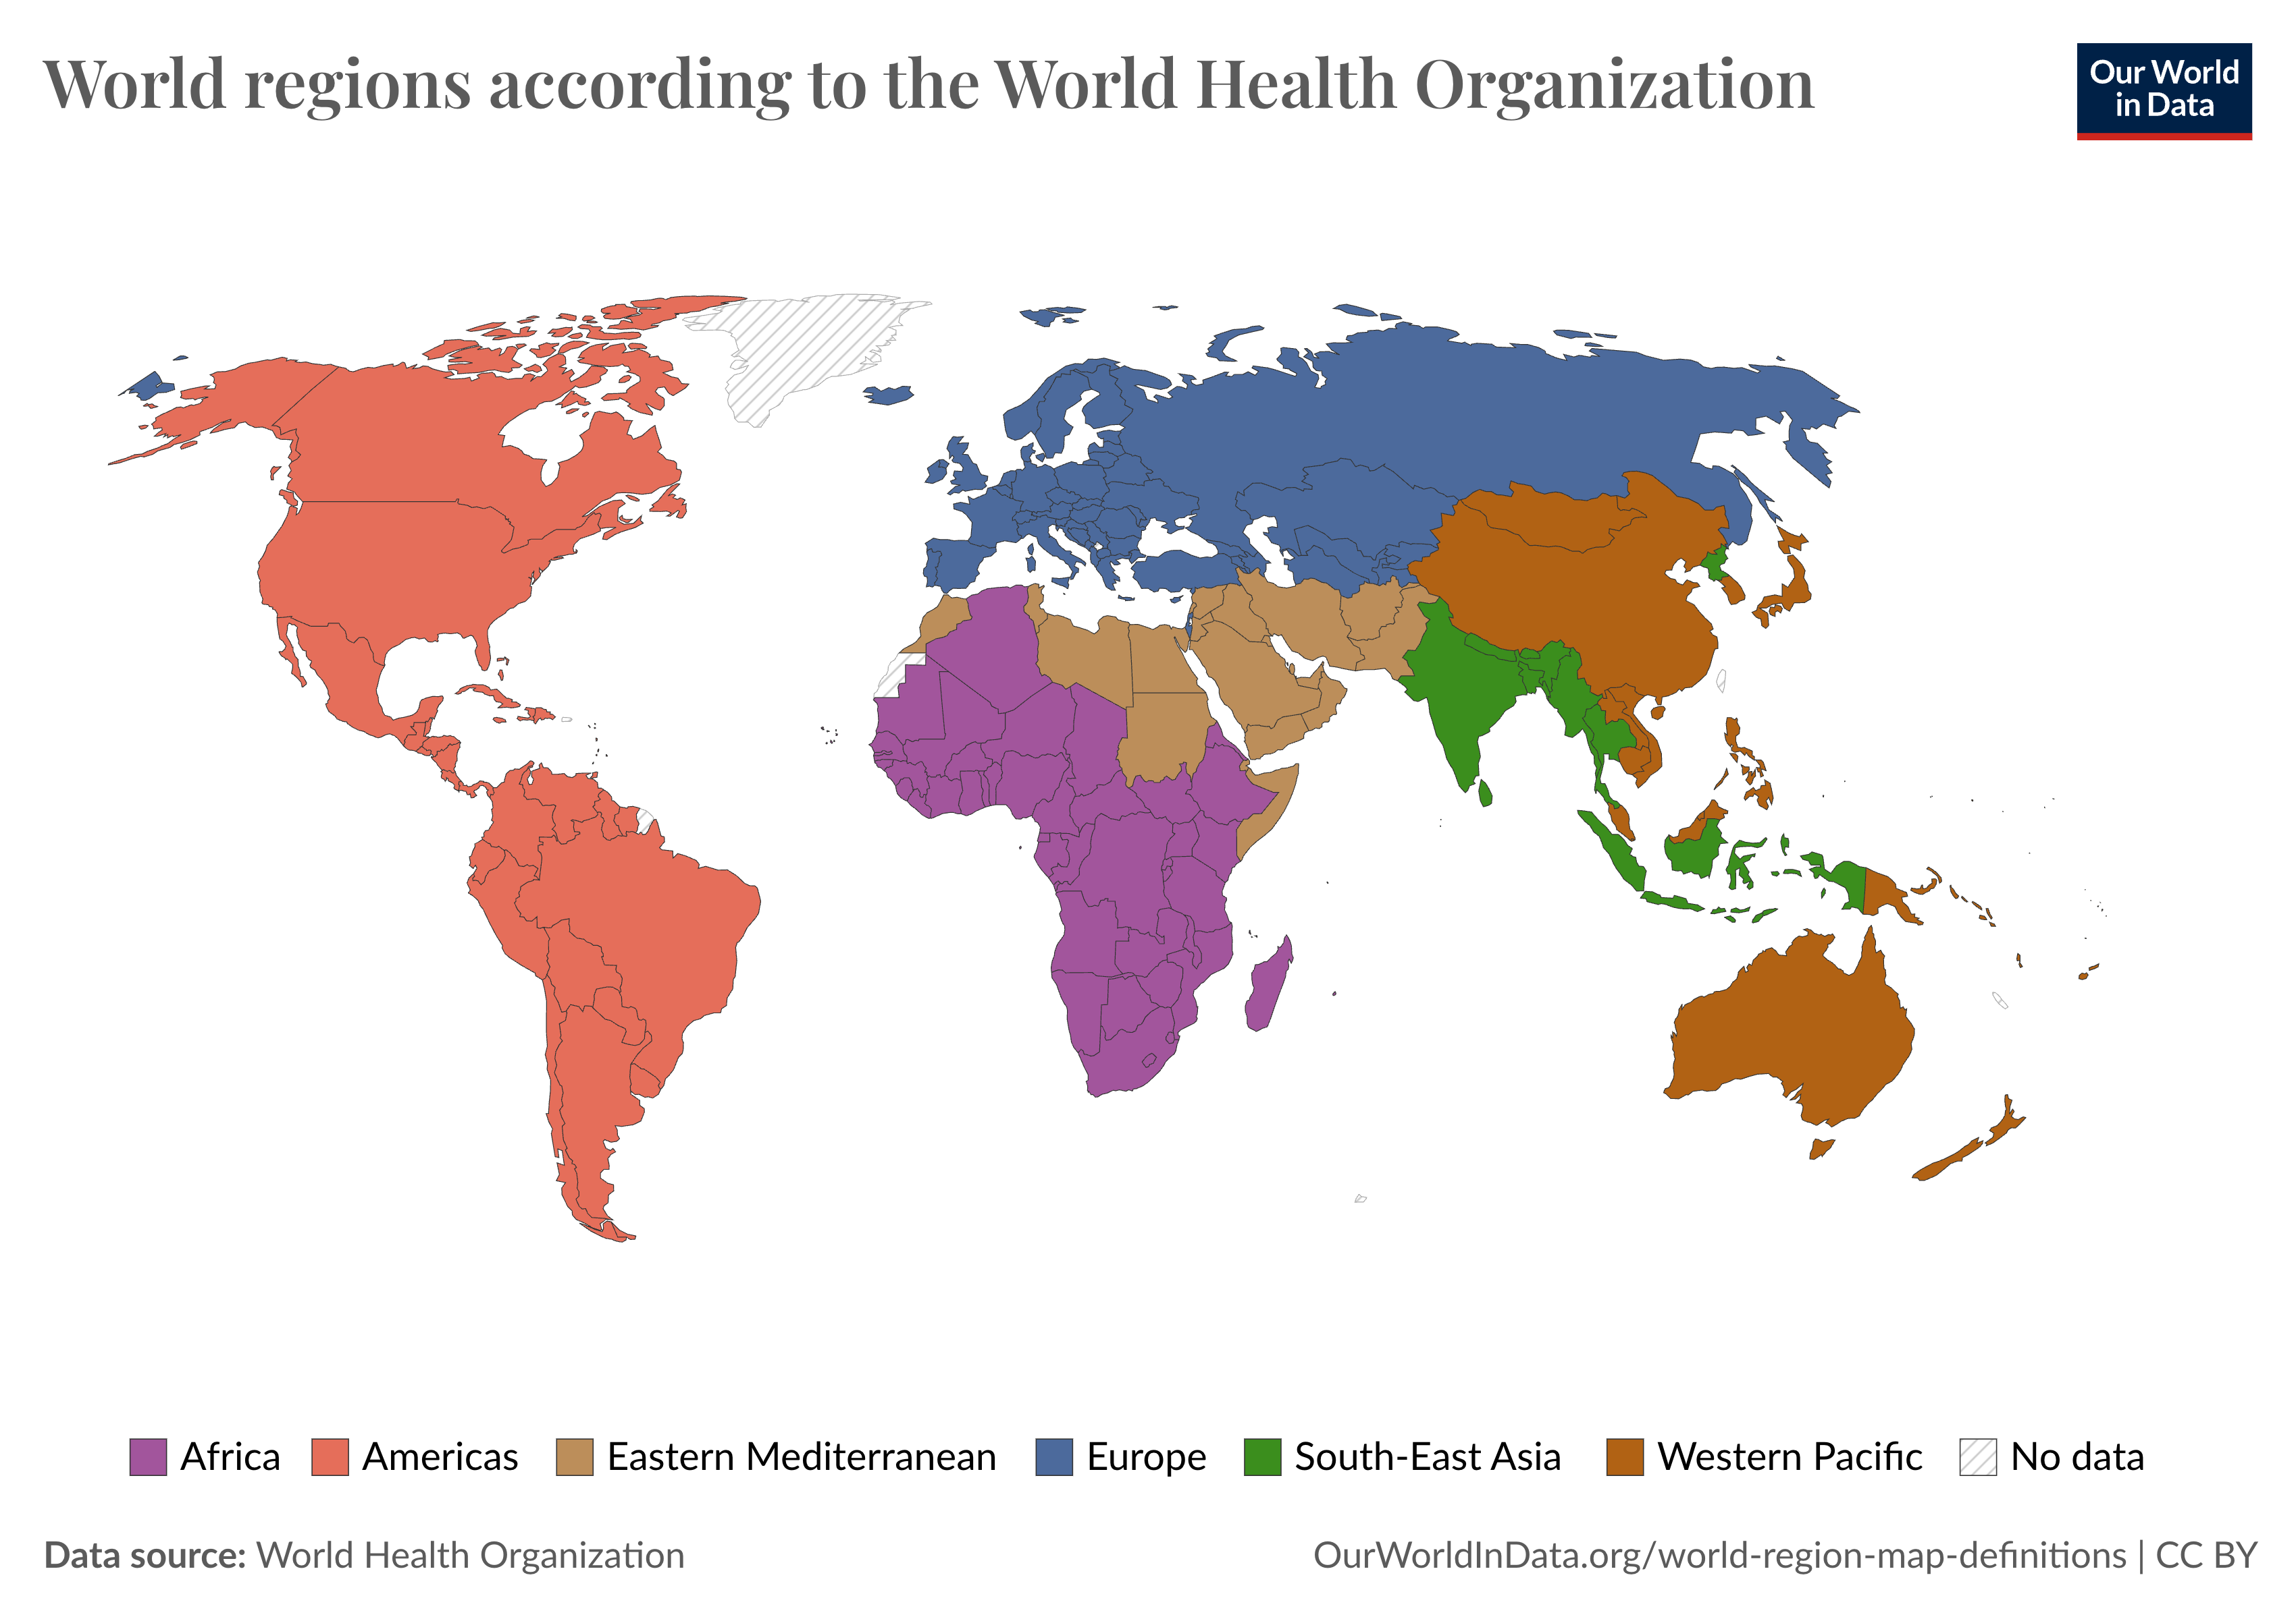
Results: Distribution of recent viable Mtb infection
3.4%
[2.4-4.7]
5.5%
[3.5-8.5]
3.4%
[2.5-4.8]
47.9%
[37.6-59.4]
13.7%
[10.3-17.5]
25.7%
[17.6-35.8]
Notes:
As with most things in TB there is heterogeneity in its distribution
South-East Asia Region (SEARO) SEE-ar-oh
Western Pacific Region (WPRO) WIP-roh
African Region (AFRO) AF-roh

Slide 23
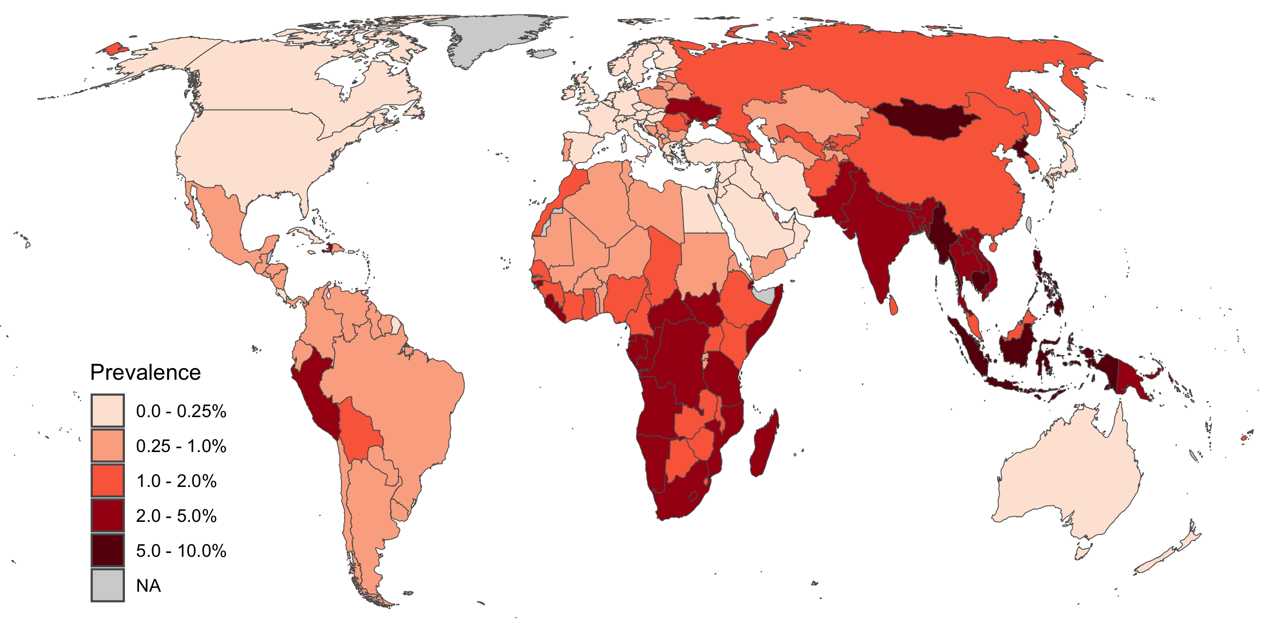
Results: Global burden of recent Mtb infection
Notes:
Global burden is primarily distributed within the Global South or non-high-income countries
AMRO: Peru mainly, and Bolivia, in South America; Haiti in Central America
EURO: Primarily Ukraine and Russia
AFRO: Many countries with a high burden, primarily in the south of the region
EMRO: Pakistan and Afghanistan
SEARO: Indonesia, India, Myanmar
WPR: Mongolia, Cambodia

Slide 24
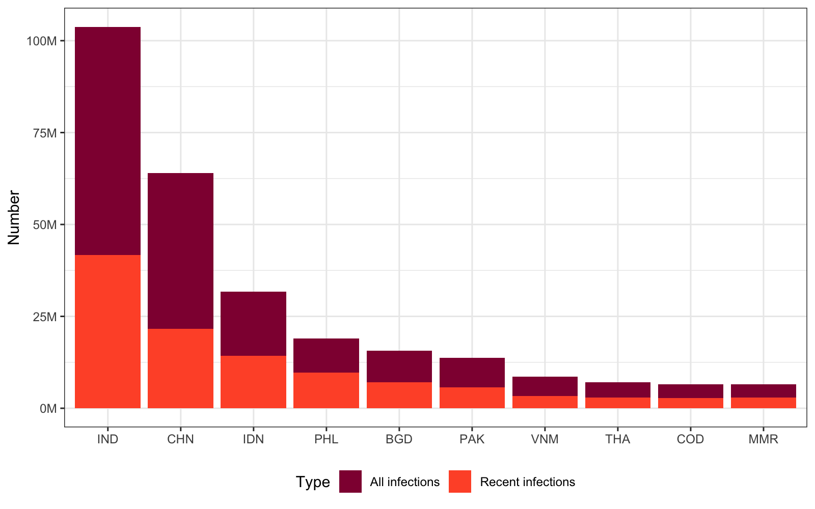
Results: Countries with highest Mtb infections
India, China, and Indonesia represent 50% of the global burden of recent infections
Notes:
Recently infected India 42 million, China 22 million, Indonesia 14 million, and the rest below 10 million
Philippines, Bangladesh, Pakistan, Vietnam, Thailand, Dem Republic of the Congo, Myanmar

Slide 25
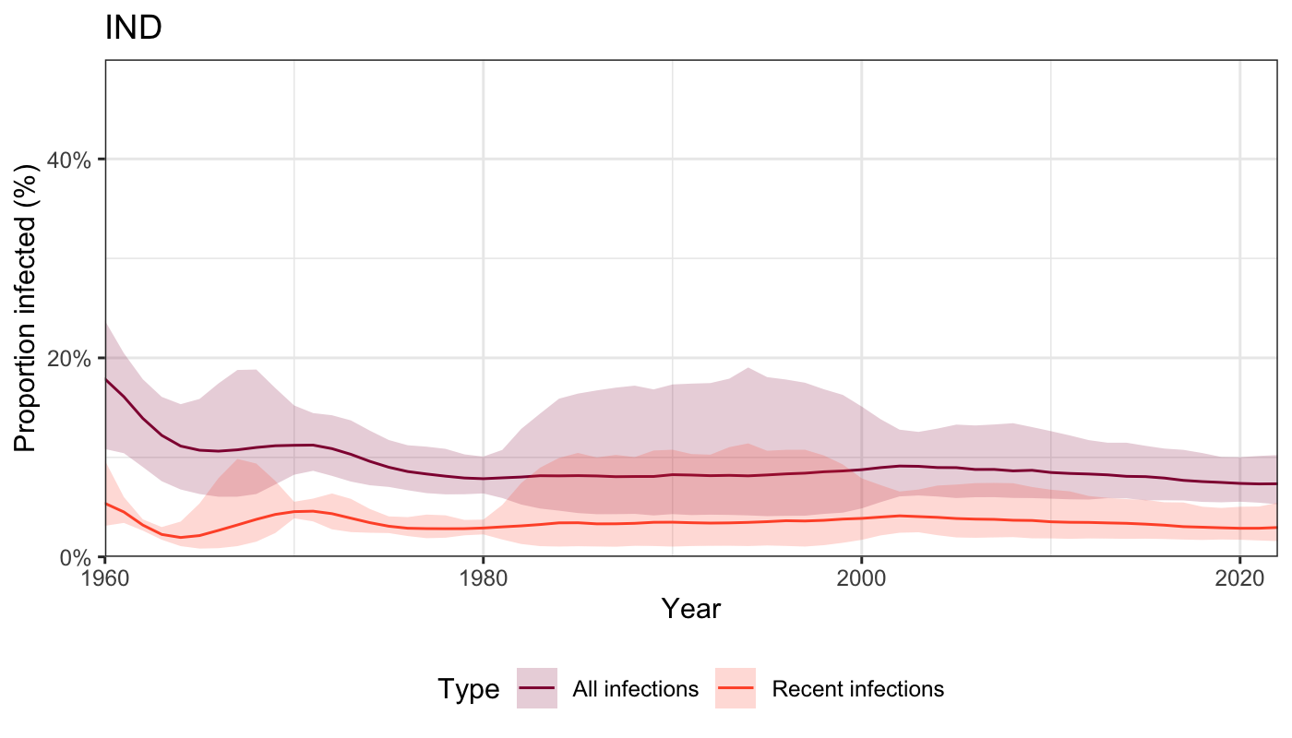
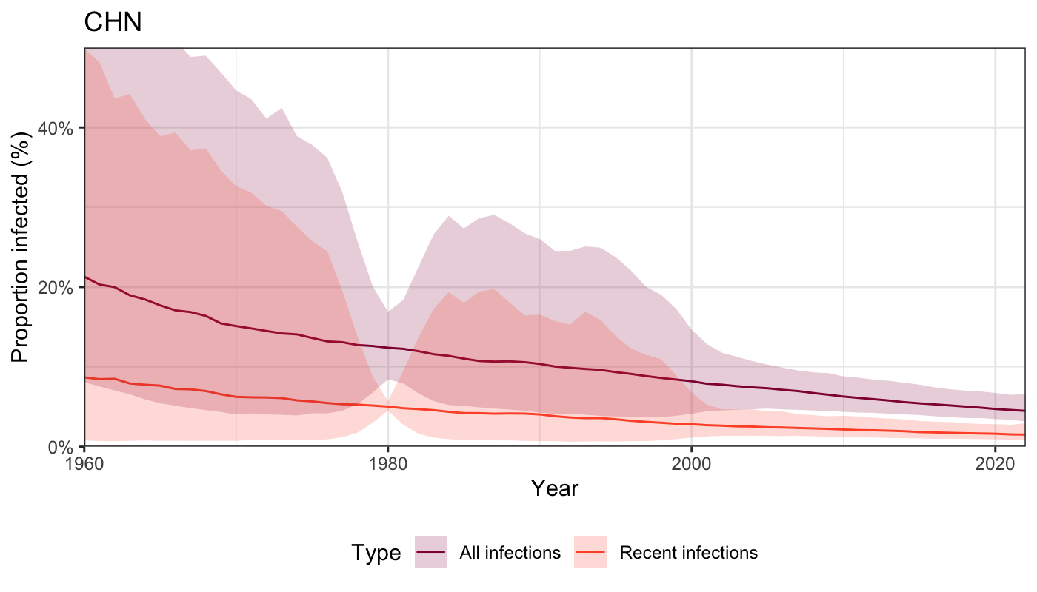
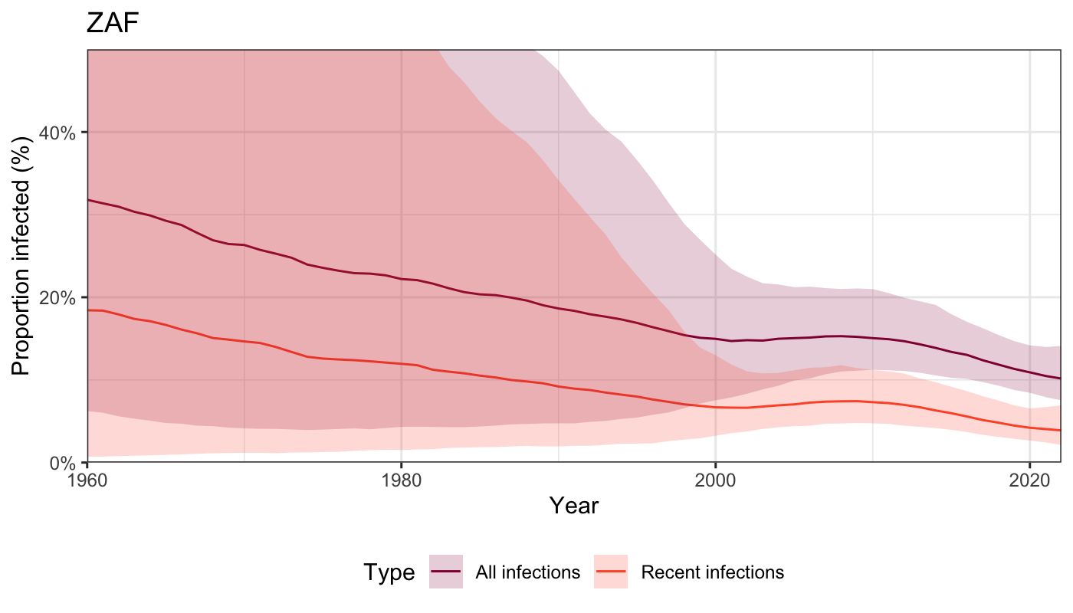
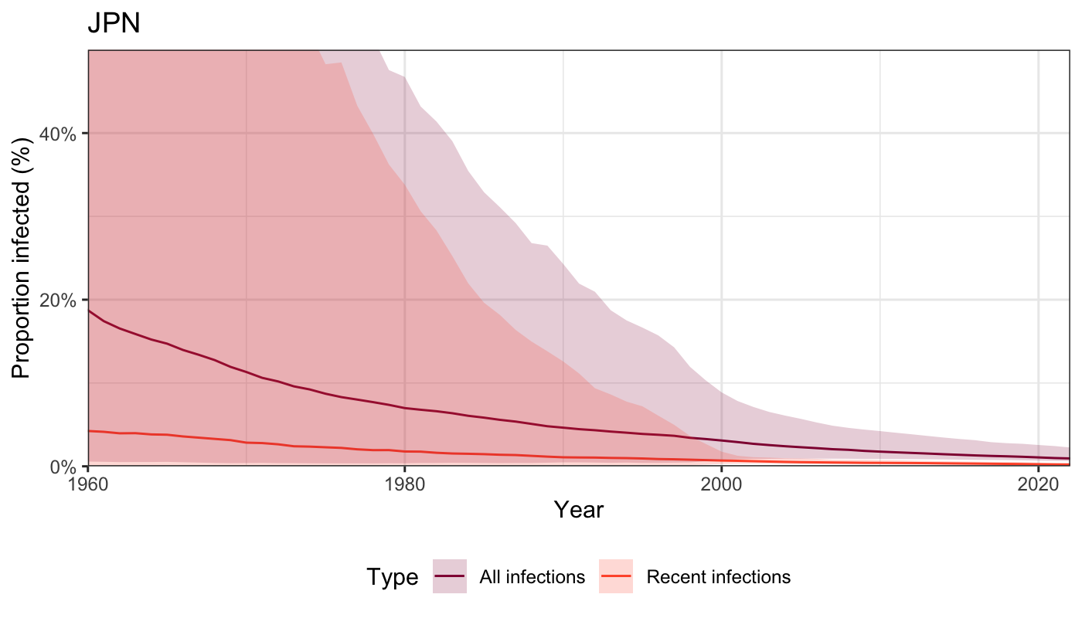
Results: Mtb infection prevalence trends
Notes:
Trends in India, China, South Africa, and Japan
Most trends follow a steady decline, that is parallel whether looking at recent vs total infections
Note the wide confidence intervals before the 2000s and how they are reduced as the GP regression uses data to recreate ARI trajectories

Slide 26
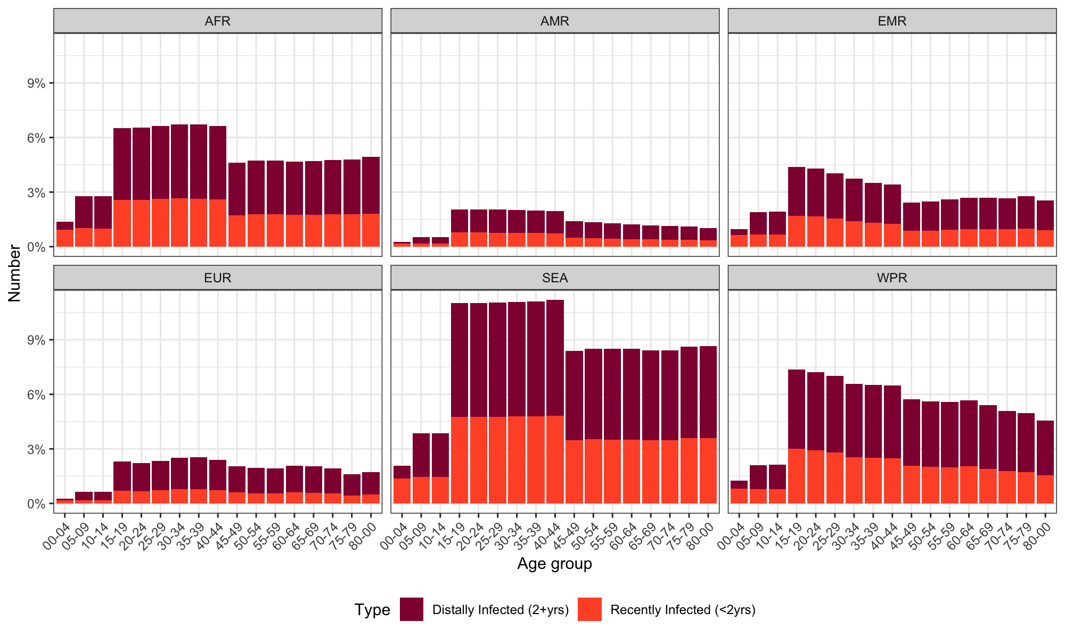
Results: Mtb infection per age groups
Of all recent infections
were in children
12%
18
million children
[95%UI: 15-22]
Notes:
Across all regions, higher estimates of infection are located in the adult population younger than 45 years old
This block-appearance is reflecting the ARI age groups
Contrast with "LTBI" which is usually monotonic with age
Of those recently infected, 11.5% (95%UI:10.5-12.3) were in children (<15 years), amounting to 18 million (95%UI:15-22)
While a high number of infections occurred, a sizeable number also self-cleared within the first two years.
Our model essentially measured the resulting prevalence of infections, rather than the substantial incidence of them.
This suggests a rapid turnover of the population at risk

Slide 27
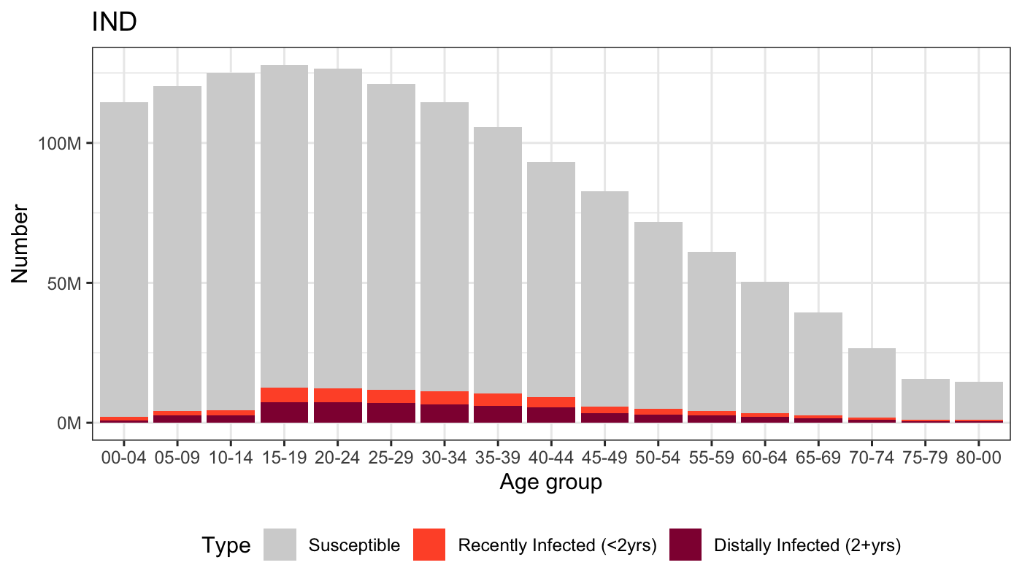
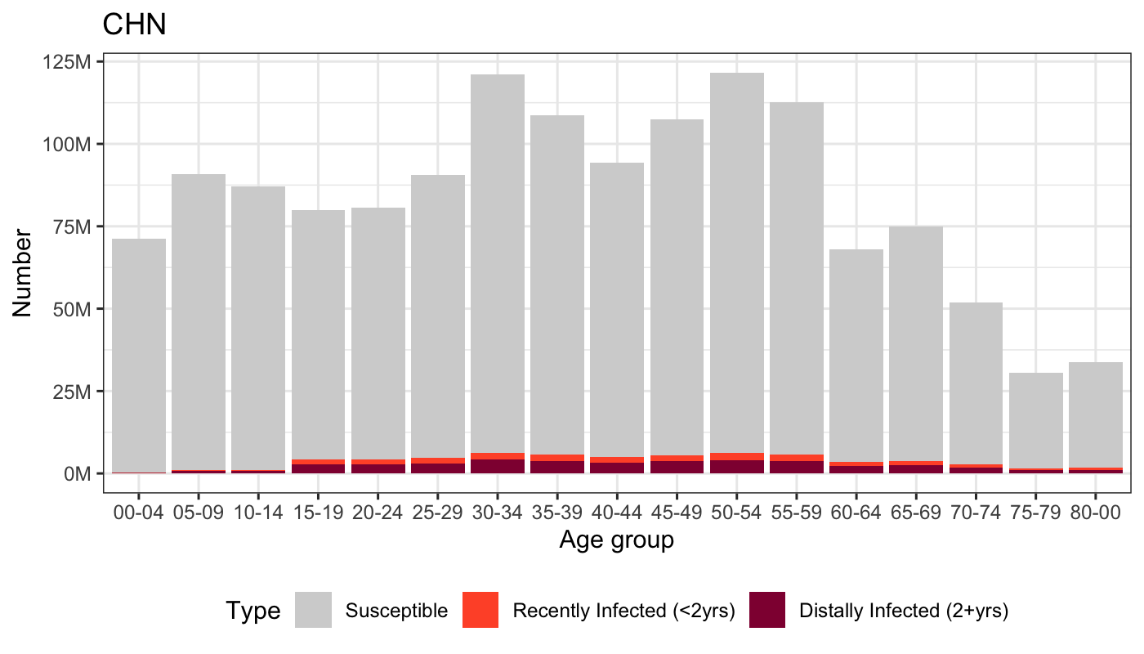
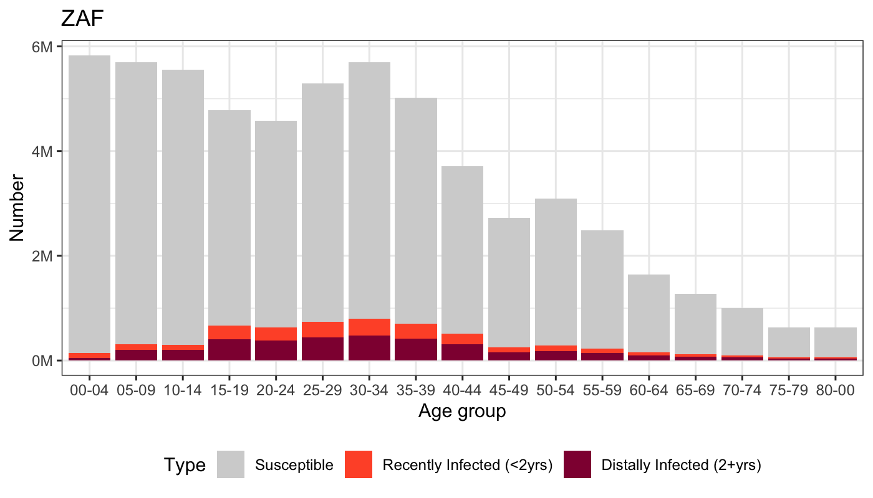
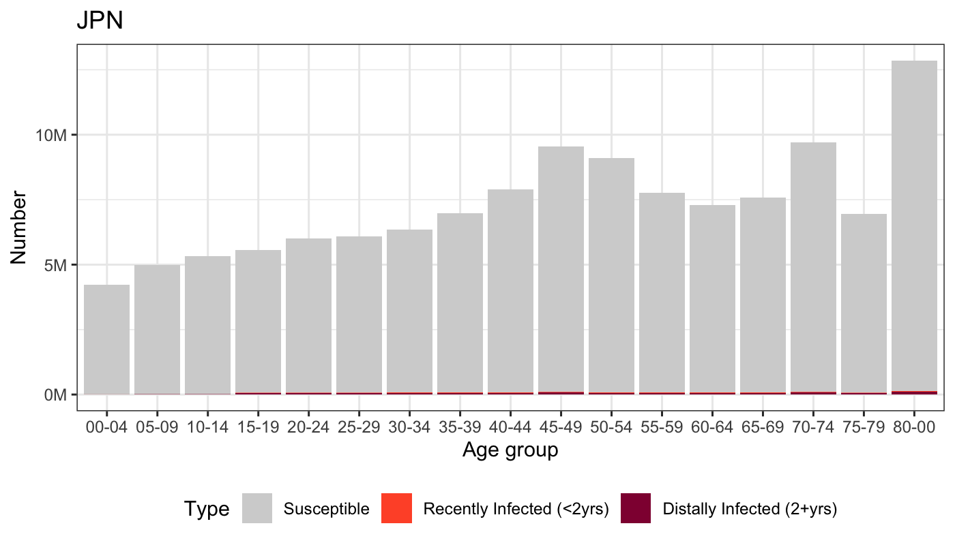
Results: Mtb infection per age groups
Notes:
Estimates in India, China, South Africa, and Japan
Unlike estimates of LTBI, there isn’t necessarily concentration of infections in the older age groups

Slide 28
Results: Scenario comparison
Metric | High self-clearance [Y20] | Low self-clearance [Y50]
Prevalence of recently infected in 2022 | 2.0% (1.6-2.5) | 1.9% (1.5-2.4)
Population recently infected in 2022 | 156 million (127-199) | 148 million (121-186)
Total prevalence in 2022 | 4.9% (4.4-5.6) | 7.7% (6.9-8.5)
Population infected in 2022 | 387 million (347-441) | 606 million (549-670)
Proportion recently infected | 40.4% (35.4-45.9) | 24.4% (20.3-29.7)

Slide 29
Conclusions
A substantial number of individuals are recently infected with viable Mtb (~156 million)
Thus, at high risk of progression to disease
We urgently need to develop diagnostic tools that can detect viable Mtb and identify who would stand to benefit from TPT

Slide 30
Acknowledgements
Co-authors:
Additional thanks to Tomos Prŷs-Jones, Marcel Behr, and
Dave Moore
Pete Dodd
Katherine Horton
Rein Houben

