Slide 1
Scaling existing diagnostics and treatment of tuberculosis disease and infection and estimating return on investment
TB MAC Seminar Series: July 18, 2024

Slide 2
Word of warning (or… what many of us know all too well)
When offered to work on a project by WHO, carefully reflect on how much you value your time and then come to terms with the fact that you will end up doing 4x more work than they are paying you for.
The work we are presenting today was done with (too little) WHO funding.
This “4 month” project… became 16.

Slide 3
Disclosures
I receive research funding from McGill University, the Canadian Institutes of Health Research, the National Sanitarium Association, the WHO, and the NIH.
I have received consulting fees from REDE-TB, WHO, and World Bank.
This work, as you know, was funded by WHO.

Slide 4
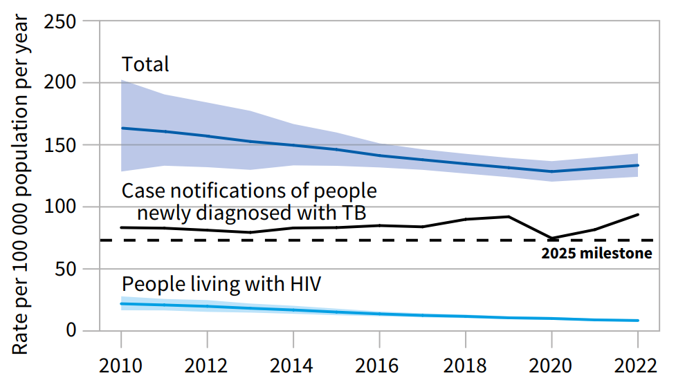
Background
Global tuberculosis incidence is falling slowly
To reach tuberculosis elimination by 2050, we need to reduce annual tuberculosis incidence globally by 30% each and every year.
We haven’t been much better than 1.5% reductions recently… if we could get back on that track, we would eliminate tuberculosis by the year 2500 (476 years).
Your eyes here
Now move your
eyes here
WHO TB Report, 2023.

Slide 5
Background
We need not wait for new technologies
Our armamentarium of diagnostics and treatments are not perfect – but better than we’ve ever had!
We have rapid PCR based diagnostics for TB disease (diagnosis in <2h)
We have mobile, digital x-ray units to support TB disease screening (on a van!)
  These can be combined with computer aided detection of abnormalities
We have MUCH shorter treatments for drug-resistant TB disease (now 6 months vs. 9-18 months), and short regimens for TB infection (1-3 months!)
Even if imperfect and even if they don’t ELIMINATE TB… using them could have a significant impact. But how much? And would we “get back?”

Slide 6
Objectives
The key question: How do we motivate countries to implement tools we know work?
We worked with the World Health Organization and four countries with distinct tuberculosis epidemiology to model the scale-up of current technologies for tuberculosis screening and preventive treatment and estimate:
Epidemiological impact
The return-on-investment

Slide 7
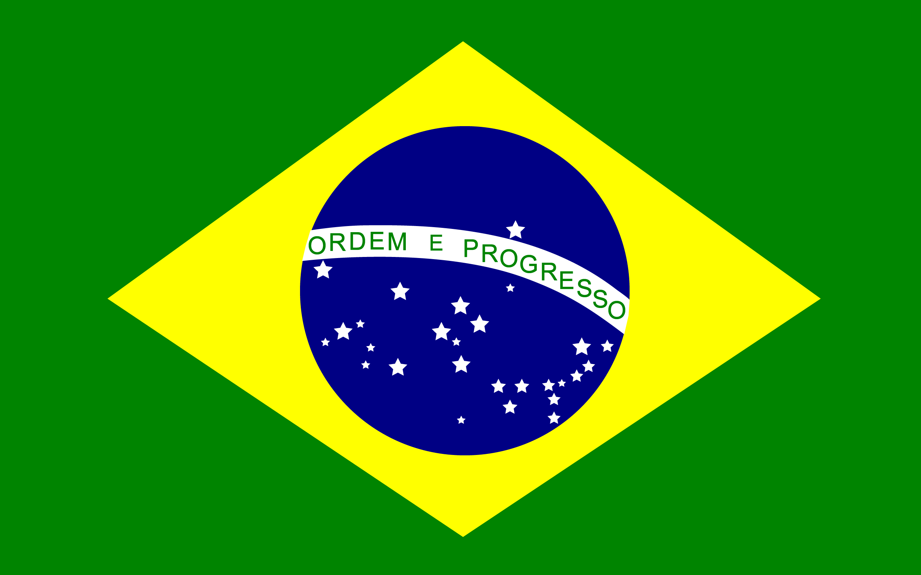



Methods
Participating countries and collaborative approach
Countries were approached for participation through WHO country offices
Agreed to volunteer their time and expertise.
Partnered with us to design interventions modeled, populations targeted, validate epidemiological and cost information, verify model calibration, and analyze and interpret results.

Slide 8
Methods
Country characteristics
 | Brazil | Georgia | Kenya | South Africa
Population (2022) | 203 million | 3.7 million | 54 million | 62 million
Estimated TB Incidence per 100,000 population | 49 (42-56) | 60 (48-73) | 237 (149-363) | 468 (304-665)
TB Notification Rate | 83% (72-98) | 68% (55-84) | 69% (45-110) | 77% (54-120)
TB Case Fatality Ratio | 11% (9-13) | 4% (3-5) | 22% (11-35) | 20% (9-34)
HIV-coinfection | 18% | 2.9% | 22.7% | 54.3%
Proportion Rifampicin-Resistant | 2.7% | 16.4% | 1% | 3.9%
TB Preventive Treatment Coverage | PLHIV: 30% HHC: 18% | PLHIV: 4% HHC: 19% | PLHIV: 32% HHC: 18% | PLHIV: 62% HHC: 6%

Slide 9
Methods
Populations targeted for tuberculosis screening & prevention
All countries prioritized people with HIV and household contacts of people with tuberculosis
  The “slam dunk” populations to target for screening and prevention: high-risk for tuberculosis infection and disease; benefits very clearly outweigh the risks at individual and population levels.
But who else? Not many “slam dunks” in tuberculosis…
We thought “high-risk” communities might be a good starting point. But who is high-risk? And would all countries agree?

Slide 10
Methods
High-Risk Communities
The WHO recommends active case finding when population tuberculosis prevalence is >1 in 200 people. This is commonly seen among people living in informal settlements…
  We tried to propose screening among informal settlements to all countries—not all were interested!
Brazil
People deprived of liberty
Population Size: 650,000
TB Prevalence: ~0.6%
Georgia
People accessing care for IDU
Population Size: = 17,500
TB Prevalence: ~0.9%
Kenya
Informal settlements in 9 cities
Population Size: 416,000
TB Prevalence: 0.7%
South Africa
The 22 highest prevalence subdistricts
Population Size: 1.1 million
TB Prevalence: ~1.9%

Slide 11
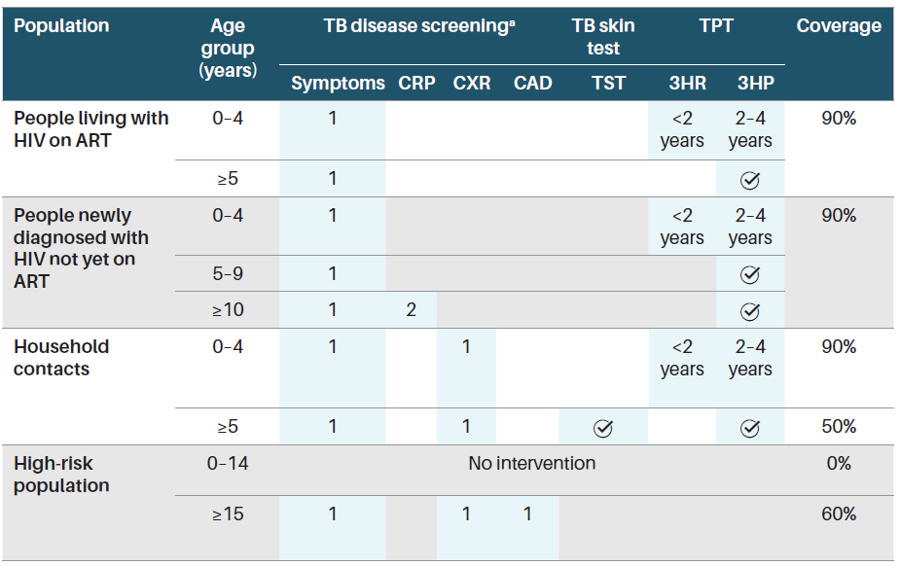
Methods
Strategies modeled
Strategies would replace those done by each country.
Would be scaled up linearly to reach target coverage levels from 2024 to 2030 and then kept at that level thereafter.
Except high-risk! We modeled 3 consecutive years of systematic screening for TB disease.
Notes:
Approx 0.3-1% of the population high-risk
Scale-up linearly from 2024-2050.

Slide 12
Modeling Methods
Modelling TB transmission
Reconstruct TB epidemics in specific settings by:
  Accurately capturing the natural history of TB disease
  Identifying and incorporating drivers of transmission (e.g, HIV, systems of care)
  Identifying the how the TB epidemic has been shaped by health systems in each setting (e.g, history of TB detection and treatment)
  Comparing simulations against data on TB burden, access to care high burden groups
  Estimate potential effect of interventions, like TB prevention screening and TPT
  Provide effectiveness outputs for CEA

Slide 13
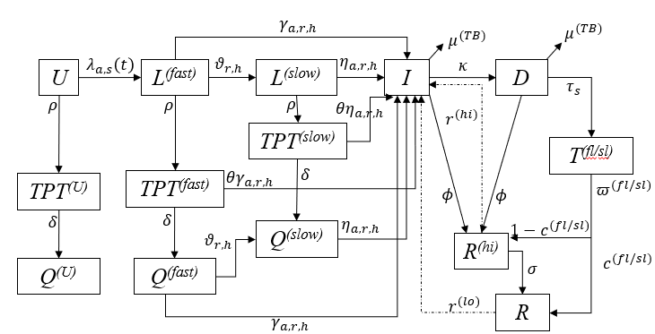
Modeling Methods
Model structure I
This structure expands on age, strain, risk, and HIV status!

Slide 14
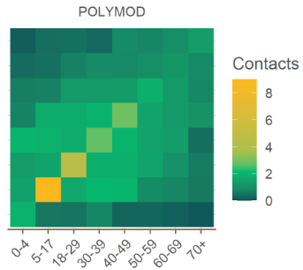
Modeling Methods
Model structure II
Age-specific contacts modelled using POLYMOD projected contact matrix
Age structure
Two-strain concomitant circulation
Two geographical risk categories
0 to 4
5 to 9
10 to 15
15+
DS
MDR
Prem K, et al. PLoS Comput Biol. 2017 Sep 12;13(9):e1005697..
Urban Slums
Others

Slide 15
Modeling Methods
Model structure III
HIV-
Undetected HIV+
PLHIV on ART
HIV acquisition rate is a time series as estimated by UNAIDS (not mechanistic)
Three HIV categories
TB Preventive Therapy
For those HIV+ newly enrolled on ART
For household contacts of index cases
Modelled dynamically as a function of the number newly treated for TB, using average household size

Slide 16
Modeling Methods
Data and model parameters
Introduce country specific algorithm performance
The natural history of disease is parametrized using widely available estimations of progression, reactivation and relative risks and mortality rates from the literature.
The cascade of care is modelled to reflect the performance of local algorithms
Similarly, baseline levels of TPT among PLHIV and HHC are modelled according to reported numbers on TPT by country
I
Diagnosis and treatment
probability
R
Tx
Treatment course duration and completion rates

Slide 17
Modeling Methods
COVID-19 disruptions
We examined incidence and mortality trends individually, and we found it was necessary to introduce disruptions for the case studies of Brazil and South Africa to reproduce the observed trends between 2019 and 2022.
We allow an extra free parameter for these two countries.
This parameter acts specifically by reducing testing capacity and treatment coverage during the pandemic period.
We assume that any disruptions during COVID-19 are resolved by 2023.

Slide 18
Modeling Methods
Calibrations: Brazil

Slide 19
Modeling Methods
Calibrations: Georgia

Slide 20
Modeling Methods
Calibrations: Kenya

Slide 21
Modeling Methods
Calibrations: South Africa

Slide 22
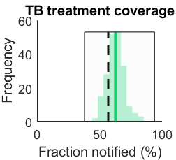
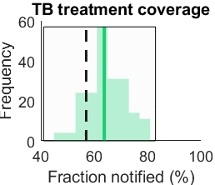
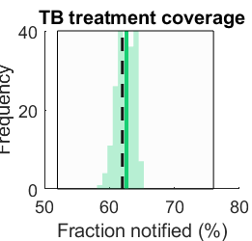
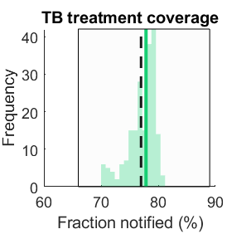
Modeling Methods
Calibrations: treatment coverage by country
Kenya South Africa Georgia Brazil

Slide 23
Modeling Methods
Modelling screening and prevention
HHC are captured by assuming a composition of the index case household (i.e., fraction U, Lf, Ls and I). PLHIV and high risk populations are directly targeted.
Screened population
U
Lf
Ls
I
TPT_{u}
TPT_{f}
TPT_{s}
R
Tx
Recruitment into TPT or Tx depends on the performance (i.e., sensitivity/specificity) of each simulated screening algorithm (e.g., 1-specificity of LTBI test for moving from U to TPT)
This exercise intends to assess the effect of screening and prevention, hence no improvements in the treatment cascade are assumed when projecting into the future (unless specified by each country)

Slide 24








Methods
Costing approach
Health System Costs (2023 $USD)
Worked closely with national TB programs and in country experts to estimate costs of TB to programs and those affected.
Considered as many health system costs as feasible while integrating costs of training and implementation (often ignored).
We use patient cost surveys to estimate the costs of tuberculosis to patients and families and crudely estimated lost productivity due to premature death as a cost equal to the per capita GDP for each year of life lost.
Hospitalizations
Medications
Outpatient care
Implementation
Tests and screening
Training
Societal Costs
All Health System Costs
Costs to patients and families
Costs of lost productivity due to premature death

Slide 25
Methods
Outcomes
From 2024 through 2050 (27 years) for status quo and intervention package we estimated:
  Tuberculosis incidence
  Tuberculosis mortality
  Years of life lost
  Health system costs
  Societal costs (i.e., costs to the health system, patients, and society; human capital approach)
  Disability adjusted life years
We calculate the RETURN ON INVESTMENT as the ratio of the SOCIETAL BENEFIT (i.e., averted societal costs) to the additional HEALTH SYSTEM costs associated with the interventions.
  In essence: for every additional dollar the health system must invest to scale-up tuberculosis screening and preventive treatment, what is returned in societal value?

Slide 26
Methods
Multiple ROI Estimations
ROI₁ used the cost to society = Lost productivity due to premature mortality only (“Original ROI”)
  One year of lost life has a value equivalent to country specific GDP in 2023 (USD)
ROI₂ used the cost to society = Lost value of health based on DALYs with WTP equal to 1xGDP (“Ambitious ROI”)
ROI₃ used the cost to society = Lost value of health based on DALYs with WTP equal to country specific thresholds based on revealed health opportunity costs (“Reasonable ROI”)
Brazil | Georgia | Kenya | South Africa
$8917 | $6628 | $2099 | $6777
Brazil | Georgia | Kenya | South Africa
$13,644 | $1603 | $1002 | $4834

Slide 27
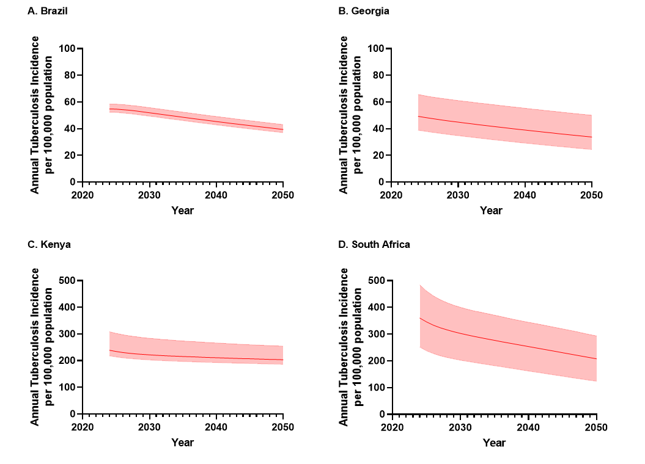
Results
Status Quo: Continued slow declines in tuberculosis incidence
1.2% annual decline
28% cumulative decline
1.4% annual decline
31% cumulative decline
0.6% annual decline
15% cumulative decline
2.0% annual decline
42% cumulative decline

Slide 28
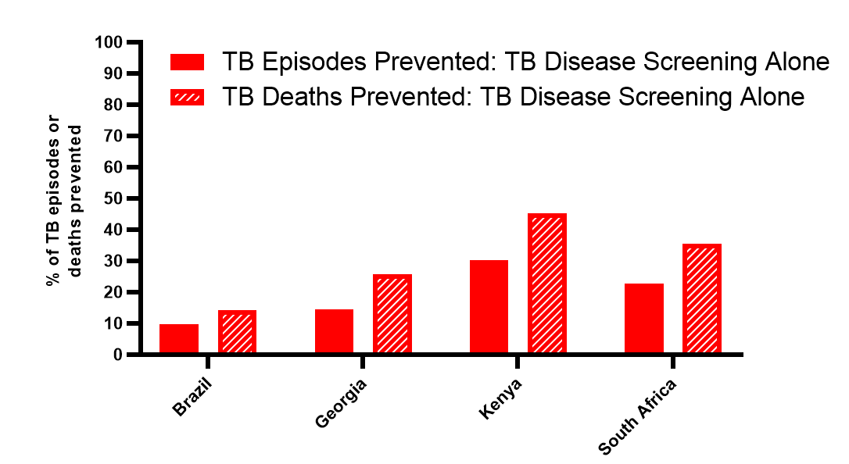
Results
Tuberculosis screening alone is highly valuable
Majority of impact due to screening in household contacts
In high HIV prevalence countries (South Africa, Kenya) – another large contributor is screening in people with HIV
Prevents millions years of life lost due to TB and can avert millions of dollars spent by patients and families during TB treatment
30%
15%
23%
10%

Slide 29
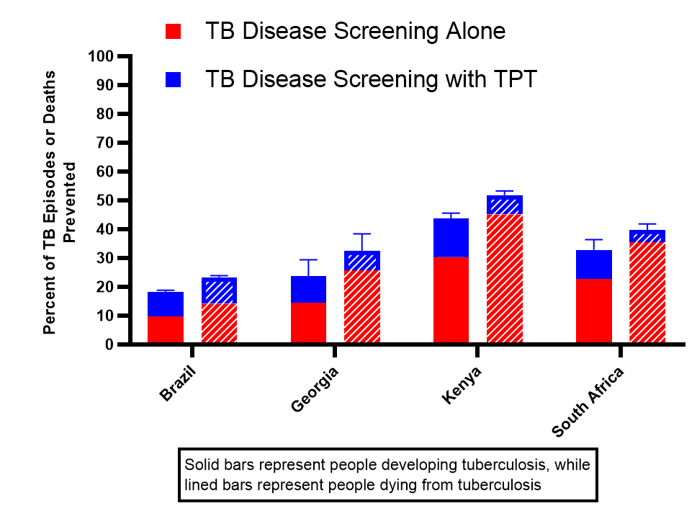
Results
Preventive treatment is impactful: even in high-incidence settings
Preventive treatment has a much larger impact on incidence than on mortality (benefits of TPT are seen over longer time horizons, TPT does not reach most vulnerable, i.e., people with HIV not on ART).
Impact of preventive treatment varies by setting, but remains highly impactful even in high-incidence settings.
Brazil = 90% increase in impact
Georgia = 65% increase
Kenya = 44% increase
South Africa = 45% increase
44%
33%
23%
19%

Slide 30
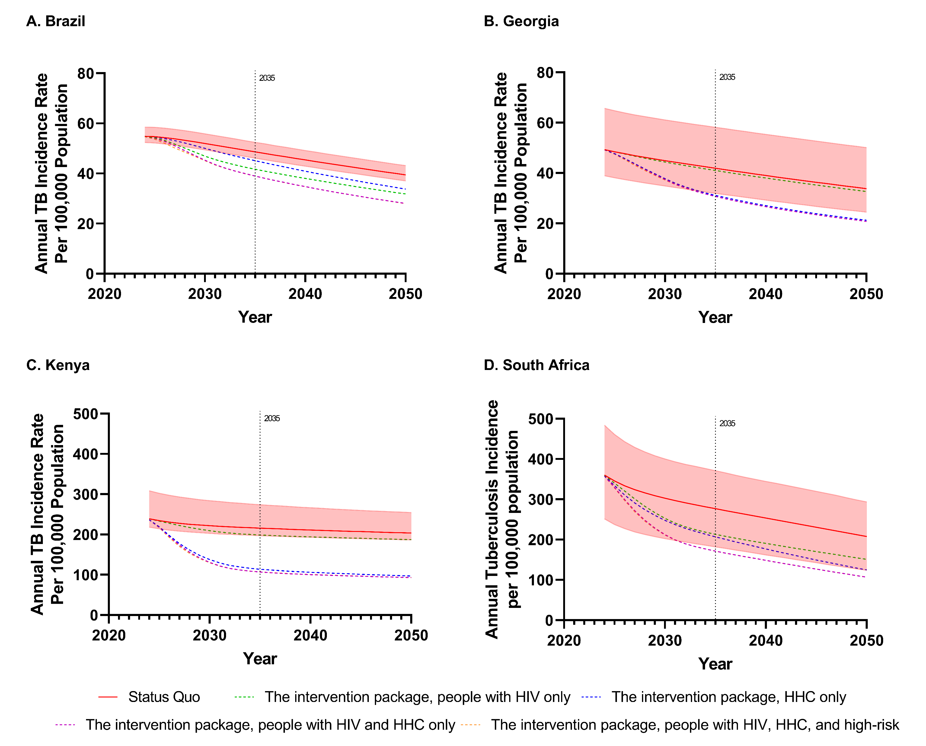
Results
Looking at it altogether

Slide 31
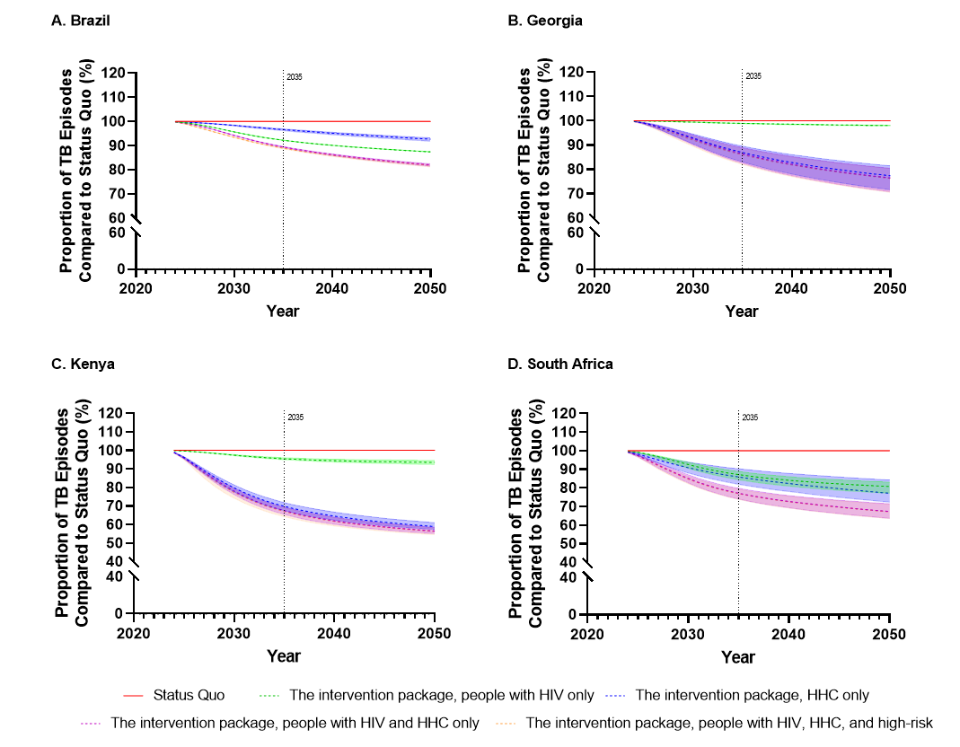
Results
And now on a relative scale…

Slide 32
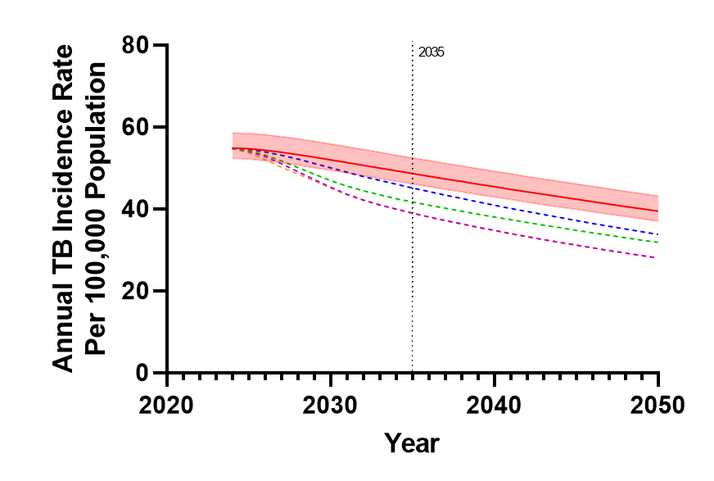
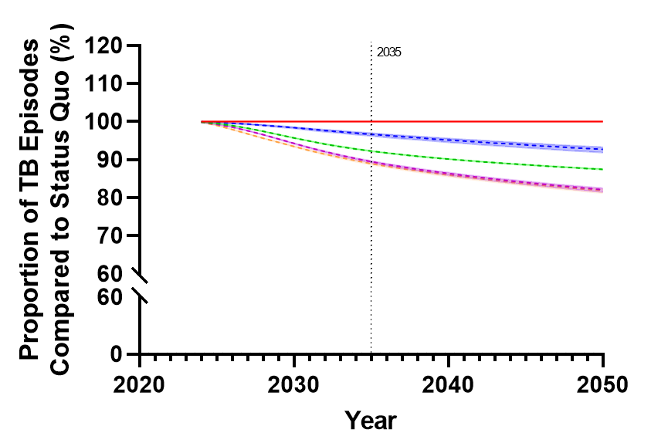
Results
A closer look at Brazil (example)

Slide 33
Results
Trade-offs of tuberculosis preventive treatment should be appreciated
TPT has consequences!
  Adverse events that are serious enough to stop treatment in 2-4%
  Patient costs associated with diagnosis and follow-ups during treatment
Impact of TPT is a function of TB infection prevalence
  Lower prevalence, more false positives
  Do the benefits outweigh the harms?
Outcome | Brazil | Georgia | Kenya | South Africa
Number of people to provide TPT to prevent 1 TB episode | 63 | 194 | 63 | 86
TPT courses provided from 2024-2050 | 14.4 million | 770,000 | 26.4 million | 37.4 million
Additional costs to patients and families associated with TPT | $430 million | $31 million | $150 million | $228 million

Slide 34
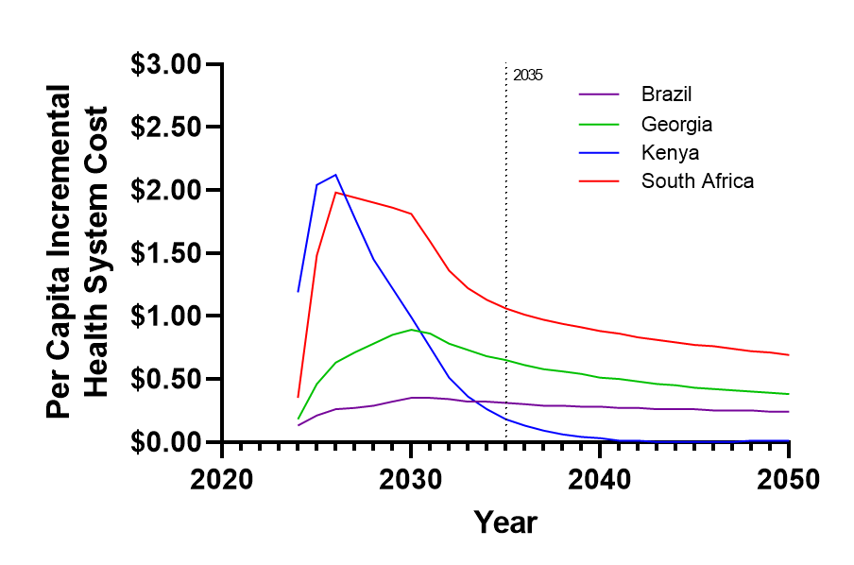
Results
Per capita health system investment is modest
Largest Annual Cost
(% of NTP Budget)
Brazil = $75 million (174%)
Georgia = $3.3 million (~25%)
Kenya = $114 million (170%)
South Africa = $119 million (83%)
Notes:
Important to remember though that these costs are often larger than the entire TB program budget!

Slide 35


Results
Substantial return-on-investment
Country | ‘Original’ ROI Estimate | ‘Ambitious’ ROI Estimate | ‘Reasonable’ ROI Estimate
Brazil* | 10.8 : 1 | 11.3 : 1 | 17.5 : 1
Georgia | 3.7 : 1 | 4.3 : 1 | 1.8 : 1
Kenya | 27.4 : 1 | 27.5 : 1 | 13.6 : 1
South Africa | 39 : 1 | 41.1 : 1 | 29.6 : 1
*Brazil is the only country where WTP based on health opportunity cost is greater than GDP.

Slide 36
Results
But, does it really speed up progress to elimination?
Somewhat! Will not eliminate tuberculosis in our lifetime… but still a big impact.
Brazil
Status Quo Annual Rate of Decline: 1.2%
New Annual Rate of Decline: 2.1%
Relative increase of 75%
Georgia
Status Quo Annual Rate of Decline: 1.4%
New Annual Rate of Decline: 3.9%
Relative increase of 446%
Kenya
Status Quo Annual Rate of Decline: 0.6%
New Annual Rate of Decline: 3.4%
Relative increase of 467%
South Africa
Status Quo Annual Rate of Decline: 2.0%
New Annual Rate of Decline: 5.3%
Relative increase of 165%

Slide 37
Results
Do we need to start today?
Findings insensitive to speed of scale-up
Fast Implementation: Scaled to target coverage by 2027
Slow Implementation: Scaled to target coverage by 2050
Outcome | Brazil | Georgia | Kenya | South Africa
Intervention Package with TPT vs. Status Quo (PRIMARY ANALYSIS)
Return on Investment | $10.80 | $3.70 | $27.40 | $39.00
Incremental Health System Cost per DALY averted | $771 | $1402 | $72 | $163
Incremental Societal Cost per DALY averted | Cost Saving | Cost Saving | Cost Saving | Cost Saving
Fast Implementation of Intervention Package with TPT vs. Status Quo
Return on Investment | $12.20 | $4.00 | $29.90 | $44.10
Incremental Health System Cost per DALY averted | $685 | $1292 | $66 | $144
Incremental Societal Cost per DALY averted | Cost Saving | Cost Saving | Cost Saving | Cost Saving
Slow Implementation of Intervention Package with TPT vs. Status Quo
Return on Investment | $7.80 | $2.90 | $22.20 | $34.10
Incremental Health System Cost per DALY averted | $1065 | $1768 | $89 | $187
Incremental Societal Cost per DALY averted | Cost Saving | Cost Saving | Cost Saving | Cost Saving

Slide 38
Conclusions
Investment case key findings
TB disease screening saves lives
The additional impact of TPT is substantial
Integrating TPT and TB screening led to the largest health and financial gains
TB screening and TPT reduce TB incidence in high-risk groups such as people with HIV and household contacts; uncertain impact of short-term active case finding
TB screening and TPT have significant impacts on national TB incidence: double the annual rate of decline!
TB disease screening and TPT are cost-effective or cost-saving
There is a substantial return on investing in TB screening and TPT

Slide 39


Acknowledgements
https://www.medrxiv.org/content/10.1101/2024.03.12.24303930v1.full
Modeling and Costing team
Juan Vesga (LSHTM)
Mona Salah (McGill University)
Monica Shandal (UCSC)
Elias Jabbour (McGill University)
Kevin Schwartzman (McGill University)
South Africa
Norbert Ndjeka (NTP)
Hlengani Mathema (NTP)
Yolisa Tsibolane (NTP)
Gesine Meyer-Rath (HERO, Wits)
Mmamapudi Kubjane (Wits, UCT)
Nkateko Mkhondo (WHO)
Brazil
Fernanda Dockhorn Cost (NTP)
Maiko Luis Tonini (NTP)
Daniele Maria Pelissari (NTP)
José Nildo de Barros Silva (NTP)
Luiy Henrique Arroyo (NTP)
Farley Liliana Romera Vega (NTP)
Danielle Gomes Dell’Orti (NTP)
Monica Rondon Cotacio (NTP)
Julio Croda (Federal University of MGS)
Jason Andrews (Stanford)
Anete Trajman (Federal University of Rio)
Pedro Avedillo (PAHO)
Nestor Vera Nieto (PAHO)
Kleydson Alves (WHO)
Georgia
Zaza Avaliani (National TB Center)
Nino Lomtadze (National TB Center)
Nelly Solomonia (National TB Center)
Irma Khonelidze (NCDC)
Maka Danelia (NCDC)
Elena Tudor (Moldova)
Nino Mamulahvili (WHO)
Andrei Dadu (WHO)
Kenya
Immaculate Kathure (NTLP)
Rhoda Pola (NTLP)
Aiban Ronoh (NTLP)
Wesley Tomno (NTLP)
Silan Kamuren (NTLP)
Simion Ndemo (NTLP)
SK Macharia (NTLP)
Auma Perez (NTLP)
Daniel Mwai (University of Nairobi)
Wesley Rothich (Health Economics)
Eunice Omesa (WHO)
WHO
Saskia den Boon
Matteo Zignol
Dennis Falzon
Cecily Miller
Ines Garcia Baena
Nimalan Arinaminpathy
Mathieu Bastard

