Slide 1
Model-based methods for estimating effects of COVID-19 on TB incidence and mortality
Nim Arinaminpathy, Imperial College London
TB-Mac seminar series, 27 April 2023

Slide 2
Outline
Evidence of disruptions to TB services
Model structure
Model calibrations
Modelling TB service disruptions
Concluding thoughts

Slide 3
Recent methods for TB burden estimation: incidence
Notification-to-incidence ratios
  For low-burden countries with good reporting: standard factor for under-detection and under-reporting
  For countries with inventory studies: measured ratio
  For countries without this and other data: expert-led assumptions for this ratio
For countries with recent prevalence surveys and slowly varying epidemics:
Incidence $≈$ $\frac{\text{Prevalence}}{\text{Average} \text{duration} \text{of} \text{untreated} \text{TB}}$
Assumptions based on evidence from pre-chemotherapy era
Evidence from prevalence surveys for proportion of prevalent TB on treatment
Notes:
Add proportions in each of these categories

Slide 4
Recent methods for TB burden estimation: mortality
Vital registration data and mortality surveys
  Through IHME estimates (adjusted for WHO envelope of total mortality)
  Or directly through recorded TB mortality
For countries where VR data is unavailable:
  Use case fatality rates for different categories (treated, untreated, also by HIV status) derived from systematic reviews
Notes:
Mention drug resistance is handled separately

Slide 5

Stop TB Partnership, April 2020

Slide 6
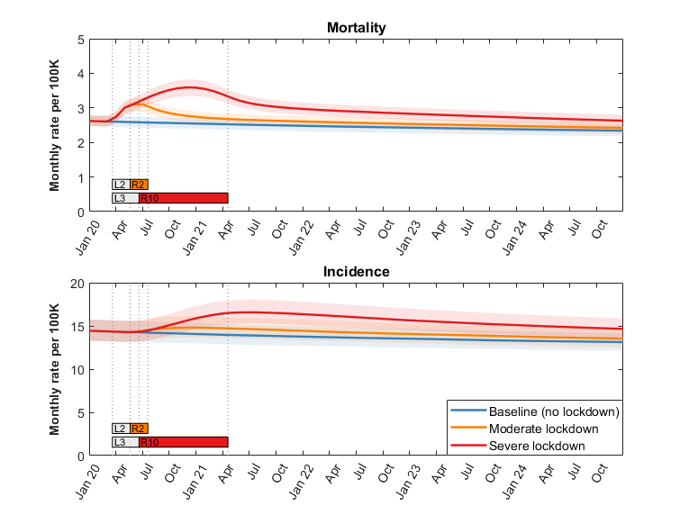


Understanding the
dynamics
Lucia Cilloni,
Han Fu…. et al
EclinicalMedicine (2020)
‘Long tail’ of incidence and mortality

Slide 7
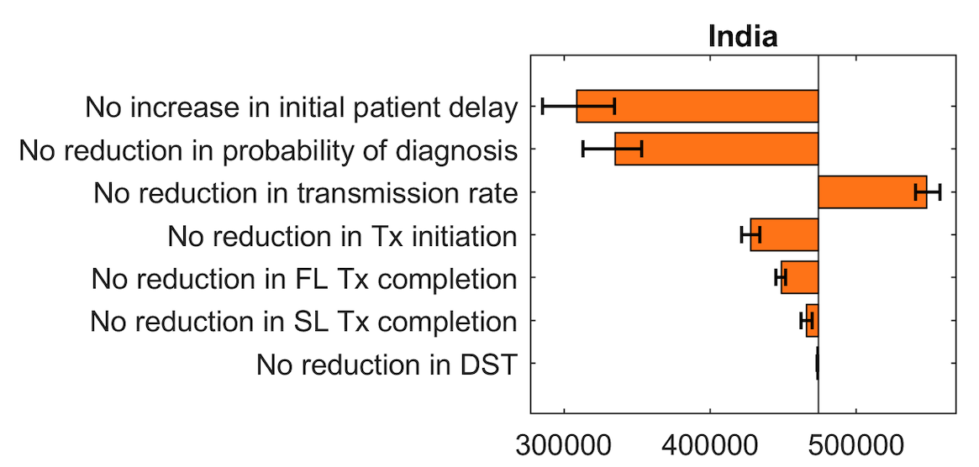
Sensitivity analysis to different disruptions
‘Leave-one-out’ analysis wrt excess incidence, 2020 - 2030
Most important disruptions appear to be those happening prior to treatment initiation…
…But also important uncertainties about how much TB transmission has been reduced

Slide 8
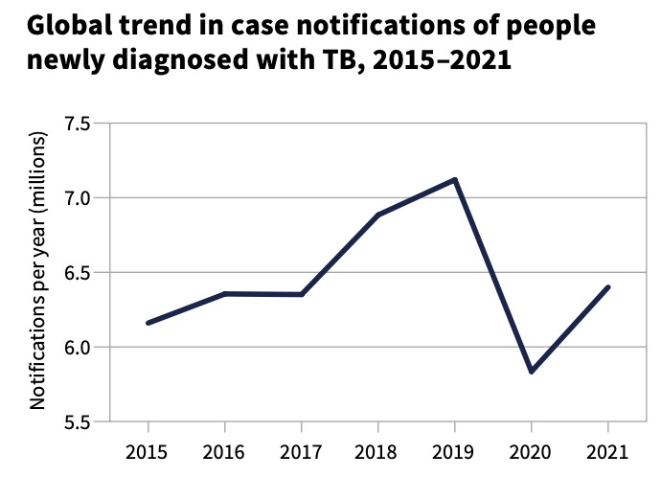
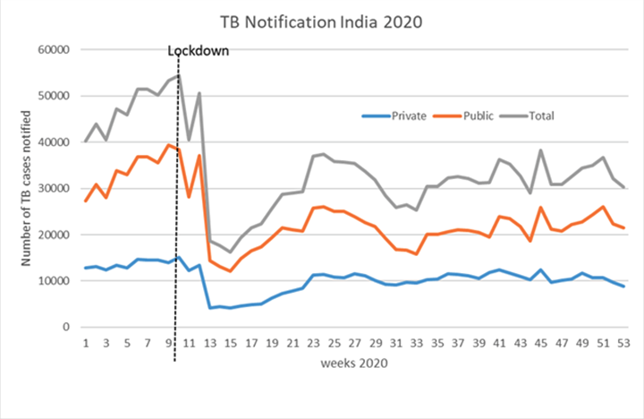
Major impacts on TB treatment during the COVID pandemic
18% drop relative to 2019
Global TB Report, 2022
Notes:
Explain that this is a problem, because so much of the TB response depends on timely treatment

Slide 9
Notifications as evidence of disruptions
Drops in notifications could arise from a range of different factors:
Symptomatic patients not being able to access care
Even once symptomatic patients present for care, healthcare facilities do not have capacity to diagnose/manage TB
  Diagnostic facilities are diverted to COVID
  Any available HR capacity is diverted to COVID
  Some primary care providers simply closed their facilities
Temporary decrease in TB burden
Programmatic delays in reporting TB

Slide 10
Notifications as evidence of disruptions
Drops in notifications could arise from a range of different factors:
Symptomatic patients not being able to access care
Even once symptomatic patients present for care, healthcare facilities do not have capacity to diagnose/manage TB
  Diagnostic facilities are diverted to COVID
  Any available HR capacity is diverted to COVID
  Some primary care providers simply closed their facilities
Temporary decrease in TB burden
Programmatic delays in reporting TB
Model delays to diagnosis and treatment initiation, to match notifications
Model lockdown-related reductions in transmission
[Likely to have resolved once reports stabilised]

Slide 11
Other possible effects of COVID-19 on TB
‘Direct’ effects: e.g. evidence from India, that co-disease with COVID-19 and TB carried substantially higher mortality risk than either disease alone
Other ‘indirect’ effects: possibility for disruptions in other parts of the care cascade than just diagnosis, e.g. treatment continuity or provision of DST
  No systematic data for these outcomes
  Previous analysis suggests that these types of disruptions may have only minor effects on TB incidence and mortality, compared to diagnosis (Cilloni et al, EClinicalMedicine 2020)
‘Distal’ effects acting on TB determinants, e.g. impoverishment

Slide 12
Other possible effects of COVID-19 on TB
‘Direct’ effects: e.g. evidence from India, that co-disease with COVID-19 and TB carried substantially higher mortality risk than either disease alone
Other ‘indirect’ effects: possibility for disruptions in other parts of the care cascade than just diagnosis, e.g. treatment continuity or provision of DST
  No systematic data for these outcomes
  Previous analysis suggests that these types of disruptions may have only minor effects on TB incidence and mortality, compared to diagnosis (Cilloni et al, EClinicalMedicine 2020)
‘Distal’ effects acting on TB determinants, e.g. impoverishment
Not modelled

Slide 13
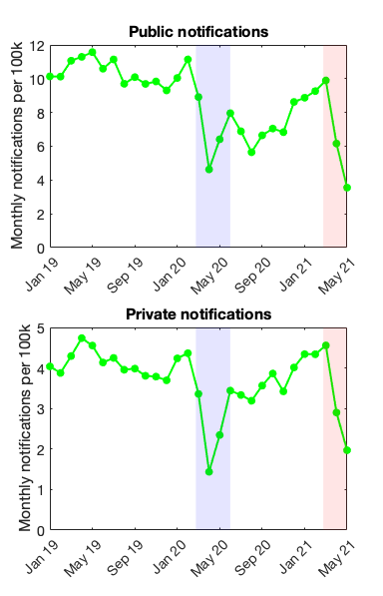

The overall approach
National
lockdown
Second
wave
$$λ$$
Latent, ‘fast’ progression
Latent, ‘slow’ progression
Uninfected
Breakdown
Reactivation
Active, infectious disease
Recovered
On TB treatment
Diagnosis and treatment initiation rate
COVID-19-related
disruptions

Slide 14
The overall approach
Concentrated on 28 countries that accounted for 95% of drop in global TB notifications from Jan 2020 – Dec 2021 inclusive
  Regional aggregations used for countries that had large large reductions without making substantive global contribution
Models accounting for public/private sectors and HIV status
  But not by drug resistance status (see last talk by Pete Dodd)
Not including separate disruptions by HIV status, nor by public/private sectors
  Except for India, where stratified data available
Not distinguishing disruptions for:
  Males vs females (see McQuaid et al, BMC Medicine 2022)
  Children vs adults (see Ranasinghe et al, Lancet Global Health 2022)
For 2022 report: not providing projections for future years, only ‘nowcasting’

Slide 15
Model structure and calibration to pre-COVID data

Slide 16




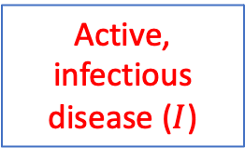






Model structure
$$λ$$
Latent, “fast” progression
$$w$$
Latent, “slow” progression
Uninfected
$$u$$
$$v$$
$$ρ$$
Active, infectious disease ($I$)
$$μ_{TB}$$
On TB treatment, public sector
$$τ$$
Also including:
Exogenous reinfection
Relapse
Population turnover
Self-cure
$$k\left(t\right)d_{pu}$$
Recovered
On TB treatment, private sector
$$τ$$
$$k\left(t\right)d_{pr}$$

Slide 17






Model structure
HIV ‘layers’
$$λ$$
Latent, “fast” progression
$$w$$
Latent, “slow” progression
Latent, “fast” progression
Latent, “slow” progression
Uninfected
Latent, “fast” progression
Latent, “slow” progression
HIV -ve
$$u^{\left(h\right)}$$
$$v^{\left(h\right)}$$
$$ρ^{\left(h\right)}$$
Active, infectious disease ($I$)
Active, infectious disease ($I$)
Active, infectious disease ($I$)
$$μ_{TB}^{\left(h\right)}$$
On TB treatment, public sector
HIV +ve,
untreated
On TB treatment, public sector
On TB treatment, public sector
$$τ$$
$$k\left(t\right)d_{pu}$$
Recovered
Recovered
Recovered
On TB treatment, public sector
On TB treatment, public sector
On TB treatment, private sector
On ART
$$τ$$
$$k\left(t\right)d_{pr}$$

Slide 18
Public/private sectors
Structure used for countries identified as ‘PPM priority’ countries by WHO
In working with notification data, need to account for under-reporting by private healthcare providers
Notification data typically isn’t available separately for the private sector:
Assume that disruptions affected public and private sectors equally
Exception: India, whose Nikshay data shows public and private separately
  See separate modelling exercise by India NTEP
‘Private’ reflects only ‘engaged private’: Assume that disruptions apply to all private providers equally

Slide 19
HIV/TB coinfection
Structure used for countries for which >10% of incident TB is estimated to be HIV coinfected
Dynamics of HIV not explicitly modelled
  Taken as external input
Transitions between strata informed by Thembisa model estimates for:
  HIV incidence and prevalence; and ART coverage
HIV confers increased risk of progression to active disease from all latent compartments; ART reduces this risk

Slide 20
Country groupings
HIV/TB | Public/private | HIV/TB and public/private | Neither HIV/TB nor public/private
Brazil Colombia Lesotho Papua New Guinea Zimbabwe | Angola Bangladesh Cambodia China India Indonesia Nepal Pakistan Philippines Myanmar Viet Nam | Kenya South Africa Thailand | Azerbaijan DPR Korea Ethiopia Kazakhstan Kyrgyzstan Malaysia Mexico Mongolia* Peru Romania Russian Federation Timor Leste*

Slide 21
Model calibrations: targets and parameters
 | All models | Public/private countries | HIV/TB countries
Calibration targets | Pre-COVID incidence rates Pre-COVID mortality rates (WHO estimated) | Private notifications where available (India, soon also Philippines and Indonesia) | Proportion of TB incidence that was HIV-coinfected, 2019 Mortality rates amongst HIV +ve TB, 2019
Free parameters | Average onward infections per case per year Mortality hazard, untreated TB | Upon careseeking, proportion of patients visiting public vs private sector | Relative hazard of developing TB given latent infection, HIV +ve vs HIV –ve Relative hazard of mortality for untreated TB, HIV +ve vs HIV –ve

Slide 22
How calibrations were performed
Bayesian MCMC to systematically propagate uncertainty from input parameters to model projections
For each country: 3 independent MCMC chains to ensure convergence
Ran for 100,000 iterations, then ‘thinned’ to extract 250 samples
Uncertainty intervals on model projections quantified as 2.5th, 50th and 97.5th percentiles
See additional info for further outputs on calibration results

Slide 23
Modelling disruptions

Slide 24
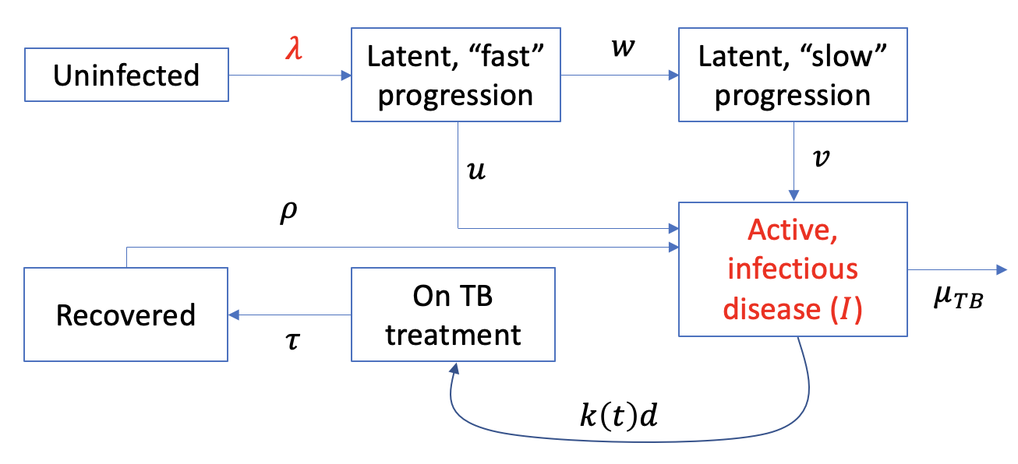
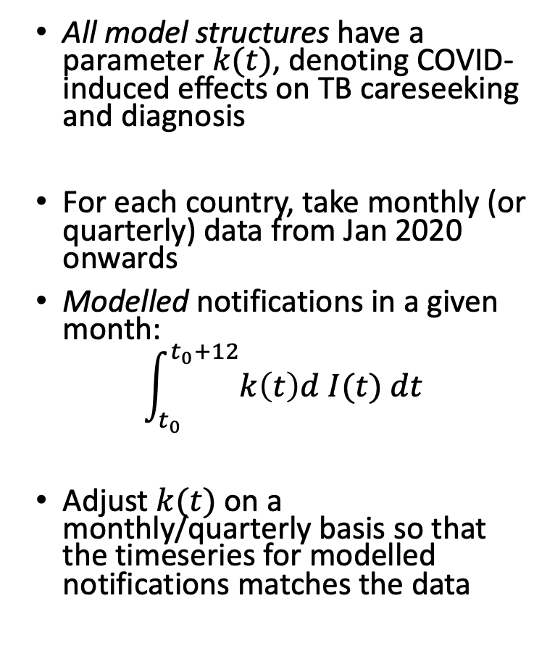

Modelling disruptions
All model structures have a parameter $k(t)$, denoting COVID-induced effects on TB careseeking and diagnosis
For each country, take monthly (or quarterly) data from Jan 2020 onwards
Modelled notifications in a given month:
$$\int_{t_{0}}^{t_{0}+12}{k\left(t\right)d I(t) dt}$$
Adjust $k(t)$ on a monthly/quarterly basis so that the timeseries for modelled notifications matches the data
$$λ∝I$$

Slide 25
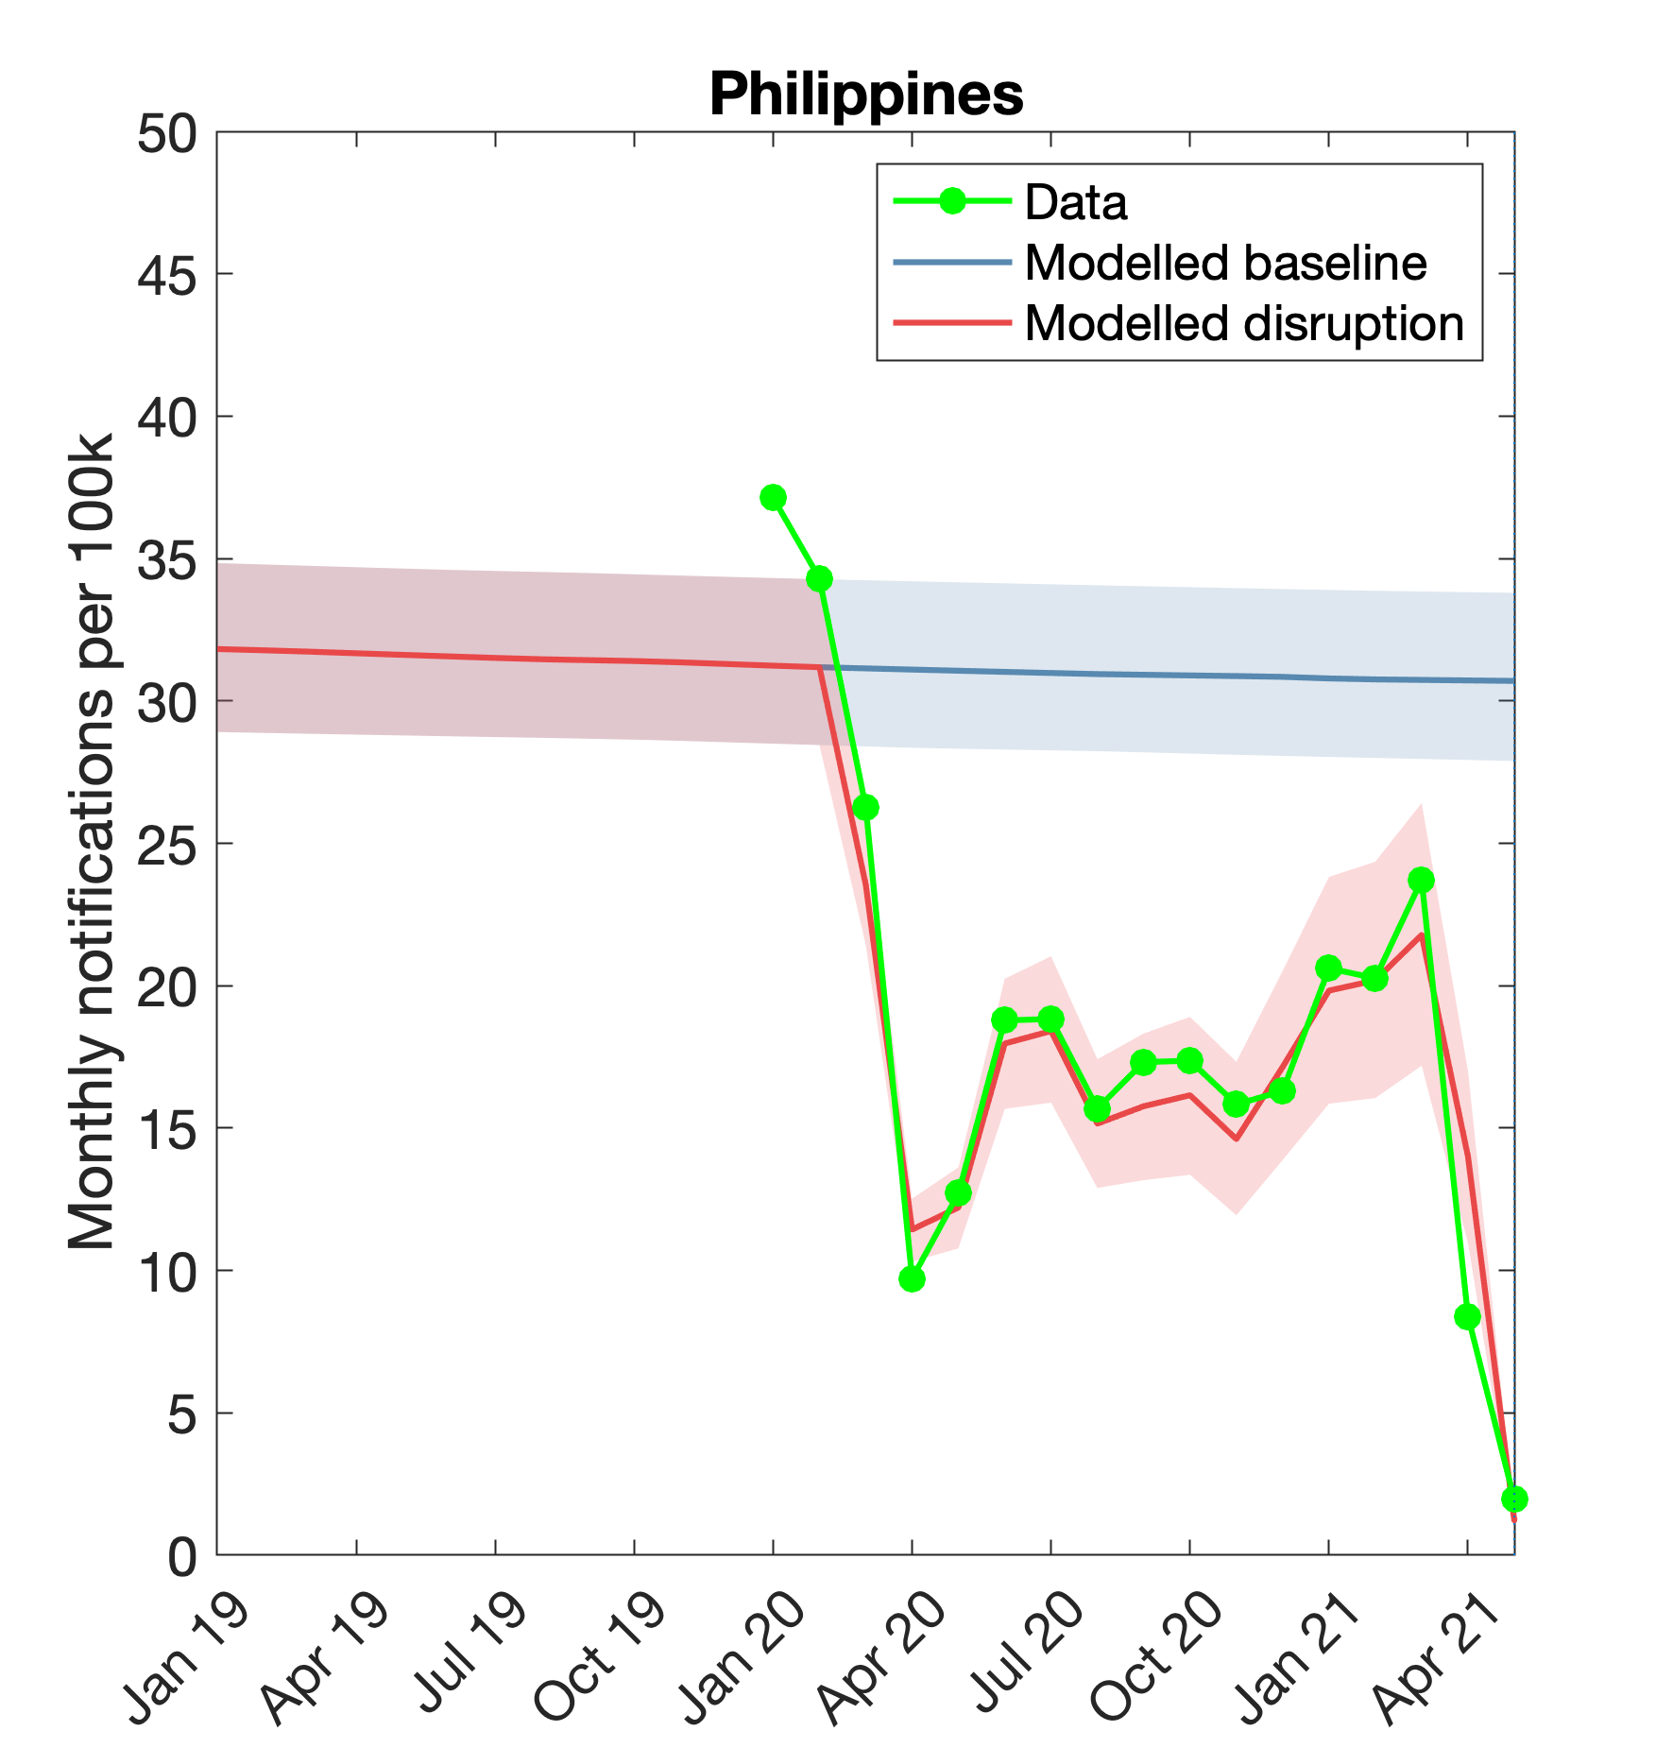
Modelling disruptions
All model structures have a parameter $k(t)$, denoting COVID-induced effects on TB careseeking and diagnosis
For each country, take monthly (or quarterly) data from Jan 2020 onwards
Modelled notifications in a given month:
$$\int_{t_{0}}^{t_{0}+12}{k\left(t\right)d I(t) dt}$$
Adjust $k(t)$ on a monthly/quarterly basis so that the timeseries for modelled notifications matches the data

Slide 26
TB transmission reductions
Much as restrictions have affected SARS-CoV-2 transmission, they are likely to have done the same to TB
We don’t yet have direct evidence for effects on TB transmission during lockdowns
For purpose of modelling: assume that TB transmission was reduced by a constant factor c during periods of restrictions
  Draw c from a uniform distribution from 25% - 75%
  Where restrictions acted only at the subnational level, scale c by the size of the population affected
Assume that TB transmission returned to pre-pandemic levels after restrictions were lifted

Slide 27
Putting it all together: results for global TB estimates

Slide 28
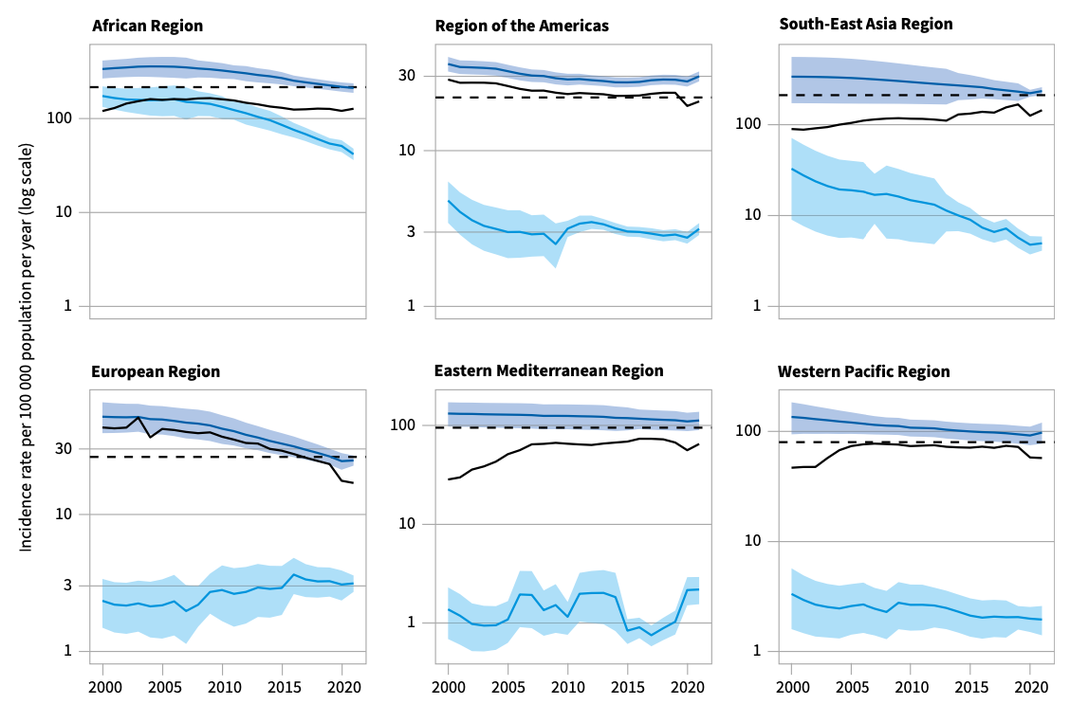
Regional incidence projections
WHO Global TB report, 2022

Slide 29
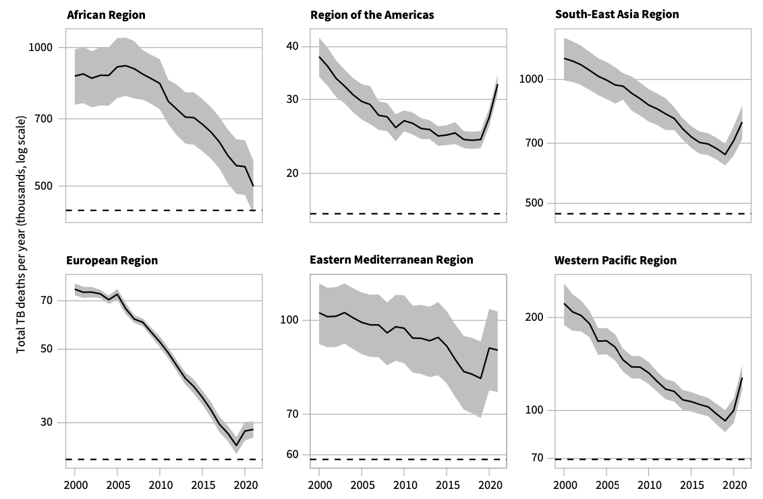
Regional mortality projections
WHO Global TB report, 2022

Slide 30
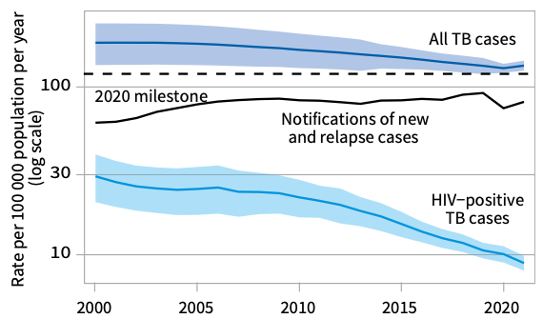
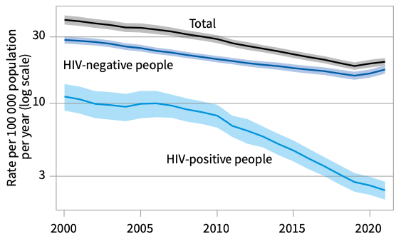
Estimates for global burden
Global mortality
Global incidence
WHO Global TB report, 2022

Slide 31
Conclusions

Slide 32
Summary
Founding hypothesis: during COVID disruptions, reduced notifications were associated with reduced case-finding, and thus increased opportunities for transmission
Mathematical modelling suggests that TB incidence and mortality have increased for the first time in decades, in the wake of COVID-19

Slide 33
Next steps/open questions
Where possible, incorporating additional country-specific data
  E.g. private notifications, other available data from Philippines etc
  Also ongoing India work: drawing from rich sources of in-country data
Longer term: ways of moving back towards data-based, rather than model-based, estimates
  New sources of information e..g upcoming prevalence surveys, inventory studies, etc
  Implications of recent findings on TB natural history? (Richards et al, Lancet global Health 2023; Ryckman et al, PNAS 2022)
Ways of quantifying reductions in TB transmission?

Slide 34
Acknowledgements
WHO Global TB Programme
WHO Global Task Force on Impact Measurement
Several National TB Programmes that have closely engaged

Slide 35
Thank you
…Questions?

Slide 36
Appendix slides

