Slide 1

Quantifying progression and regression across the spectrum of pulmonary tuberculosis: a data synthesis study
Alexandra Richards

Slide 2
Introduction
Background on TB modelling
Systematic Review
Model fitting
Implications

Slide 3
Background on TB modelling
Systematic Review
Model fitting
Implications

Slide 4
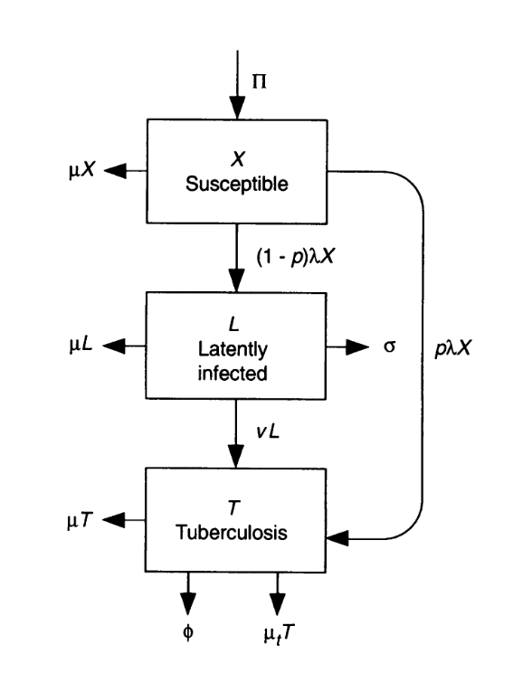
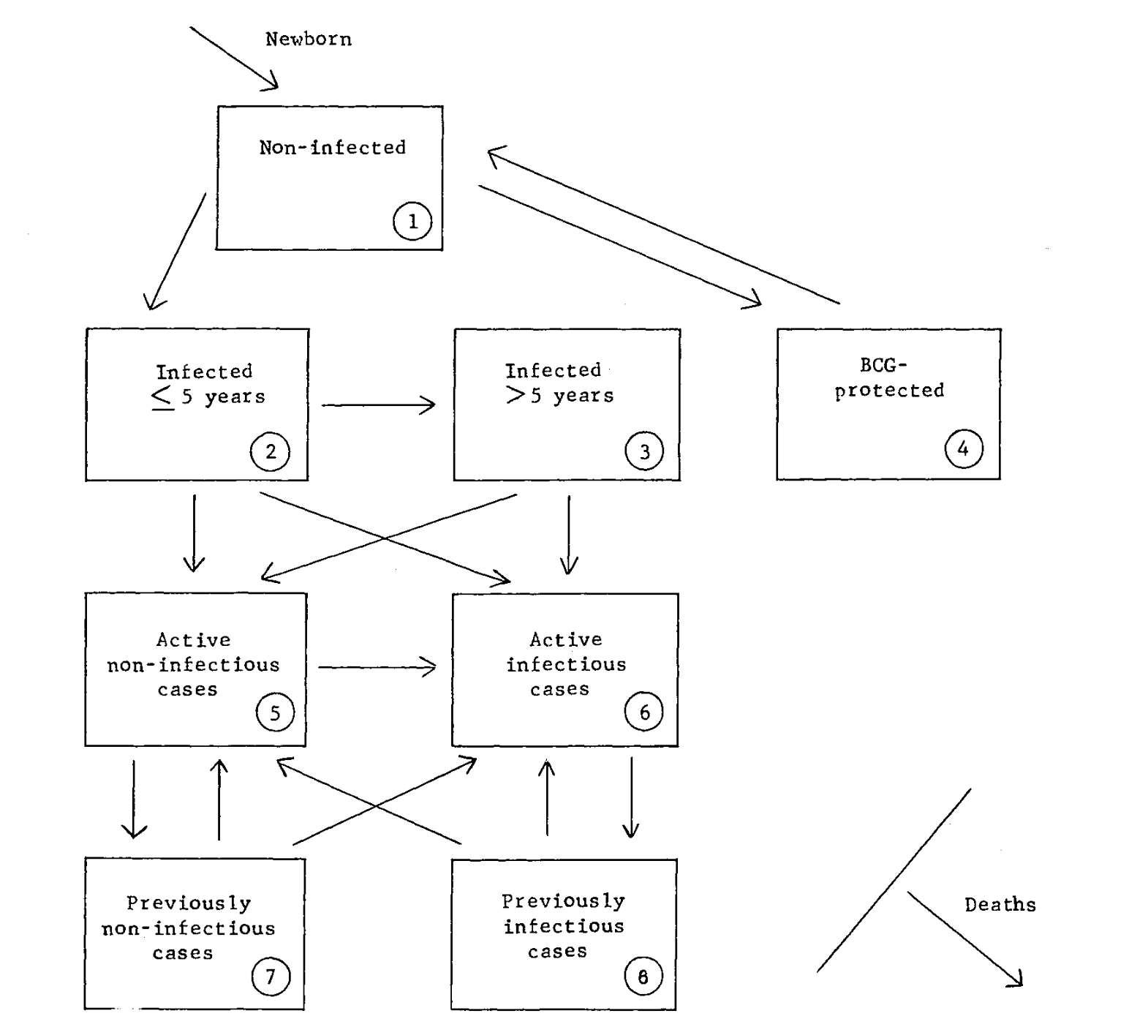
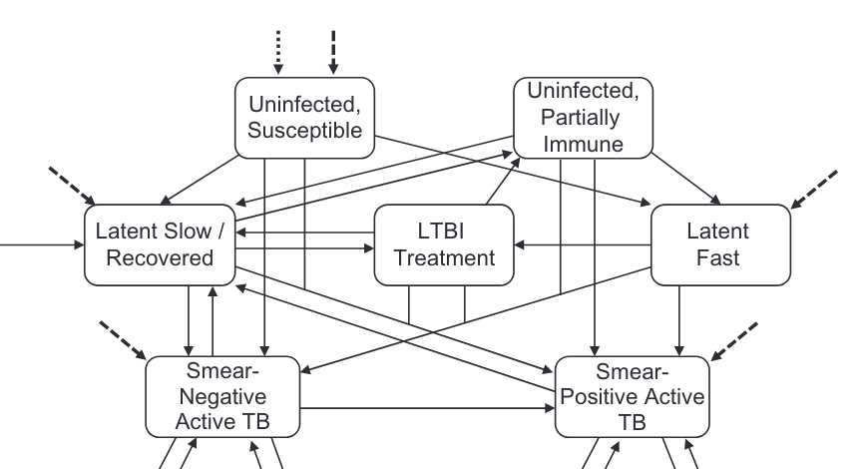
Background
TB models
1968
1995
2018
Waaler HT. A Dynamic Model for the Epidemiology of Tuberculosis. Am Rev Respir Dis. 1968 Oct;98(4):591–600.
Blower SM, Small PM, Hopewell PC. Control Strategies for Tuberculosis Epidemics: New Models for Old Problems. Science. 1996 Jul 26;273(5274):497–500.
Menzies NA, et al. Prospects for Tuberculosis Elimination in the United States: Results of a Transmission Dynamic Model. Am J Epidemiol. 2018 Sep;187(9):2011–20.

Slide 5
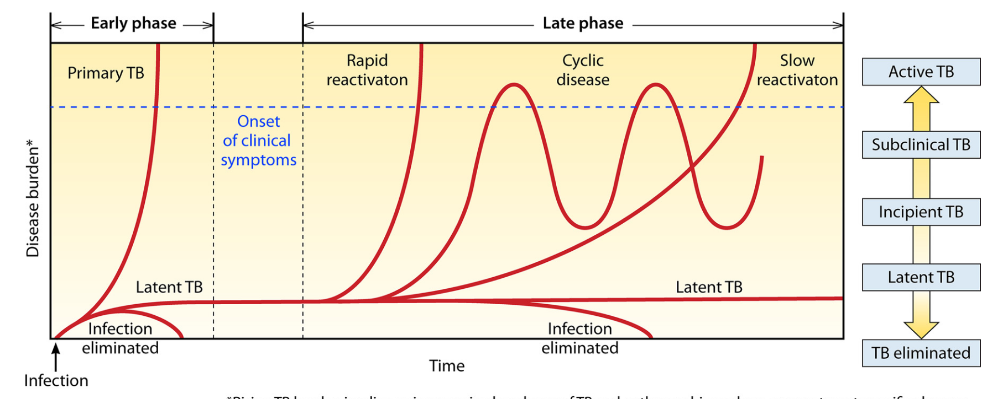
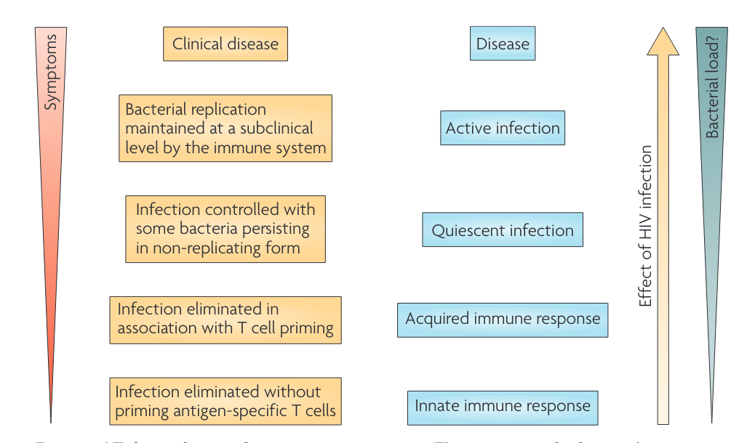
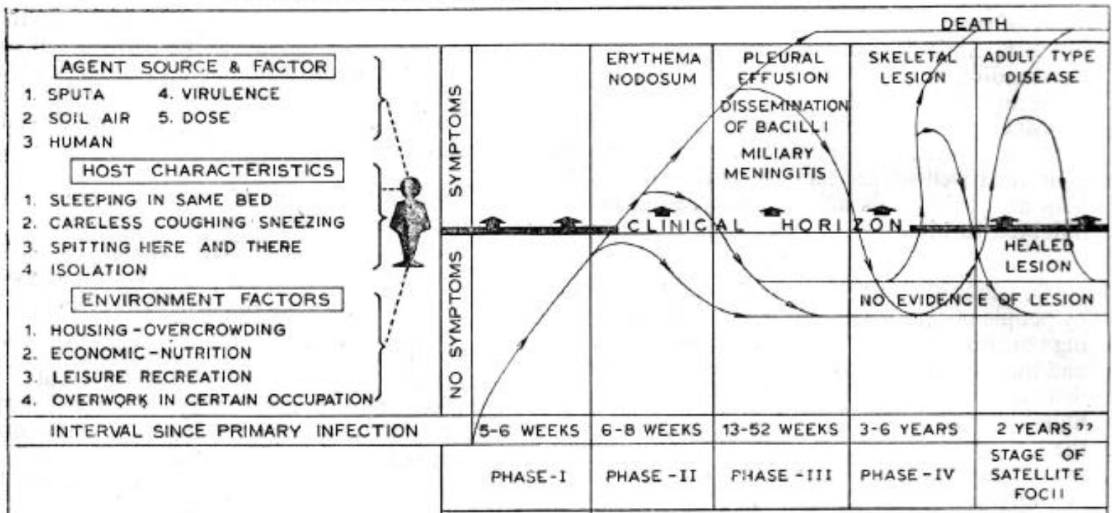
Background
2018
TB natural history
2009
1977
Drain PK, et al. Incipient and Subclinical Tuberculosis: a Clinical Review of Early Stages and Progression of Infection. Clinical Microbiology Reviews. 2018;31(4):24.
Barry CE, et al. The spectrum of latent tuberculosis: rethinking the biology and intervention strategies. Nat Rev Microbiol. 2009 Dec;7(12):845–55.
Gothi GD. Natural History of Tuberculosis. Indian Journal of Tuberculosis. 1977;25(2).

Slide 6
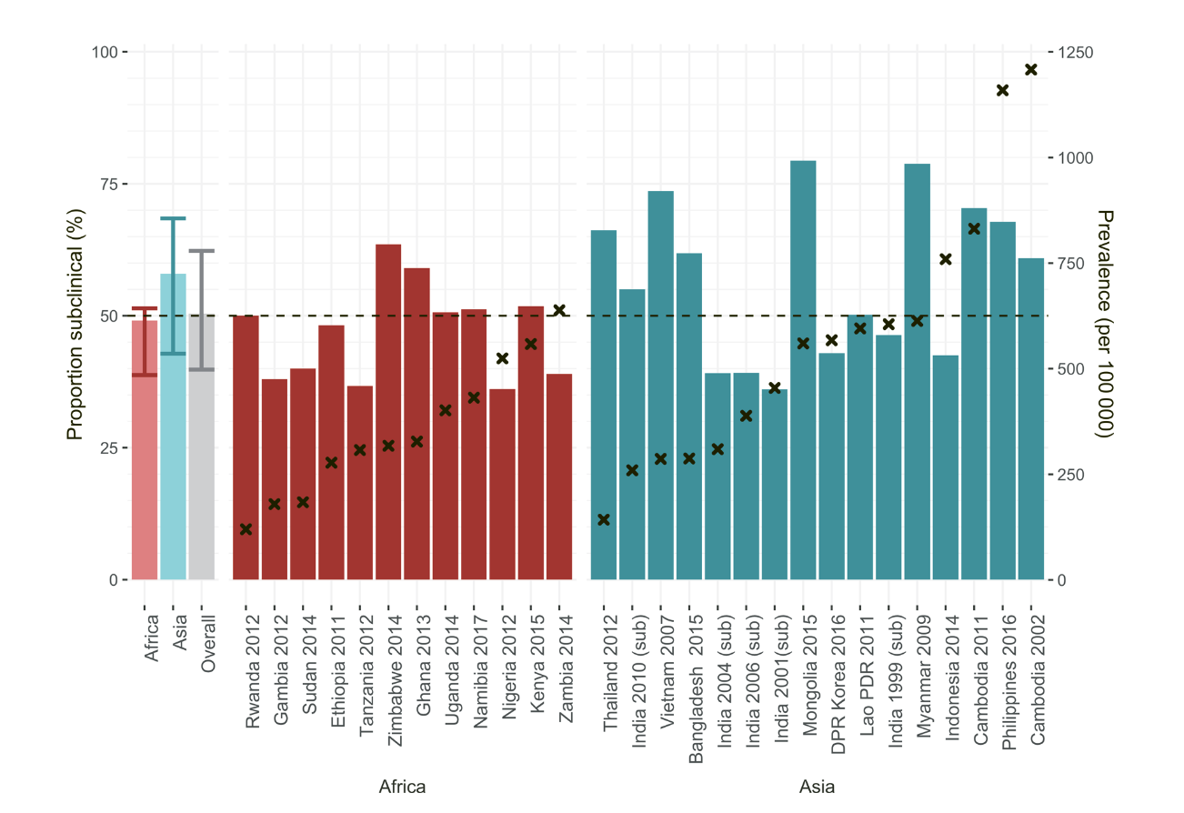
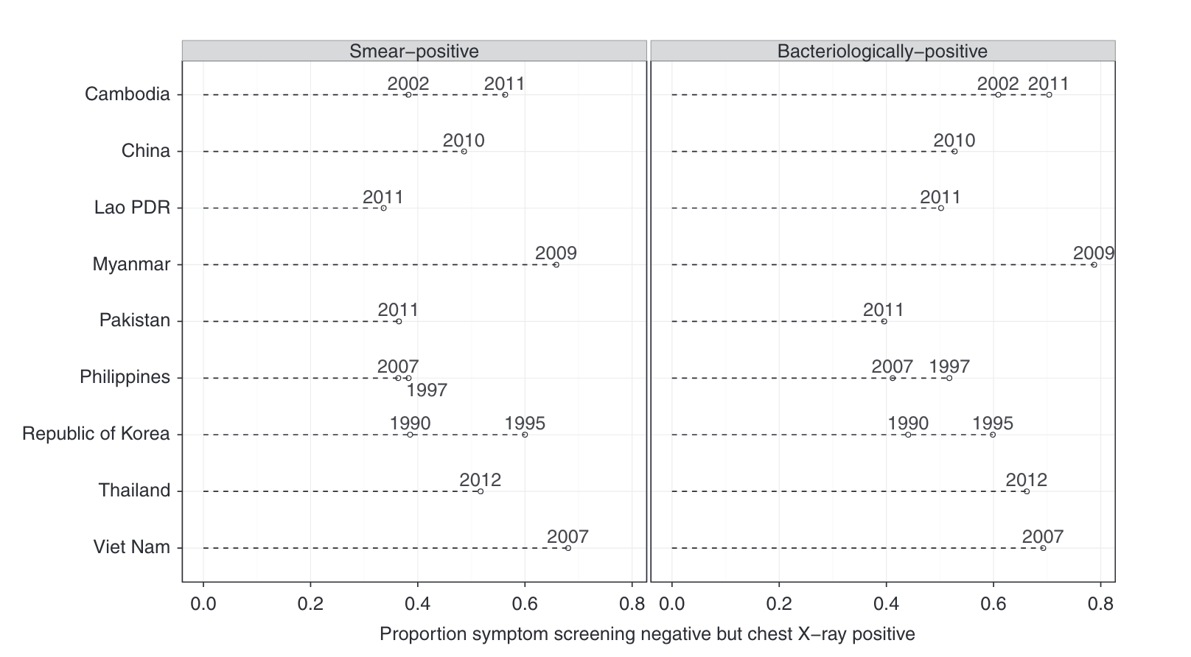
Background
Prevalence surveys
Onozaki I, et al. National tuberculosis prevalence surveys in Asia, 1990-2012: an overview of results and lessons learned. Trop Med Int Health. 2015 Sep;20(9):1128–45.
Frascella B, et al. Subclinical Tuberculosis Disease—A Review and Analysis of Prevalence Surveys to Inform Definitions, Burden, Associations, and Screening Methodology. Clinical Infectious Diseases. 2021 Aug 1;73(3):e830–41.

Slide 7
Definitions
Clinical disease – infectious disease (bacteriologically positive), reports symptoms
Subclinical disease – infectious disease, does not report symptoms
Prevalence – proportion of infectious disease in the population (subclinical + clinical)
TB disease – any progression beyond infection that can be detected through testing (e.g. x-rays), not necessarily infectious

Slide 8


The problem
Where can we find data on symptoms and understand how disease develops?

Slide 9
Background on TB modelling
Systematic Review
Model fitting
Implications

Slide 10
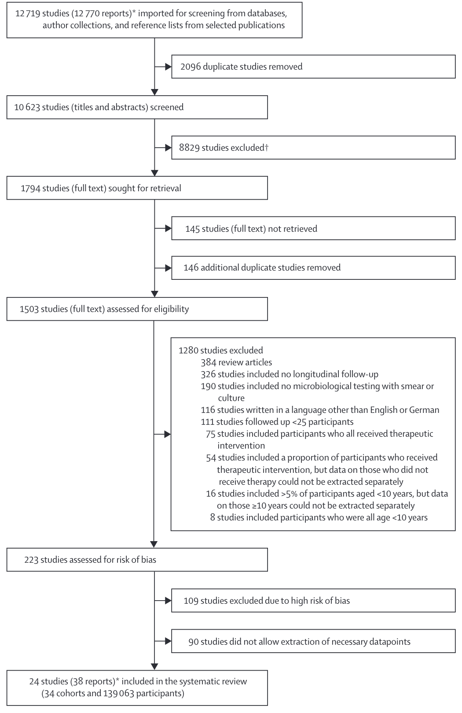
Systematic Review
Dates: 1895-1960
Databases: PubMed, EMBASE, Web of Science, Index Medicus, Personal libraries
Requirements: pulmonary TB in adults (> 10 years old), with bacteriological testing and no medical or surgical interventions
Sossen B, et al. The natural history of untreated pulmonary tuberculosis in adults: a systematic review and meta-analysis. The Lancet Respiratory Medicine. 2023 Mar 23 0(0).

Slide 11
Data
Systematic review
22 studies for disease progression, 2 for infection progression (not used further here)
1935 – 2004
13 observational studies, 11 controlled trials
11,894 individuals with 1,527 events recorded
  In disease progression studies: 5,942 individuals and 1034 events
Other sources
- Mortality rate from clinical disease (0.39)
- Ratio of subclinical to clinical disease (1:1)
- Ratio of minimal to infectious disease (2.5:1)
Sossen B, et al. The natural history of untreated pulmonary tuberculosis in adults: a systematic review and meta-analysis. The Lancet Respiratory Medicine. 2023 Mar 23 0(0).
Tiemersma EW, et al.. Natural history of tuberculosis: duration and fatality of untreated pulmonary tuberculosis in HIV negative patients: a systematic review. PLoS ONE. 2011 Apr 4;6(4):e17601.
Ragonnet R, et al. Revisiting the Natural History of Pulmonary Tuberculosis: A Bayesian Estimation of Natural Recovery and Mortality Rates. Clinical Infectious Diseases. 2021 Jul 1;73(1):e88–96.
Frascella B, et al. Subclinical Tuberculosis Disease—A Review and Analysis of Prevalence Surveys to Inform Definitions, Burden, Associations, and Screening Methodology. Clinical Infectious Diseases. 2021 Aug 1;73(3):e830–41.
Onozaki I, et al. National tuberculosis prevalence surveys in Asia, 1990-2012: an overview of results and lessons learned. Trop Med Int Health. 2015 Sep;20(9):1128–45.
Mungai BN, et al. ‘If not TB, what could it be?’ Chest X-ray findings from the 2016 Kenya Tuberculosis Prevalence Survey. Thorax. 2021 Jun 1;76(6):607–14.

Slide 12
Background on TB modelling
Systematic Review
Model fitting
Implications

Slide 13
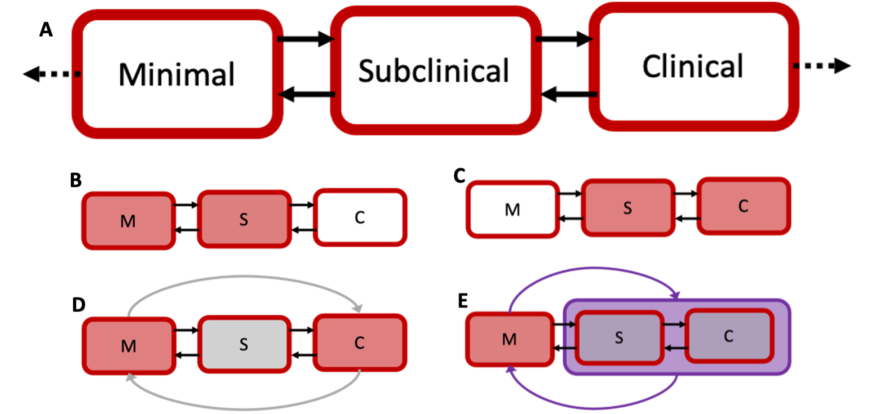
Model structure
Minimal:
individuals with pathological changes in their lungs, due to M.tb with all bacteriologic tests negative (likely not infectious)
Subclinical:
individuals with positive bacteriologic tests (likely infectious) but nt reporting symptoms, also likely to have pathological changes in their lungs
Clinical:
individuals with with positive bacteriologic tests (likely infectious) and exhibiting symptoms of TB, also likely to have pathological changes in their lungs

Slide 14
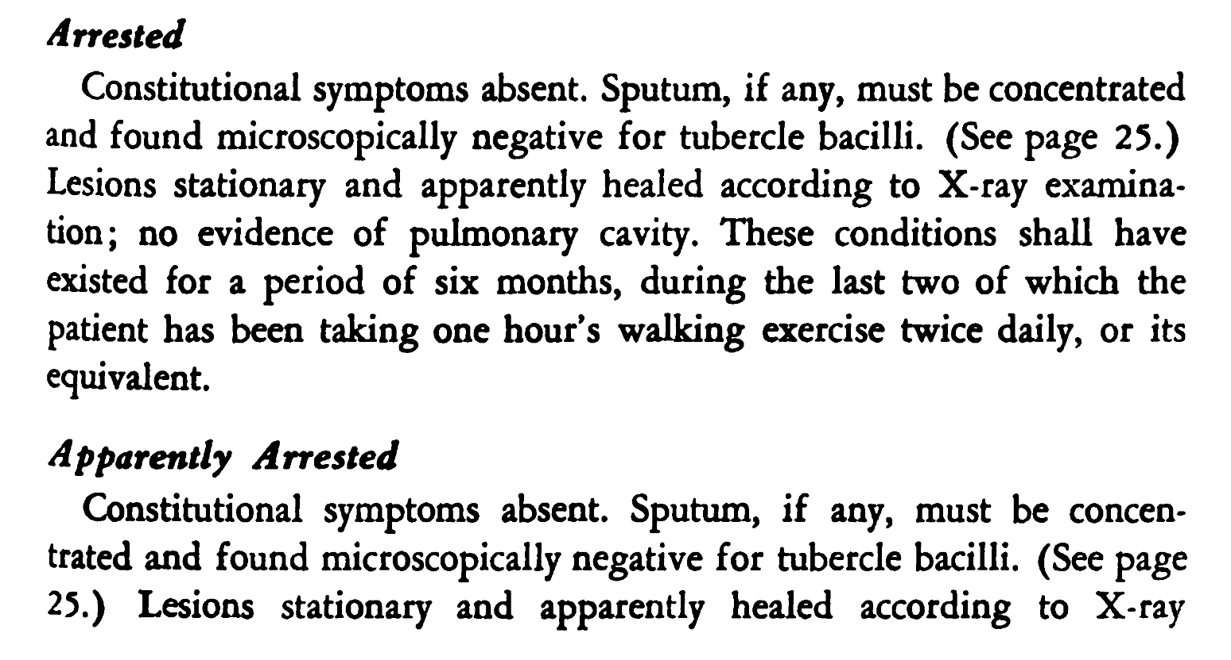
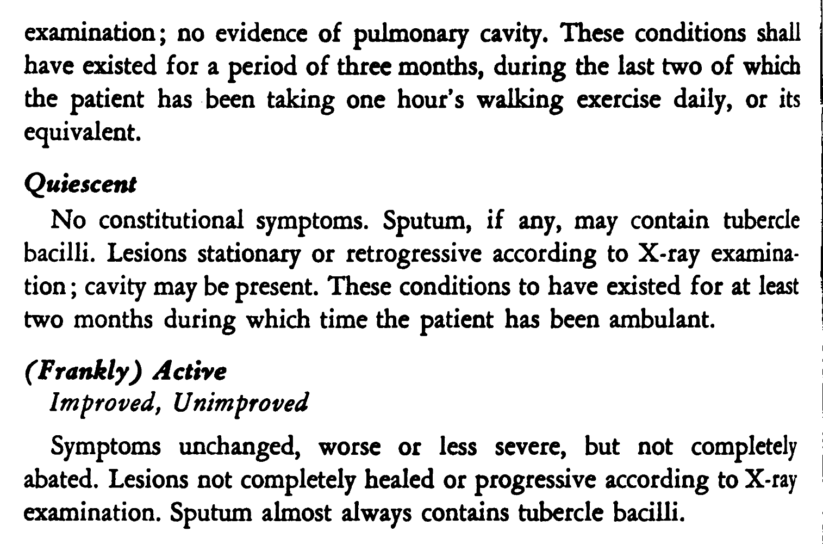
Data assumptions
Minimal disease
Subclinical disease
Clinical disease
National Tuberculosis Association. Diagnostic standards and classification of tuberculosis. [Internet]. 1940 ed. New York, N.Y.,; 1940.

Slide 15
TB Disease Model - Fitting Process
Cumulative – count everyone who has ever reached the state of interest
Single – count everyone in the state of interest at a particular time

Slide 16
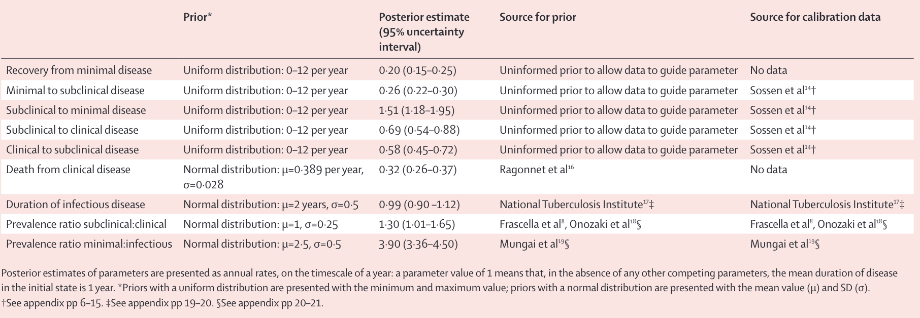
Model Priors

Slide 17
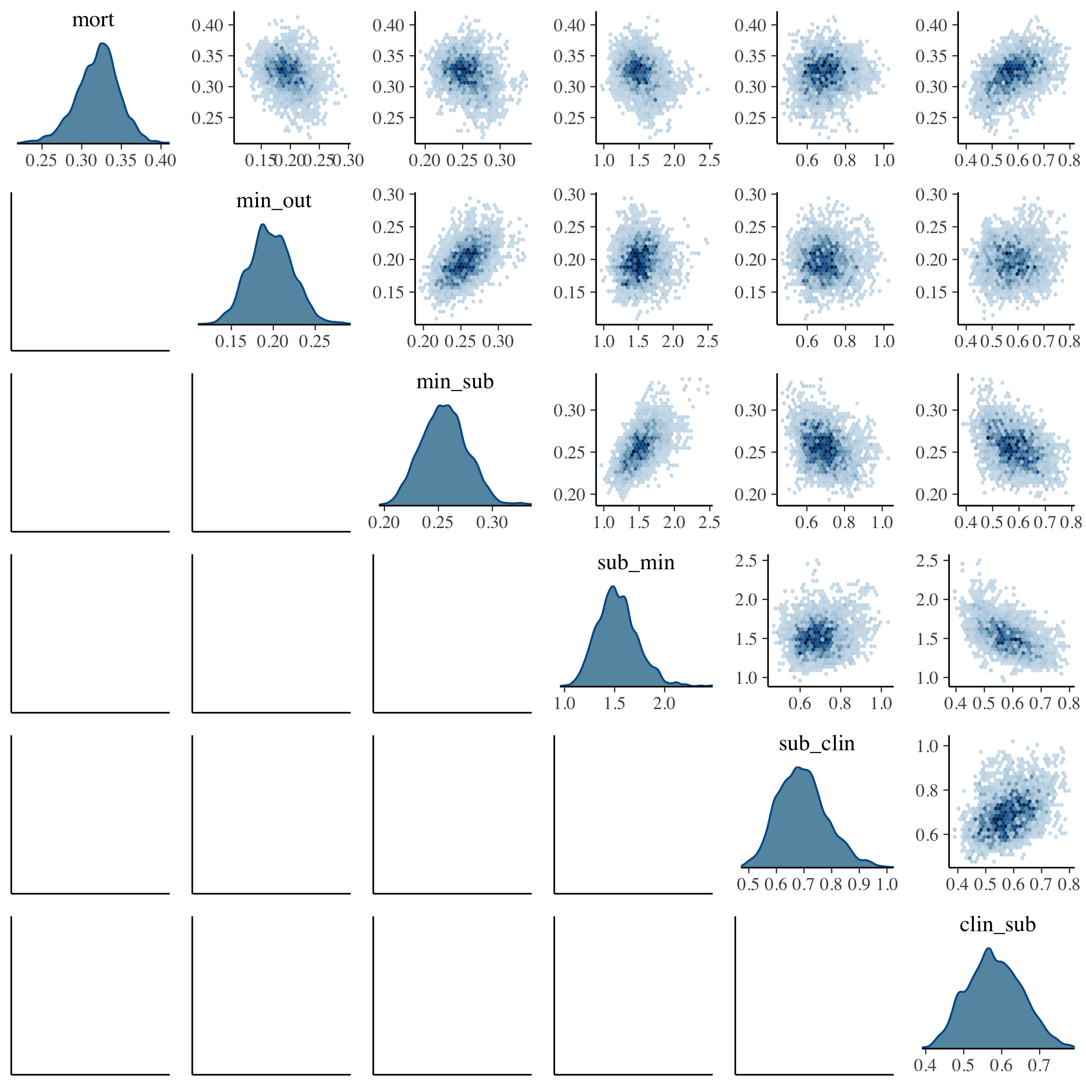
Parameter fitting

Slide 18
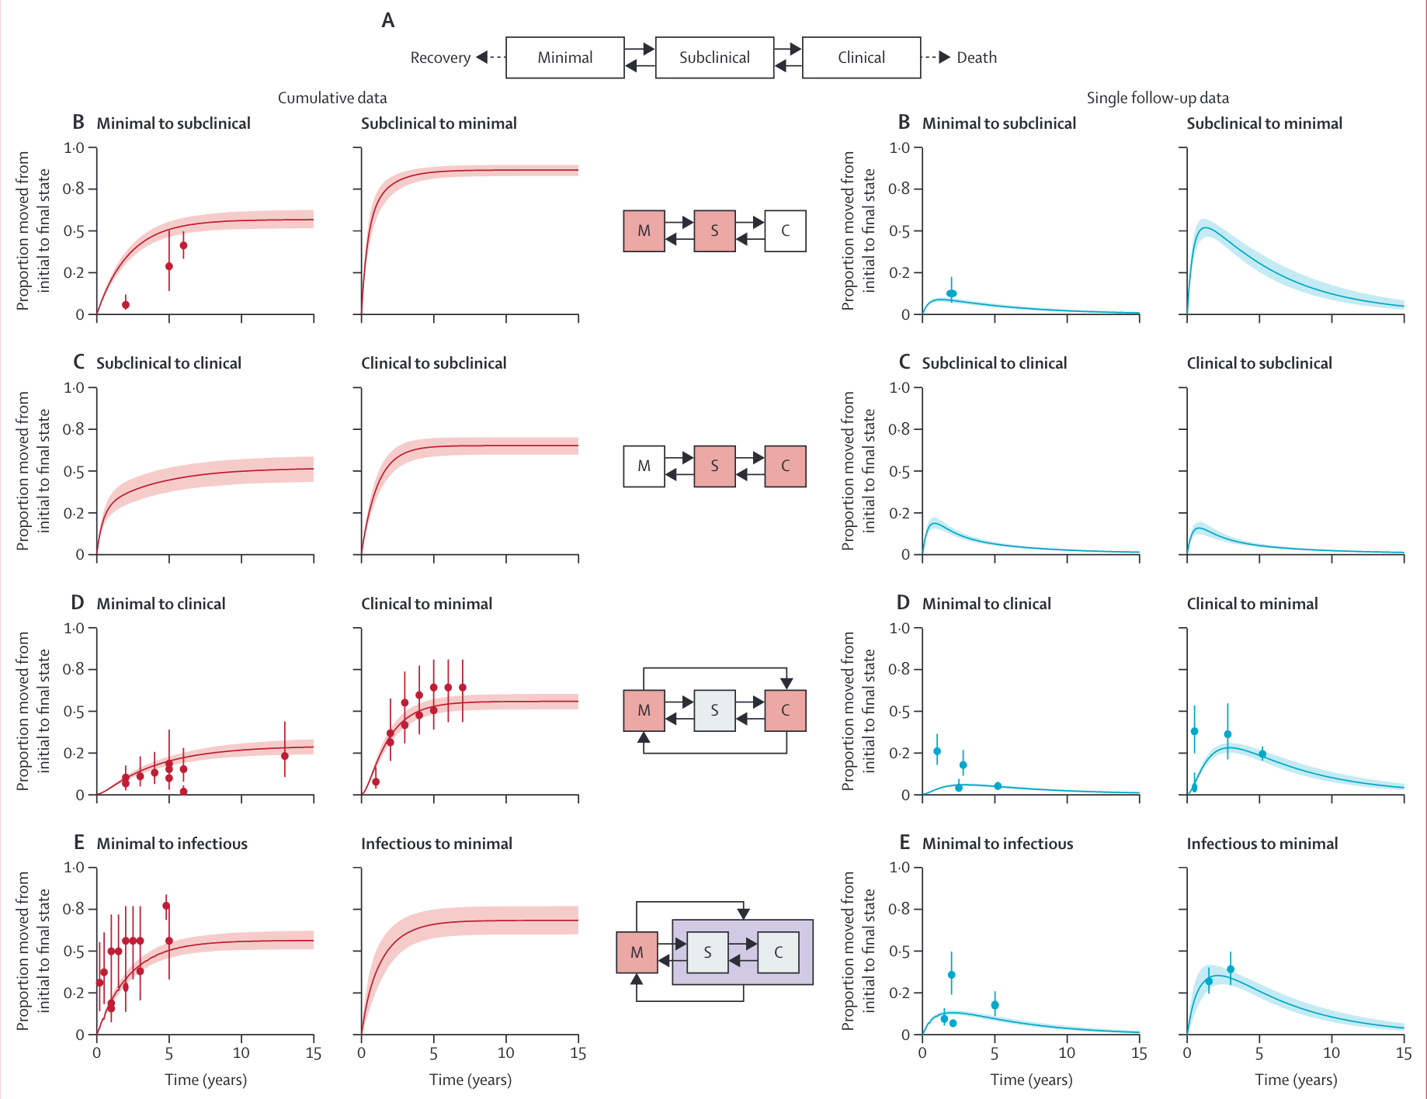
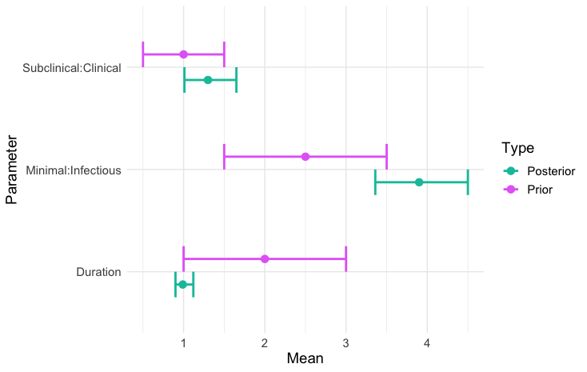
Results

Slide 19
Background on TB modelling
Systematic Review
Model fitting
Implications

Slide 20
What does this mean?
We have data-based parameters to inform a natural history model
Created a model to follow individuals through disease
Three cohorts:
  All subclinical disease at start
  All clinical disease at start
  Shared distribution of minimal/subclinical/clinical
Followed for 5 years to see changes in trajectory and ultimate outcomes

Slide 21
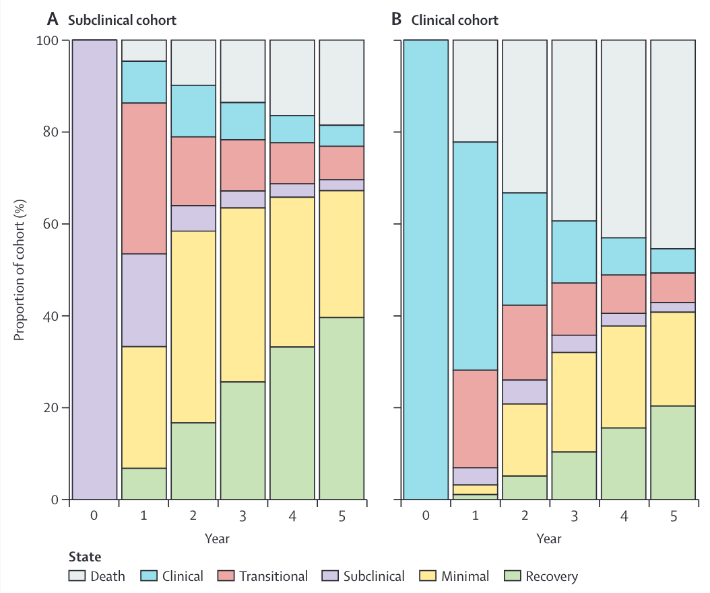
What does this mean?
Median duration ~12 months
~14% with infectious disease by 5 years
50% with subclinical never developed symptoms

Slide 22
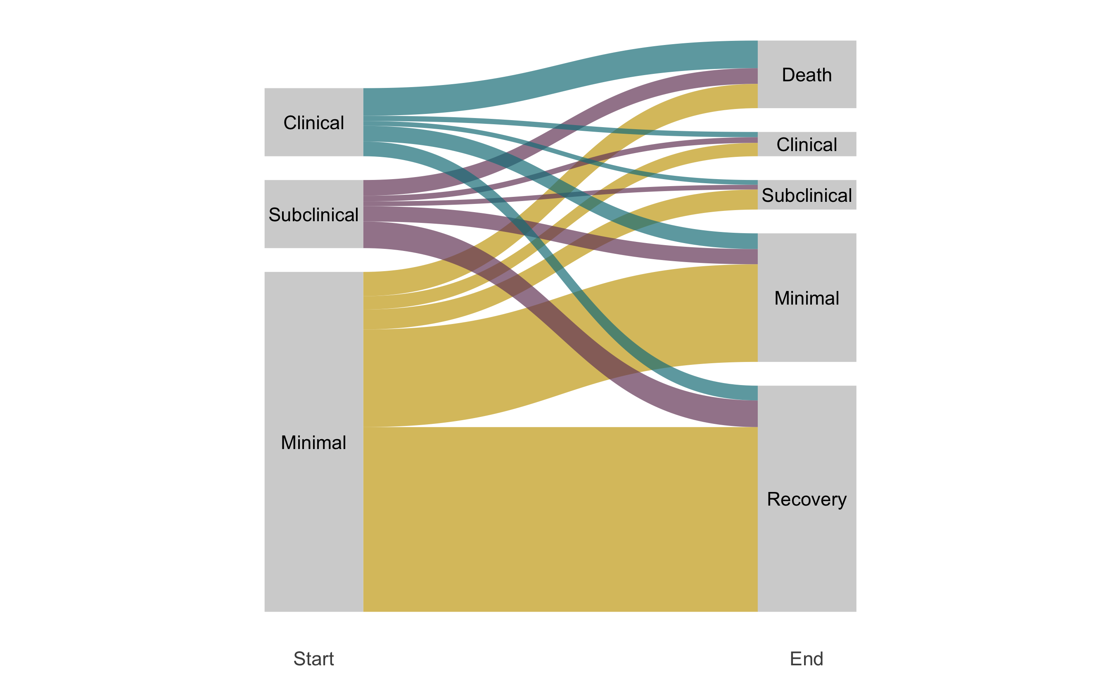
What does this mean?

Slide 23
What does this mean? Where next?
It is unlikely that everyone with TB will develop symptoms
Minimal disease may hold a reservoir for future progression
Need to think about appropriate treatments at different stages of disease
Need to find easy detection methods for non-clinical disease
A paper extending this work to include progression from infection accepted at PNAS (available on medRxiv)
Horton KC, et al. Re-evaluating progression and pathways following Mycobacteria tuberculosis infection within the spectrum of tuberculosis disease. medRxiv; 2022

Slide 24


Acknowledgements
LSHTM
Rein Houben
Jon Emery
Katherine Horton
Nicky McCreesh
Alison Grant
Systematic Review
Hanif Esmail
Bianca Sossen
Torben Heinsohn
Beatrice Frascella
Federica Balzarini
Aurea Orandi-Alacreu
Brit Häcker
Ewelina Rogozinska
Frank Cobelens
Katharina Kranzer

